Slide 1

Mountain House Community Services District
6.A. Discuss and Review the Contractor Instructor Handbook and Provide Staff with Recommendations
April 17, 2024

Slide 2
Recommendation
Staff recommends that the Commission discuss and review the draft version of the Independent Contract Instructor Handbook and provide staff with recommendations.

Slide 3

Background
Parks and recreation departments offer several services to the community including life-long learning and discovery.
Recreation programs are a pillar in recreation as they offer opportunities for its citizens to learn new skills and enrich one’s life, and they are one of the 4 pillars of the Mountain House Parks and Recreation Department.

Slide 4
Background
Recreation classes are typically in the arts (dance, fine art, music), sports (lessons), health and fitness (nutrition, physical fitness) or enrichment (personal growth, STEM) categories.
Recreation programs also often divided into age and ability classifications; youth, teen, adult, senior, adaptive “Recreation Programs” are also one of the four pillars as adopted by the Mountain House Parks and Recreation Department.
Typically, these recreation classes are single-subject, and are taught by professionals who are skilled on the subject area. They typically have extensive experience and certifications in their field.

Slide 5
Discussion
The draft contains the instructor’s rights and responsibilities, business requirements, insurance requirements, policies and procedures, professional conduct, pricing, registration procedures, safety procedures, marketing and spaces for class use.
This Independent Contract Instructor Handbook contains the requirements needed to offer a high-quality program to ensure that the instructor has the required skills and certifications and meets the highest safety requirements needed to teach on behalf of the District.
Many of the requirements will be reviewed with District’s attorney, Risk Manager and Human Resources Department before the handbook is implemented.

Slide 6
Discussion
Independent instructors may be;
    Individuals
    small or home-based businesses
    local brick-n-mortar businesses (i.e. local gym, art studio, learning center)
    Professional businesses that specialize in single-subject youth recreation programs
  Independent instructor create their own curriculum and set their own prices.
  Current CSD facilities include Unity Center, TH-1 room in Town Hall in library wing, and Firehouse Community Room.
  Many of the requirements will be reviewed by the attorney, Risk Management and Human Resources.
  Once the handbook has been implemented, staff will begin recruiting instructors and programs based on community feedback.

Slide 7
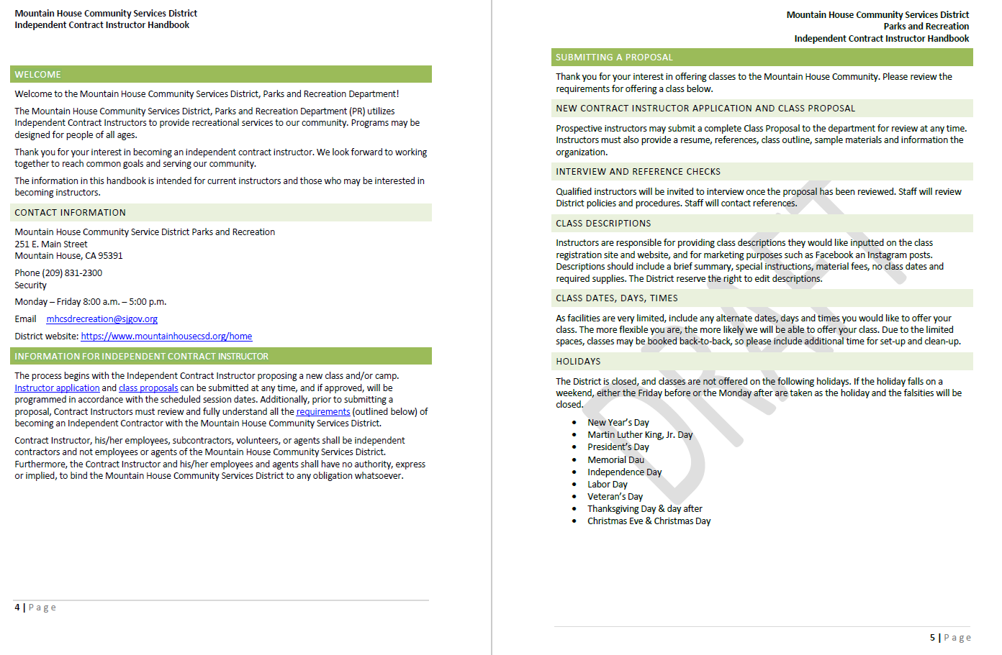

Slide 8
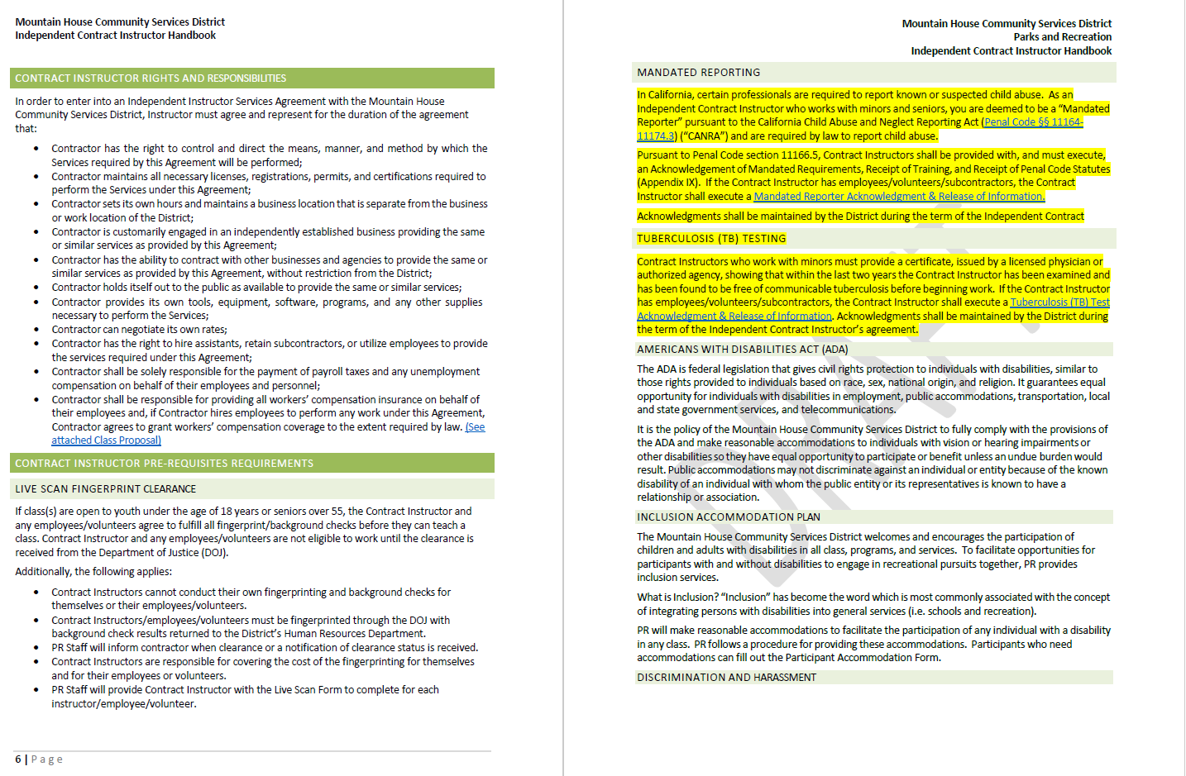

Slide 9
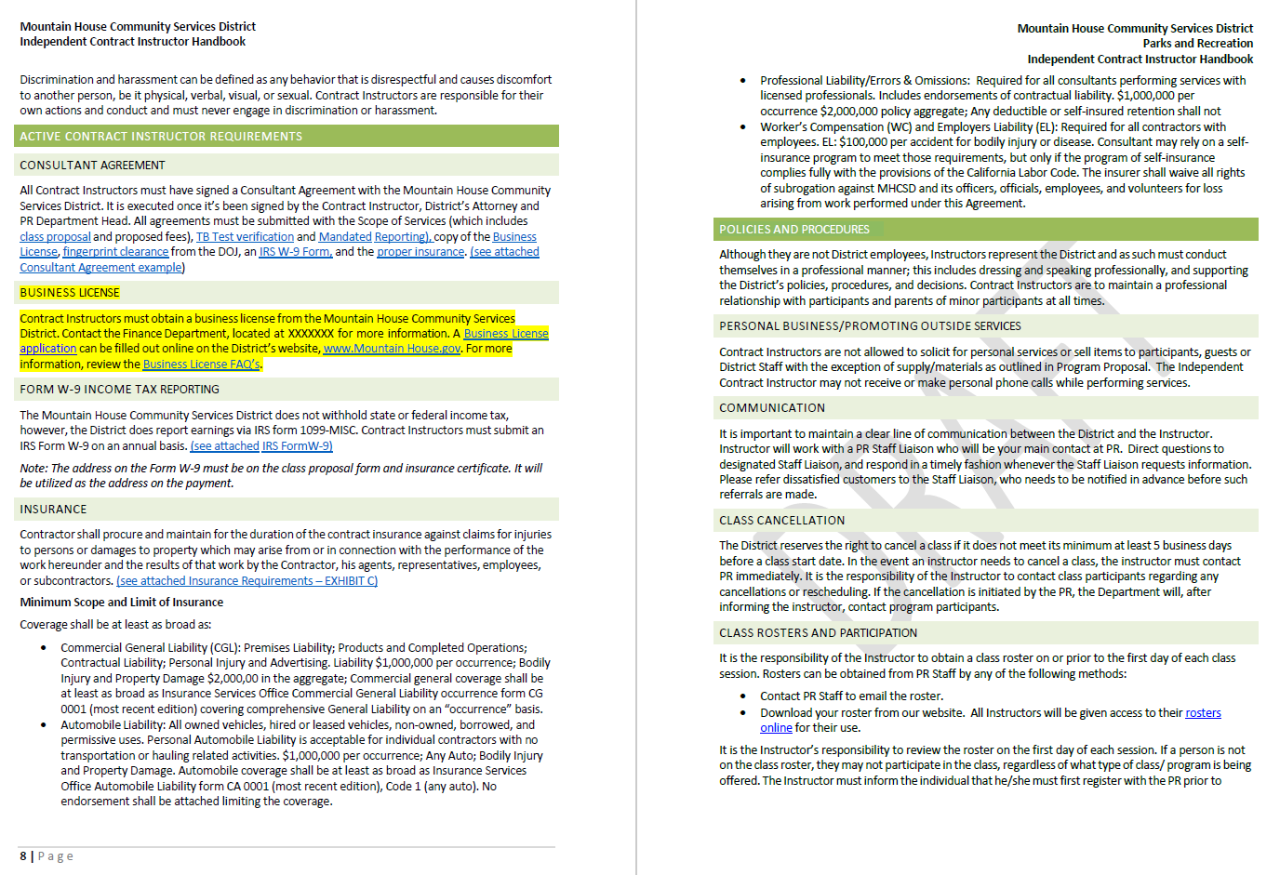

Slide 10
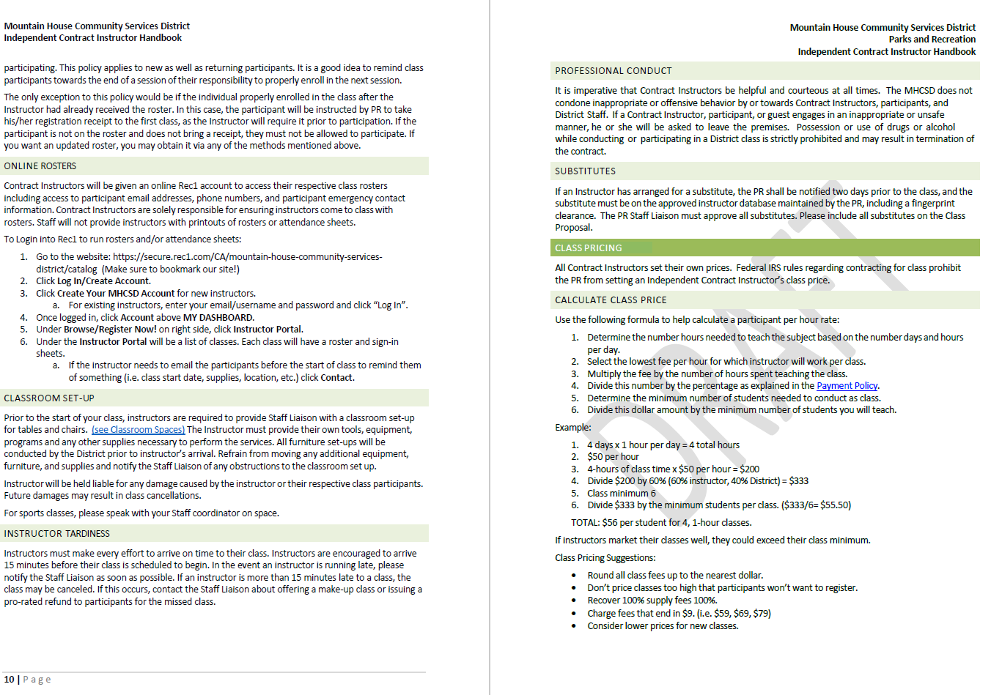

Slide 11
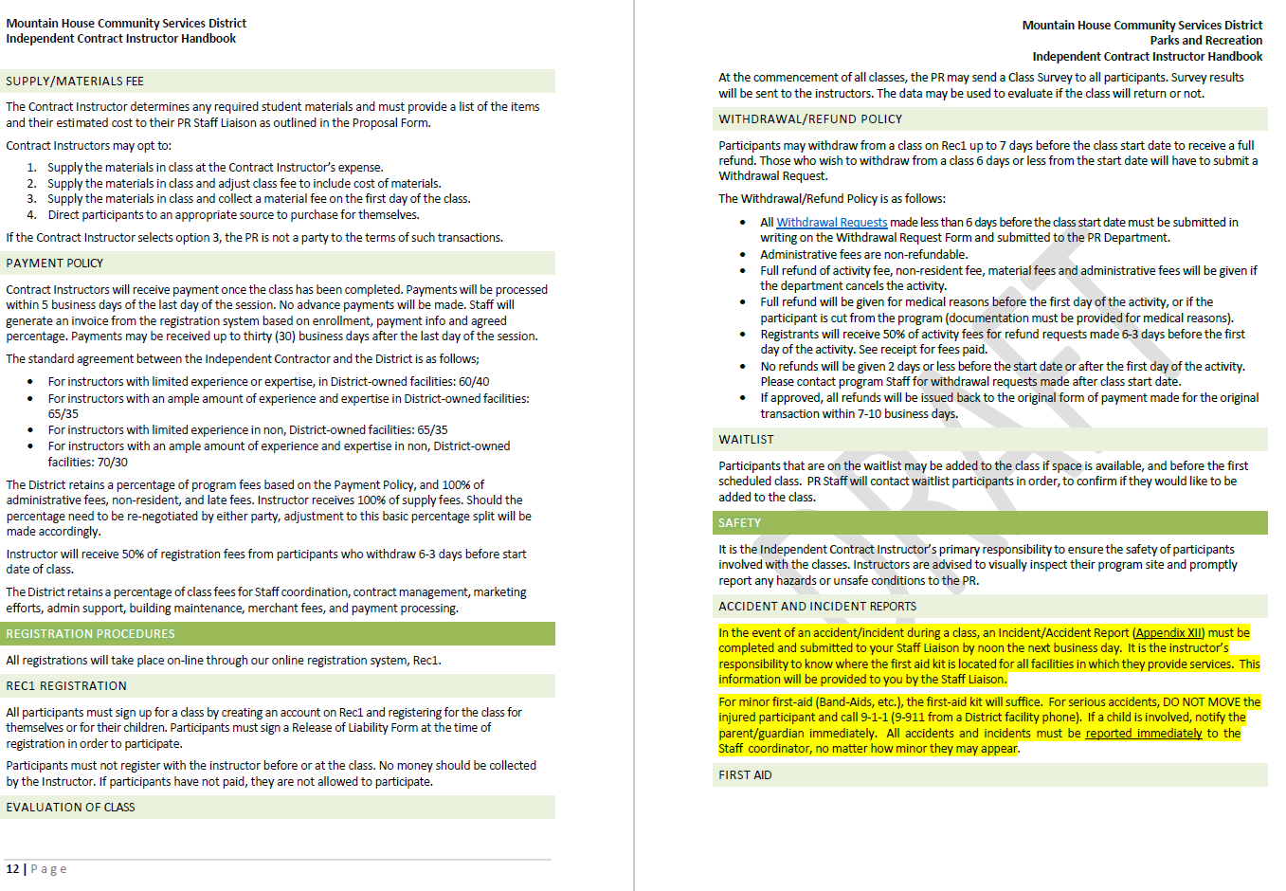

Slide 12
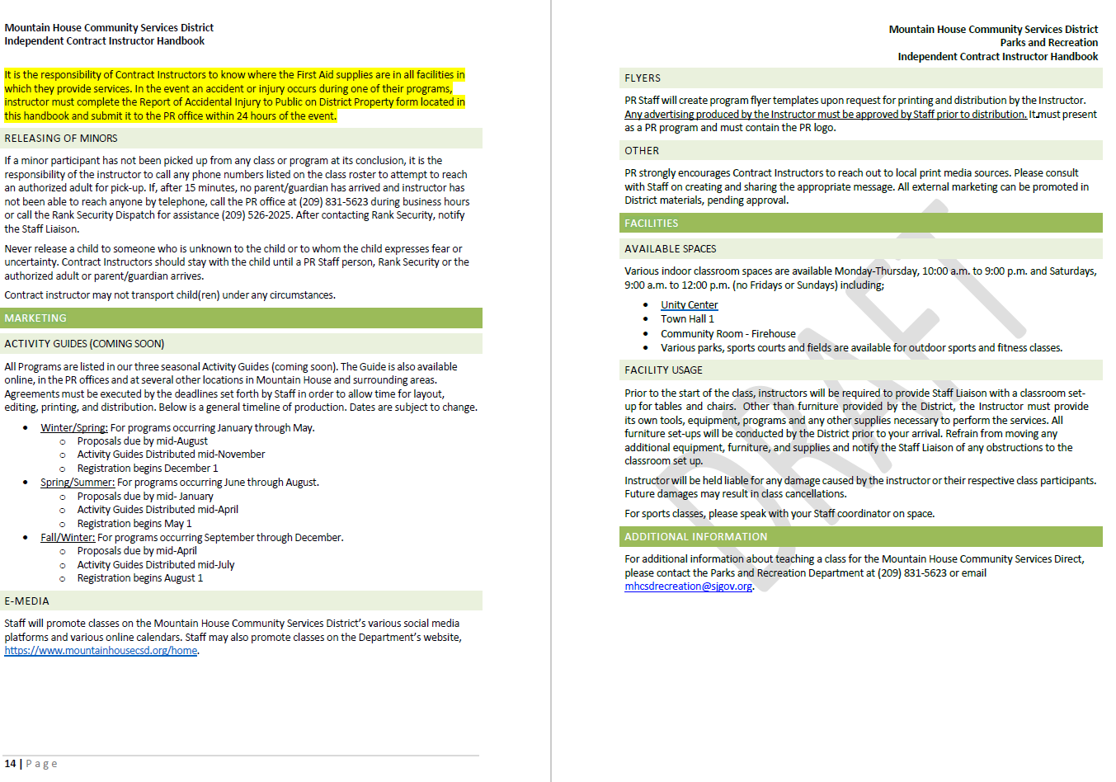

Slide 13
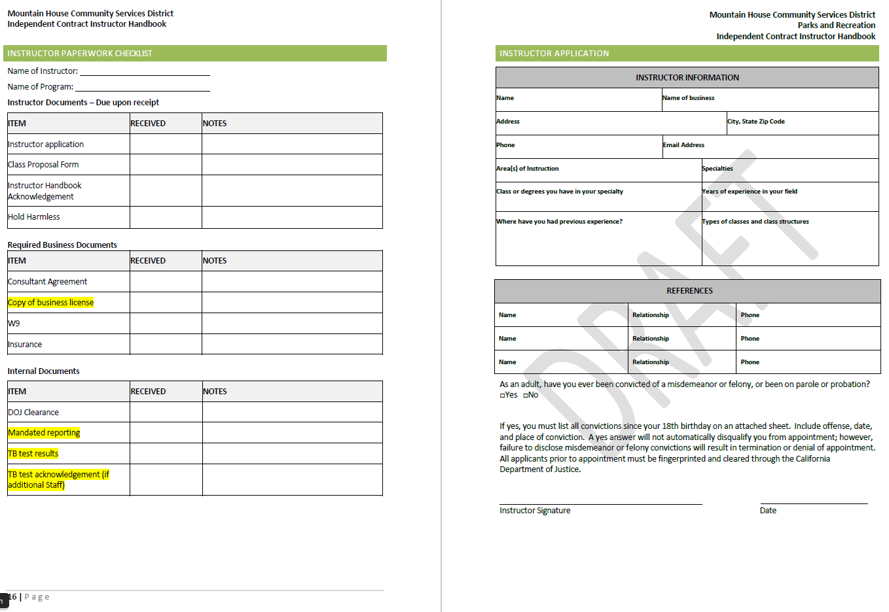

Slide 14
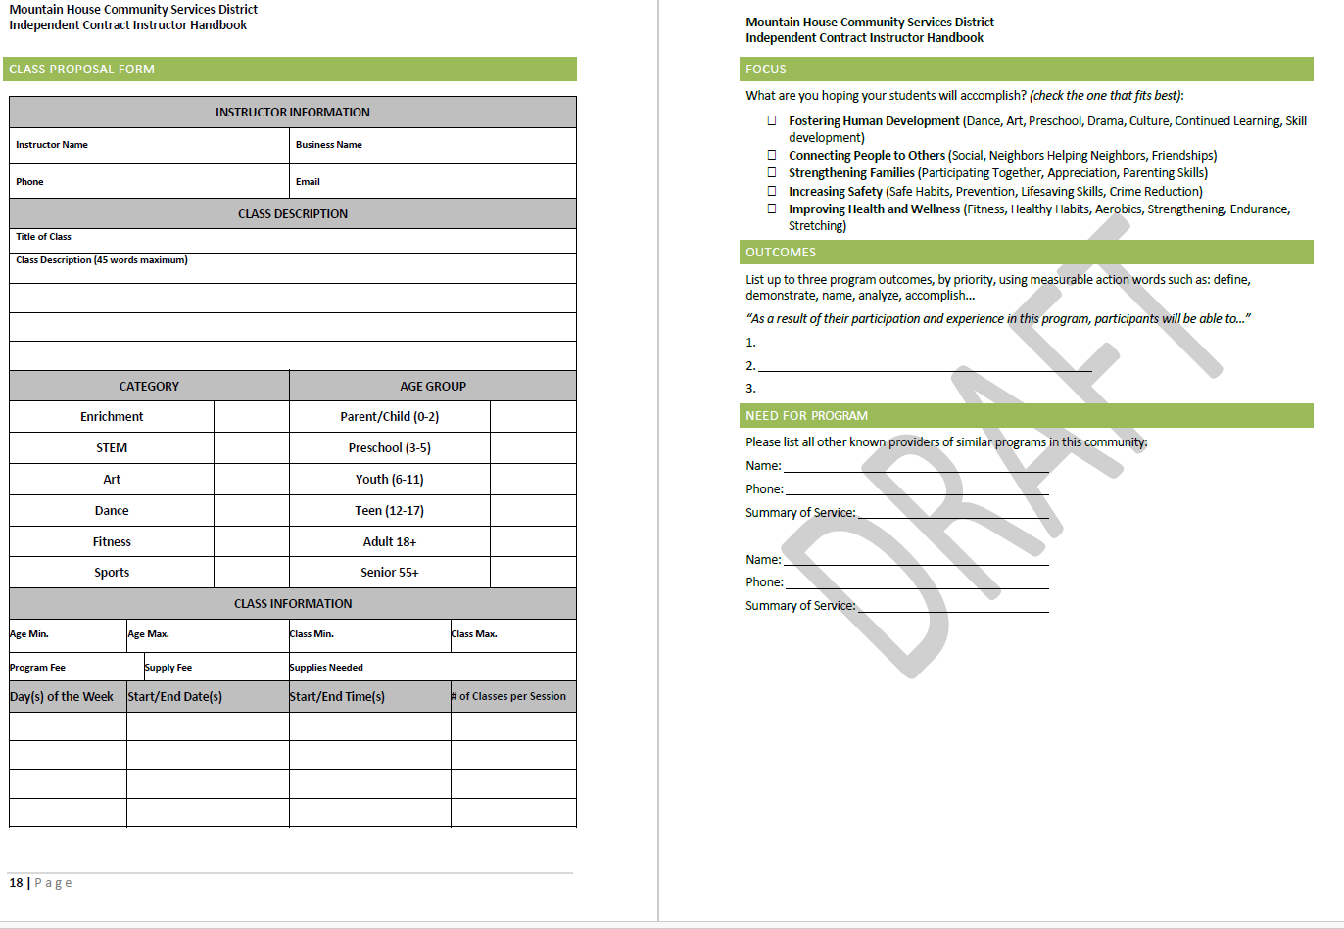

Slide 15
Recommendation
Staff recommends that the Mountain House Parks and Recreation Commission approve the Picnic Rental Policy and recommend to the Board of Directors for adoption.

Slide 16
Questions?

