Slide 1

Mountain House Community Services District
6.A. Senior Activities Survey Results
March 26, 2024

Slide 2
Senior Activities Survey
30 seniors attended the “Coffee Chat” and shared their ideas for senior programming.
26 seniors participated in the online survey.
  16 women; 9 Men; 1 unknown
  42% 50-59 years old; 42% 60-69; 16% 70-79
Participants chose as many activities as they wanted within each category.
  Categories included;
    Exercise Classes
    Social Activities
    Art Activities
    Educational Activities
    Entertainment
    Cultural Activities
    Health Aging Workshops
    Maintaining Independence
    Safety Seminars
    Outings

Slide 3
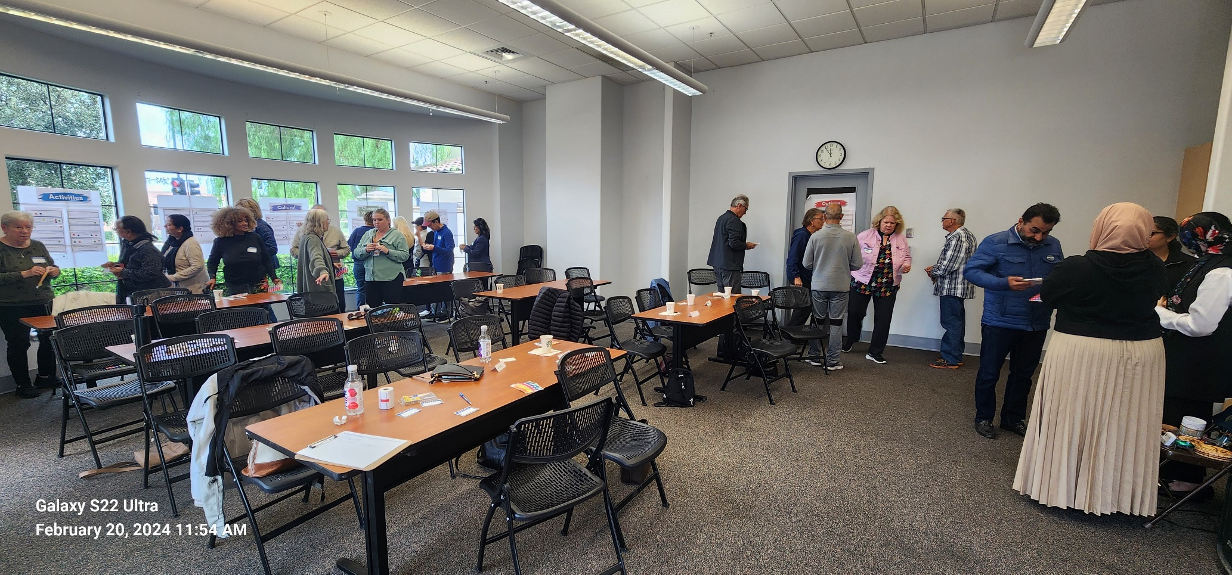
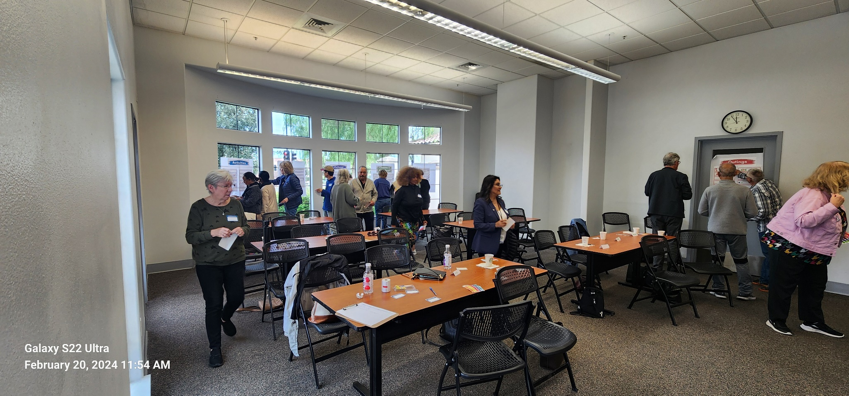
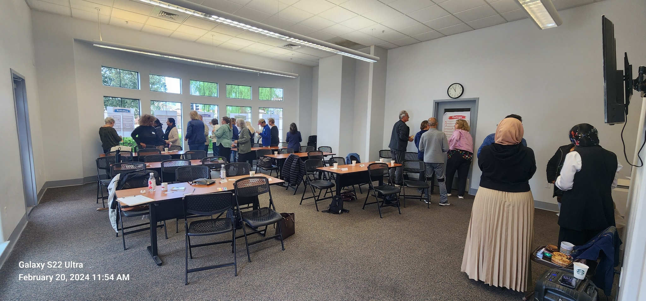
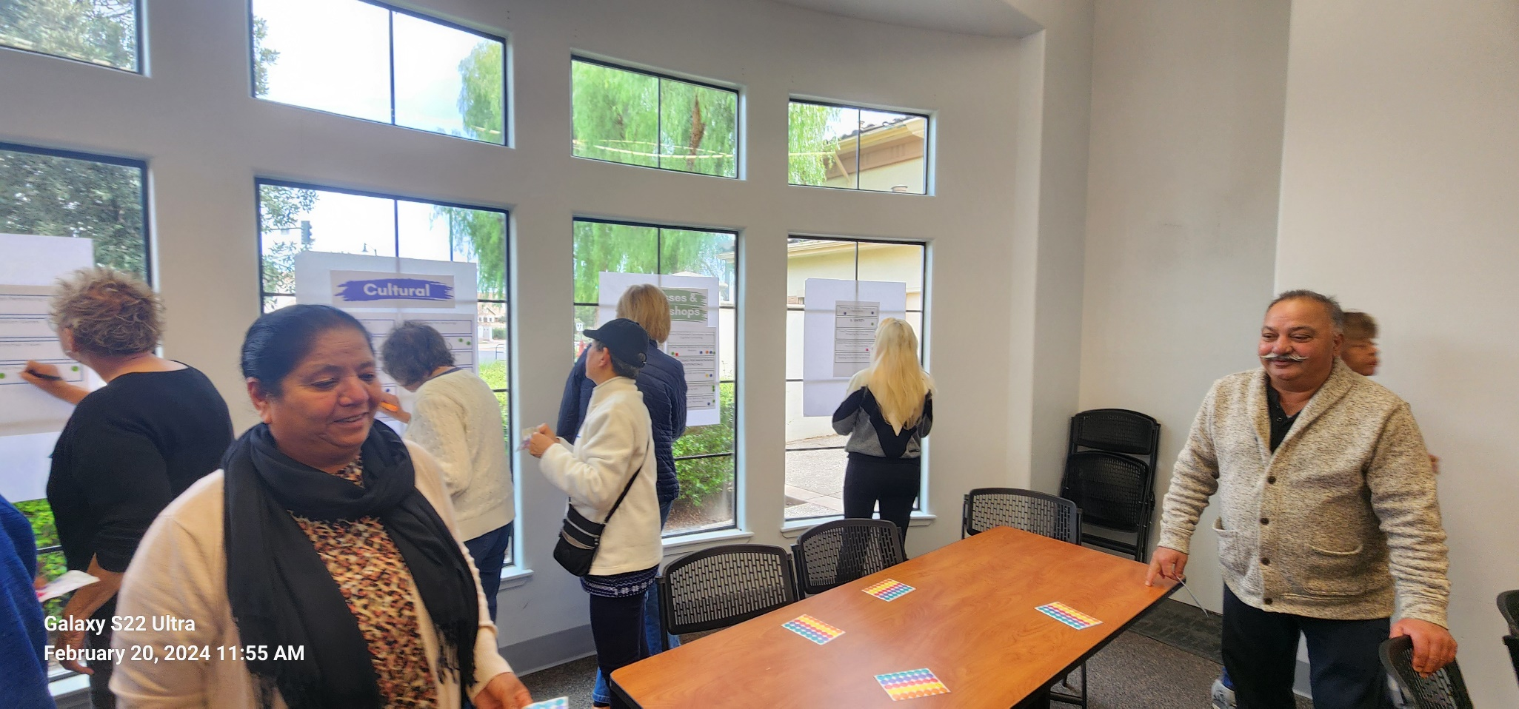
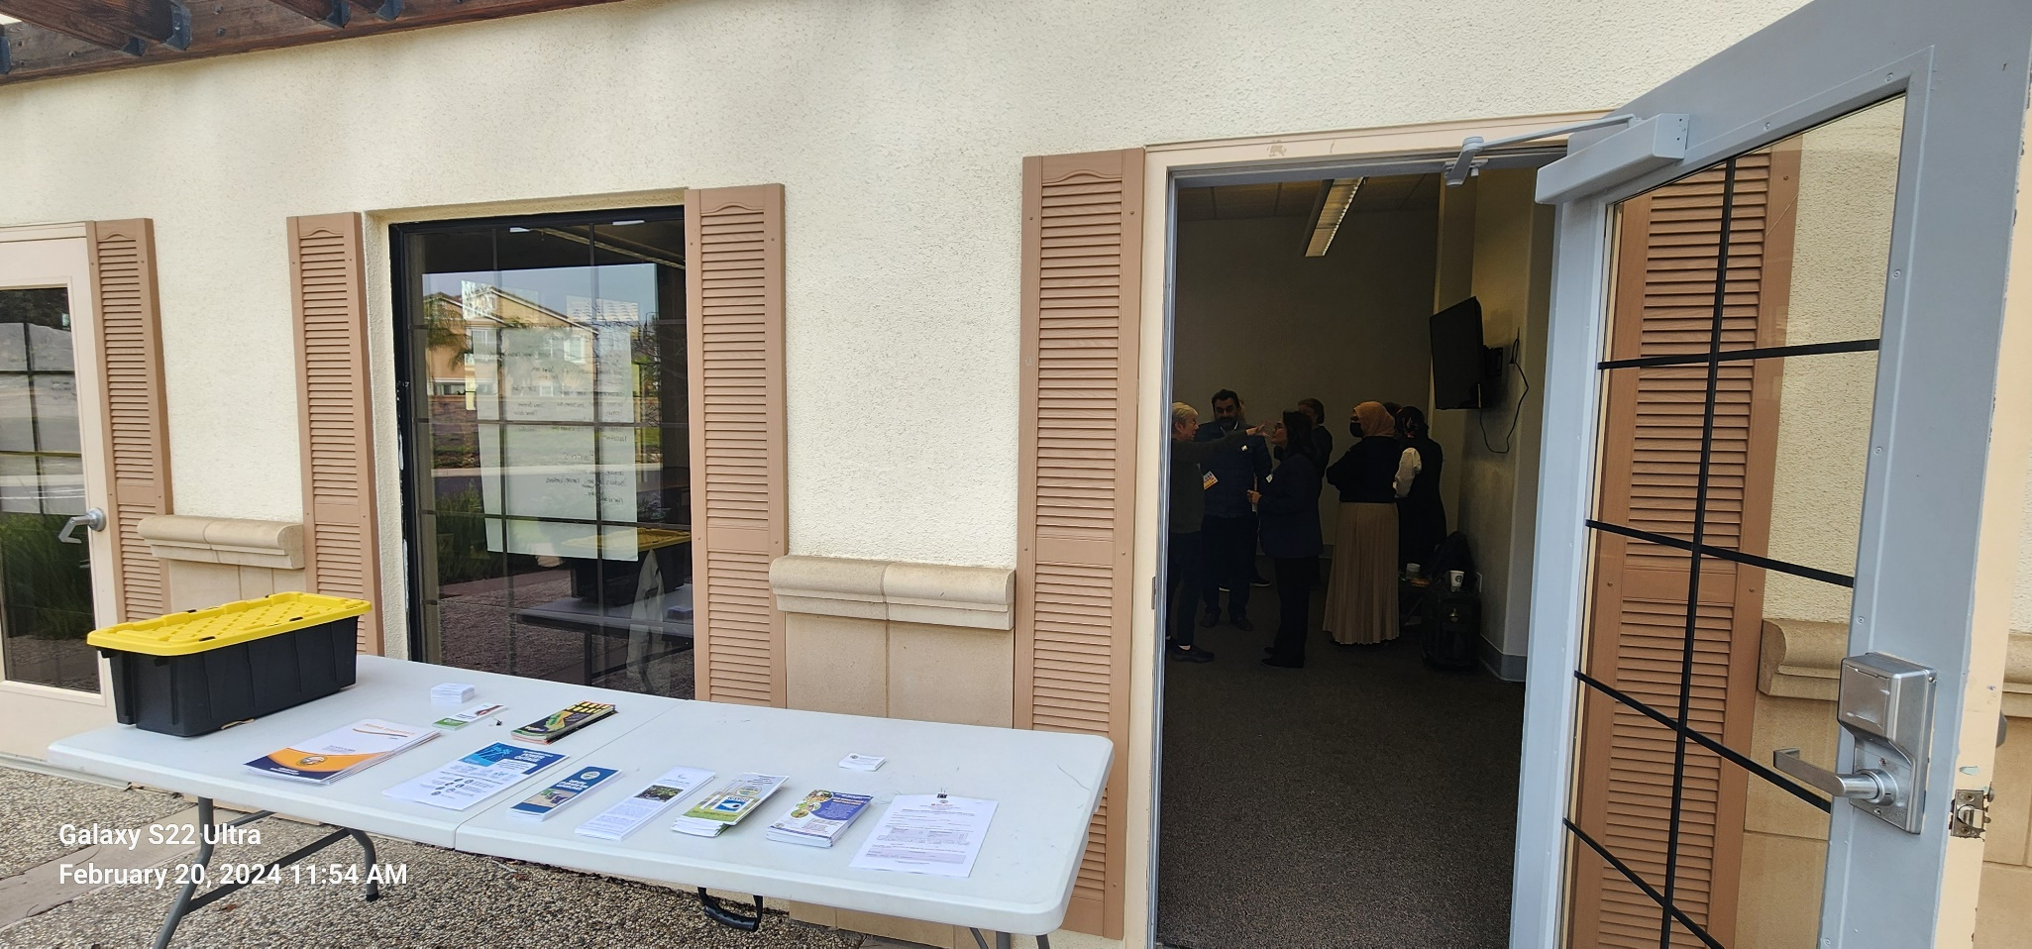
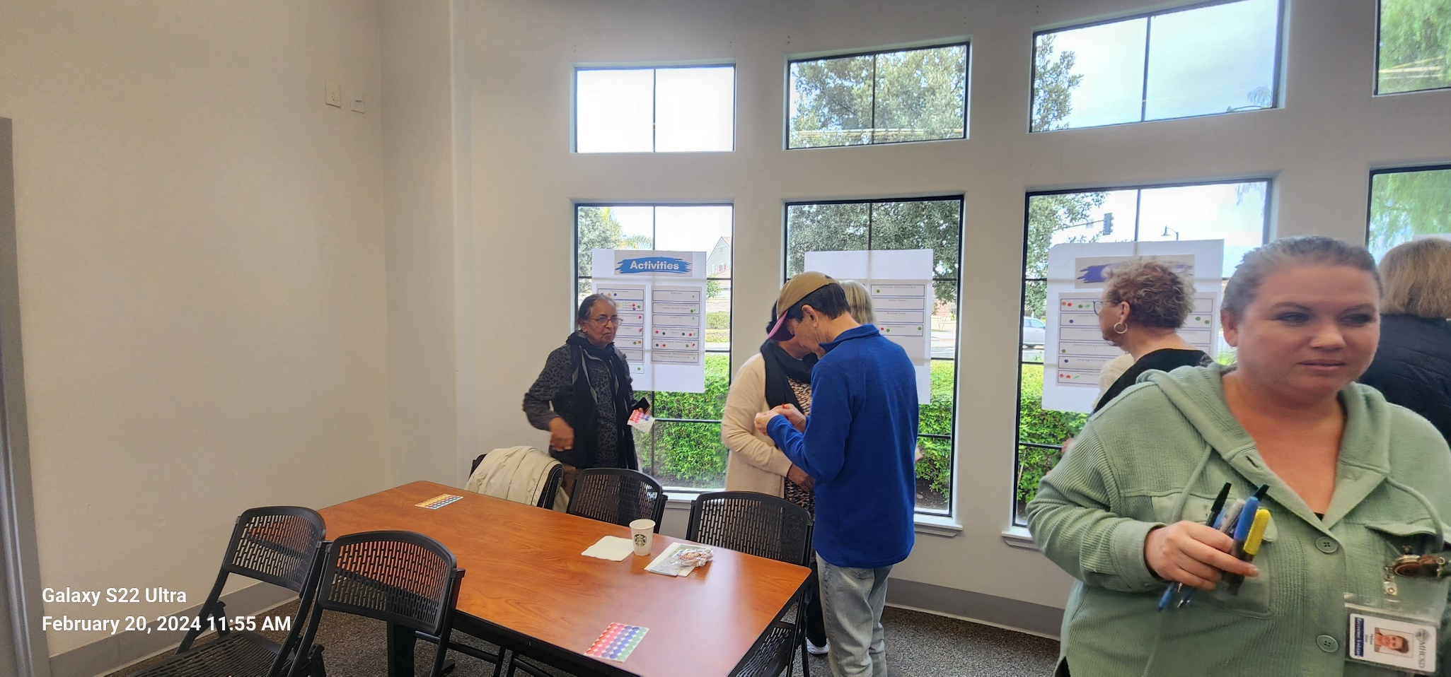
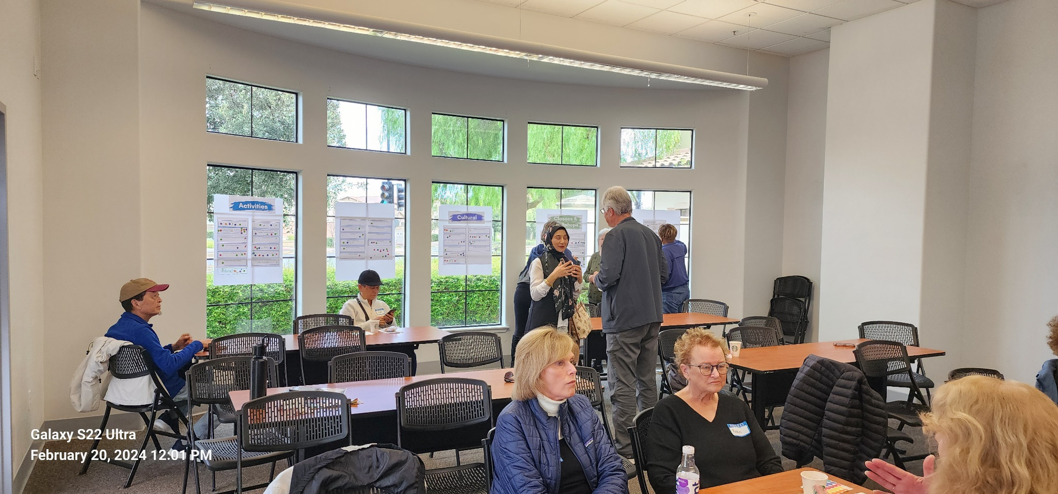
Coffee Chat

Slide 4
Exercise Classes

Slide 5
Social Activities
Social Dances 19

Slide 6
Art Activities
Arts & Crafts
22

Slide 7
Educational Activities
Computer/Cell Phone
24

Slide 8
Entertainment Activities
Card Games/Dominoes/Bunco
25

Slide 9
Cultural Activities
Crafts/Paint/Sew
24

Slide 10
Managing Independence Activities
Fall Prevention/Mobility
13
Financial/ Retirement Planning
12

Slide 11
Healthy Aging Workshops
Fitness/Strength Training for Balance
23

Slide 12
Safety Seminars
Fraud Prevention
19
Estate Planning
18

Slide 13
Outings
Local Festivals/Fairs
25
Local Museums/Art Galleries
22
Casinos
22

Slide 14
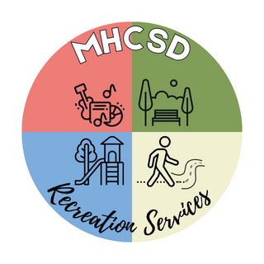
Findings
The senior community overwhelming wants fitness-type classes such as a walking group and strength training. Other interests include Yoga, Tai Chi, bowling, swimming and pickleball.
Participants want to take arts & crafts classes and participate in table games like cards, Bunco and BINGO.
Participants want to go on outings to places
like local fairs, museums and casinos were
very popular.
Participants also show an interest in learning
such as computers and cellphone use and
financial planning.

Slide 15
Next Steps
The programs for seniors has been named “Prime Time Seniors”.
Stakeholders include the Vintage Senior group and local seniors.
The Firehouse Community Room has been selected as a centralized location for senior programs.
Fitness and arts-related recreation classes such as Chair Yoga and Art of Water Coloring are part of “Senior Tuesdays” and meet on the 1st and 3rd Tuesdays of the month.
Social activities such as BINGO, games, club activities will be held on the 2nd Monday of the month.
Larger events such as the upcoming “Senior Health & Wellness Expo” will be held at the Unity Center.
Staff are working on securing the necessary resources to expand the senior program to meet the needs and wants of the senior community including outings, workshops, and classes.

