Slide 1

Mountain House Community Services District
5.B. Approve the Tennis Court Rental Policies and Recommend to Board for Adoption
March 26, 2024

Slide 2
Recommendation
Staff recommends that the Mountain House Parks and Recreation Commission (Commission) approve the Tennis Court Rental Policies and recommend to Board for adoption.

Slide 3
Discussion
The tennis program has grown substantially since June 2020
Reservations have increased 84% from 2021-2022
Reservations have increased 10% from 2022-2023
Several issues have either been observed by staff or have been shared with staff by members of the Board and tennis community.
  Lessons, leagues and tournaments are taking up court time from public use
  Courts 1 and 2 are being used by Commercial Users
  Commercial users have been granted more than 10 hours per week
  Private rentals use their time for commercial use
  Private rentals are using alias to book courts multiple times

Slide 4
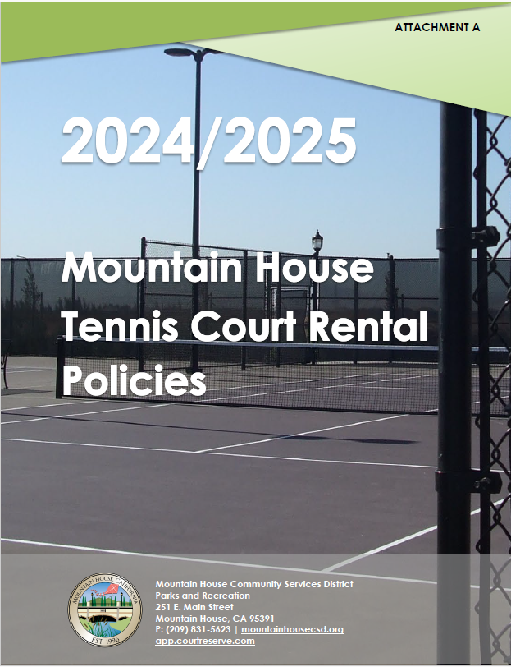
Draft Policies
The Board adopted the current Tennis Court Use Policy on June 10, 2020
Staff provided the Commission with a new comprehensive draft at their January 17, 2024 meeting.
Commissioners commented and provided staff with changes and additions.
Staff provided the Commission with an updated draft at their meeting on February 21, 2024.

Slide 5
Draft Policies
Members of the public attended the meeting on February 21, 2024 and shared their input including;
  New coaches aren’t given an opportunity to rent courts due to current coaches taking too much
  Current coaches are charging too much
  Current coaches aren’t qualified to teach
  Court 1 is a prime court; less windy
  Members of the public should be allowed to reserve/play more each week

Slide 6
Draft Policies
The updated policies reflect the commission and public comments including;
  Limiting commercial usage (lessons) up to 20 hours per week during specific hours of the week on Court 3.
    M-F 1-7pm
    SA/Su 8am-12pm, 3-7pm
  Allowing renters to rent courts 2x per week, 1-hour during Prime Time Hours, 14 days in advance.
    M-F 6-10pm
    SA/Su 8am-12pm,
  Putting a cap on charges for lessons don District-owned courts.
  Penalizing renters for classifying their account as “resident” but using it for commercial purposes.
  Penalizing excessive cancellations.
  Disallowing users with an alias.
  Requiring commercial users provide certifications with their rental requests.

Slide 7
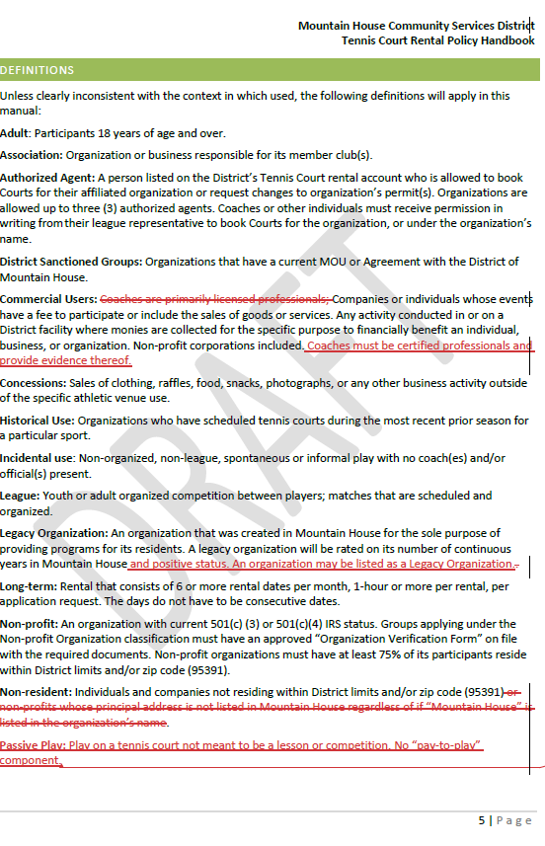
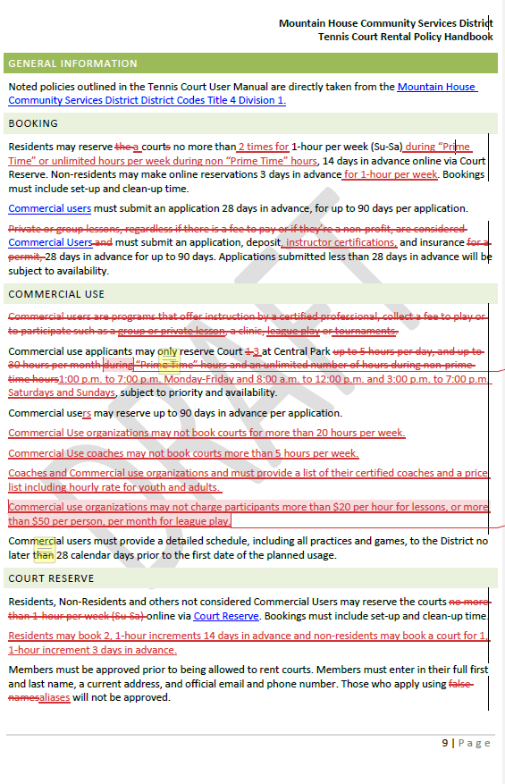
Allows players more opportunities to play during specific times of the week. May lead to others not being able to get on courts due to them being booked multiple times by some players
New requirement of all coaches to create a standard by which all instructors must meet to teach on CSD courts
How much does the commission want to cap private and group instruction? Youth vs adults, group vs private lessons
Current policy states 10 hours per week but coaches/leagues have been granted 36; over 90 hours a week are used by coaches and leagues currently

Slide 8
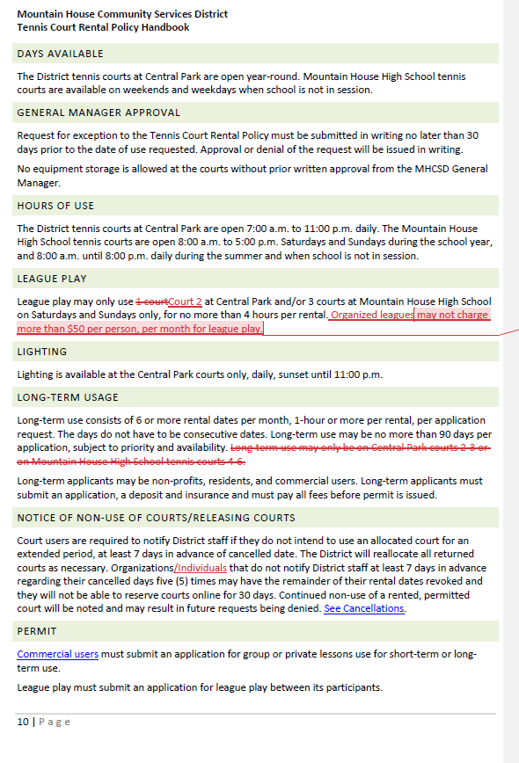
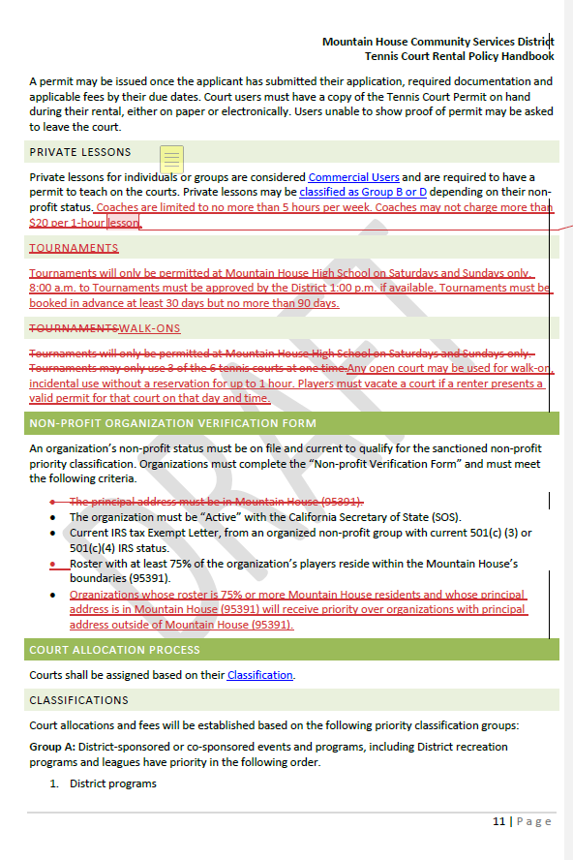
Do you want to allow private lessons? And if so, do you want to restrict their hours per week and their charges?
Leagues have been relegated to Court 2. Do you want to put a cap on league fees?
This will be required if they’d like to receive the court discount

Slide 9
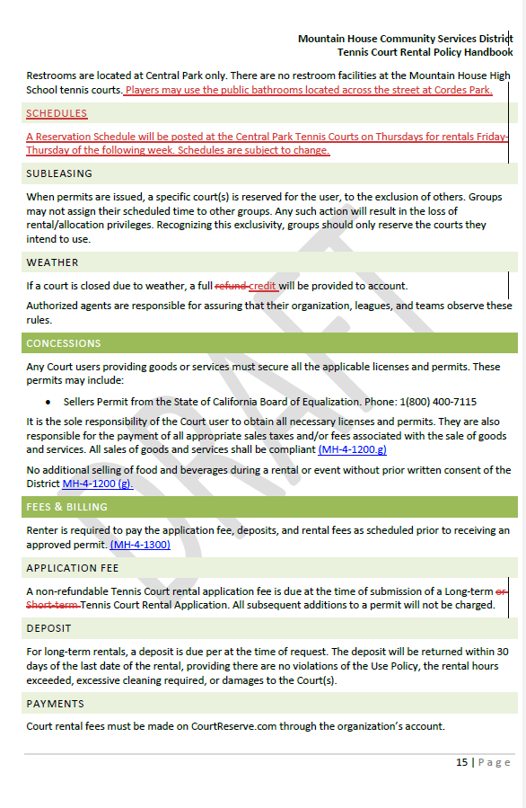
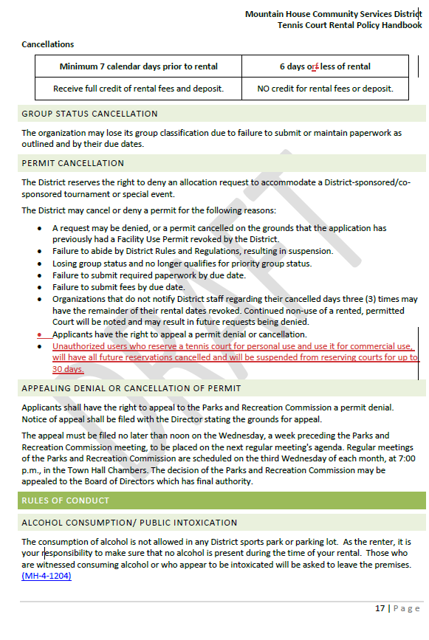
Schedules will be posted on tennis court Thursdays for Friday-Thursday
This penalizes renters who use courts for unauthorized personal use

Slide 10
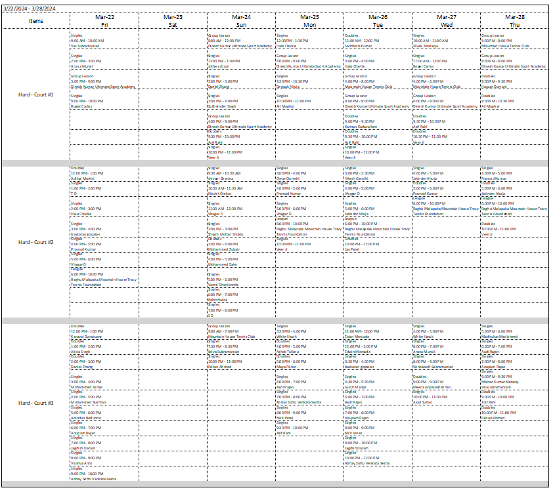

Slide 11
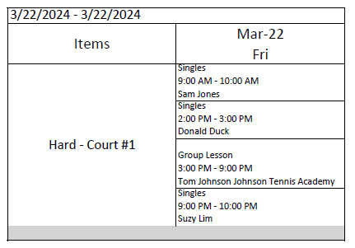
Friday-Thursday
Each column will have the date
Rentals will be identified by the type of rental, time of day and person who reserved the court
Each court will be identified
Questionable rentals will be contacted
Group lessons will be identified and the coach and their organization will be listed

Slide 12
Recommendation
Staff recommends that the Mountain House Parks and Recreation Commission (Commission) approve the Tennis Court Rental Policies and recommend to Board for adoption.

Slide 13
Questions?

