Slide 1

Mountain House Community Services District
5.A. Approve the Picnic Rental Policies and Recommend to the Board for Adoption
March 26, 2024

Slide 2
Recommendation
Staff recommends that the Mountain House Parks and Recreation Commission approve the Picnic Rental Policy and recommend to the Board of Directors for adoption.

Slide 3
Discussion
The Board adopted the current Park Facility Use Policy on September 8, 2021.
This policy contains both picnic spaces as well as fields which are now included in the new Athletic Field Rental Policy.
Staff presented a draft version of separate Picnic Rental Policies at their meeting on February 21, 2024, that outlines the general policies, regulations, and processes of renting a picnic area separate from the field rentals.

Slide 4
Suggestions
Update policy to include Cordes Park.
Allow the 1-table picnic areas be on a first-come, first-served basis.
The new policies identify clustered picnic areas of 2 or more tables that have other amenities such as a covered shelter and bathrooms and/or an adjacent green space for inflatables to accommodate larger groups.
Allow all-day rentals, 8:00am until dusk.
The new prices reflect the current hourly rate at an average of three hours per use and a deposit equal to the rental fee.
Provide restrictions on amplified sound.
All picnic rentals will be made available online.

Slide 5
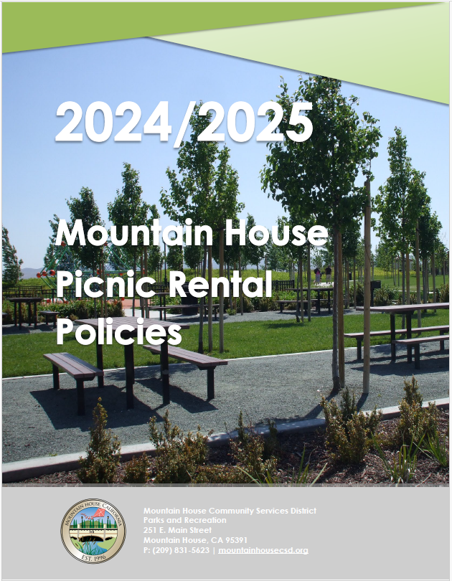
Draft Policies
Staff has provided the Commission with a comprehensive draft that allows the renter to understand the rental process.
New and Updated topics include;
  Changed from hourly booking to all day booking
  Restrictions on amplified sound and explicit music
  Allows inflatables at select picnic areas
  Removed the “Special Event” permit requirement
  Allows alcohol to be served in select parks
  Outlines discounts for non-profits and additional fees for commercial users and non-residents
  Change of fees to represent all-day usage and deposit amounts to be equal to rental fees

Slide 6
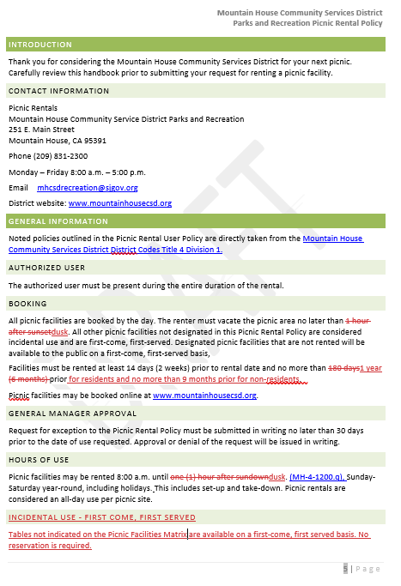
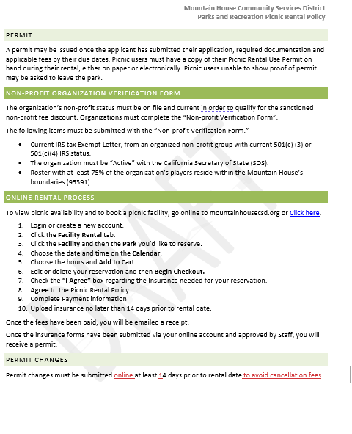
Residents can book as far out as a year and non residents, 9 months
This option allows the customer to make their own cancellations without needing staff; more automated

Slide 7
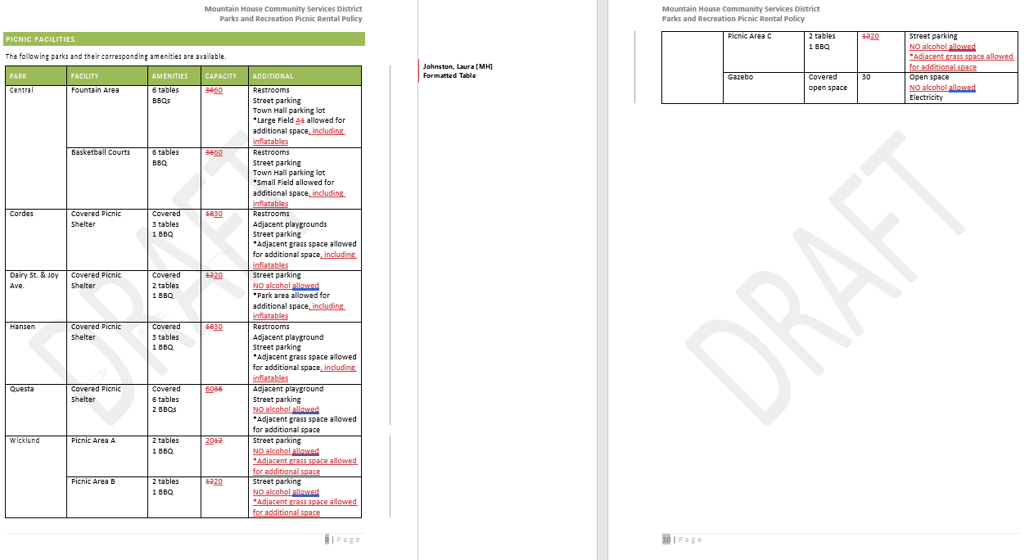
Staff updated the capacity at each site and added the additional space that’s available for things like inflatables
No alcohol allowed at parks without a bathroom, per previous policy.
Parks with bathrooms allow alcohol only with an alcohol permit issued by the district. No alcohol may be sold.

Slide 8
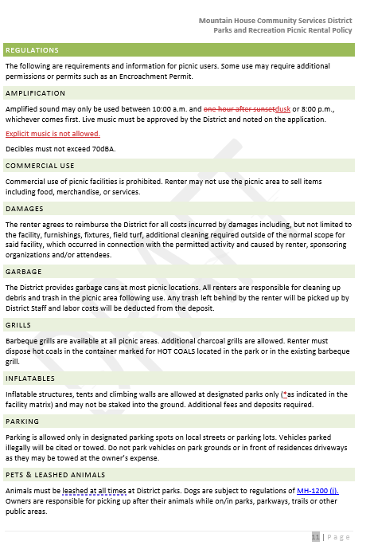
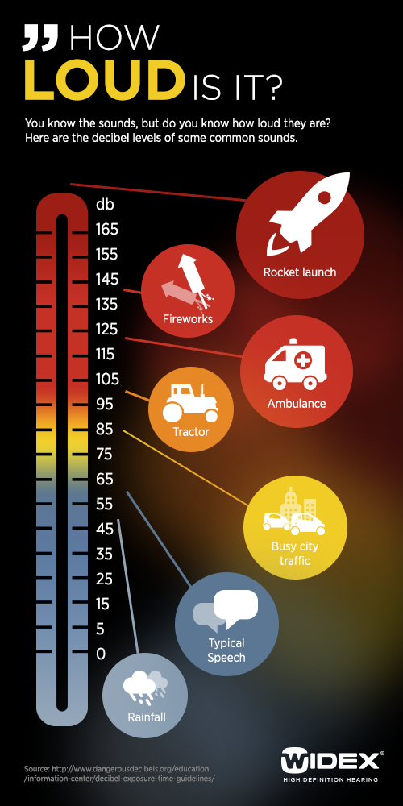
Highlighted explicit music.
While code enforcement creates a code regarding decibels, we’ve added this for the time being.

Slide 9
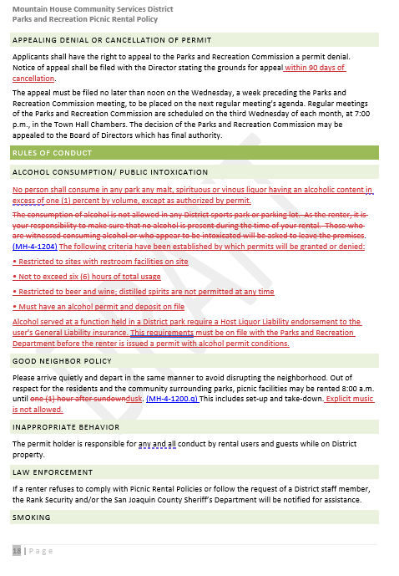
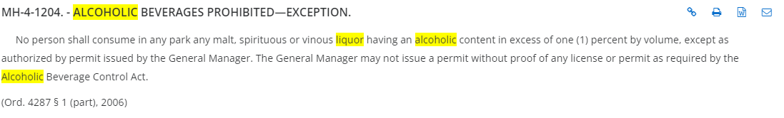
Alcohol policy was updated per the current code regarding alcohol in the park.
Alcohol policy was updated per the current code regarding alcohol in the park.

Slide 10
Recommendation
Staff recommends that the Mountain House Parks and Recreation Commission approve the Picnic Rental Policy and recommend to the Board of Directors for adoption.

Slide 11
Questions?

