Slide 1

Mountain House Community Services District
6.B. Create Workplan and Goals
February 21, 2024

Slide 2
Purpose of the Parks and Recreation Commission
Advise the Board
Provide a communication link between the community and the Board and staff

Slide 3
Commission Duties
The Commission shall evaluate the District’s recreation programs, facilities, services and relationships.
Based upon the Commission’s evaluations, they shall recommend program fees and policies for recreation programs and facilities for Board approval.
Commission Establish Goals
Public Feedback
Commission Recommend
Board Approve
Staff Implement

Slide 4

Mission Statement
To Serve the Diverse Residents of Mountain House by Providing Exceptional Programs, Events, Parks and Facilities.

Slide 5
Key Words in Purpose, Duties
EVALUATE
Programs
Facilities
Relationships
Services

Slide 6
Key Words in Purpose, Duties
RECOMMEND
Policies
Fees

Slide 7
Key Words in Purpose, Duties
ADVISE
Goals & Objectives for Parks for Parks & Recreation
Facilities
Methods of Community Involvement

Slide 8
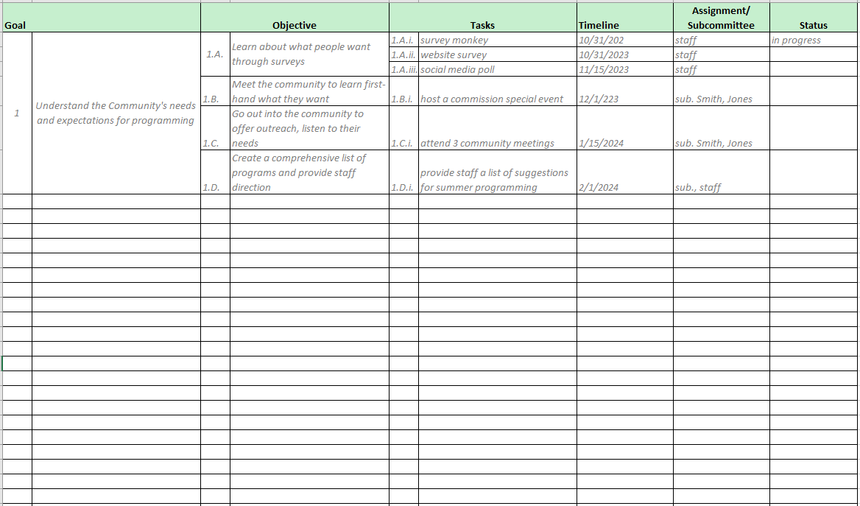

Slide 9
Brainstorm
What can you accomplish now through June 2025?
What do you want this first Parks and Recreation Commission’s legacy to be?
What have we done so far?
  Evaluated current rental policies
  Recommended new polices that are fair and equitable, using Best Practices
  Recommended new special events for more community involvement
What will do on future agendas?
  Will evaluate fees and create a pricing guideline policy
  Create opportunities for community involvement in public process
  Recommend programs for implementation that meet the wants and needs of the community

Slide 10
Questions?

