Slide 1

Mountain House Community Services District
6.A. Review and Discuss the Draft Version of the Picnic Rental Policy
February 21, 2024

Slide 2
Recommendation
Staff recommends that the Mountain House Parks and Recreation Commission (Commission) review and discuss the draft version of the Picnic Rental Policy and make recommendations for changes.

Slide 3
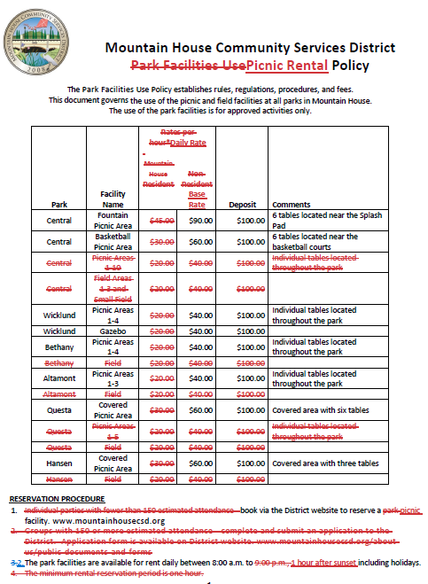
Discussion
The Board adopted the current Park Facility Use Policy on September 8, 2021.
Staff presented the Board an updated Parks Facility Use Policy at their regular meeting September 14, 2022. The proposed policies included parks, parks, picnic areas, special events and sports fields.
It was decided at that meeting the use policies would be established with the new Parks and Recreation Commission.
This policy contains both picnic spaces as well as fields which are now included in the new Athletic Field Rental Policy.

Slide 4
Discussion
There are currently 50 picnic tables located at all of the parks throughout Mountain House.
All of the tables are currently available for rent through our reservation system, Rec 1.
Several parks have clustered picnic tables (Wicklund Park), and several parks have random tables around the park (Bethany).
Several parks have a cluster of tables located underneath a shelter (Cordes) and offer additional amenities like bathrooms and an adjacent green space for additional rental opportunities (inflatables)
Each table can accommodate 6 adults.

Slide 5
Discussion
There we 80 picnic rentals in 2023; 62 (77.5%) were “picnic areas”
The average rental was 3-4 hours long
  50% were 4 or more hours long
2 of the 80 rentals started before 10am
39 (25%) ended at or after 6pm
6 rentals were for organizations whose rentals averaged 3.5 hours long
In only 1 instance were picnic areas rented back-to-back

Slide 6
Suggestions
Update policy to include Cordes Park or the new park coming to Dairy Drive and Joy Avenue.
Allow the 1-table picnic areas be on a first-come, first-served basis.
Identify picnic areas that are clustered, covered and have bathrooms as rentable places.
Allow all-day rentals, 8:00am until 1-hour prior to sunset.
Provide additional green space for rental at selected parks.
Provide restrictions on amplified sound.
Update fees to include all-day usage and change deposits to be equal to all-day rental fees.

Slide 7
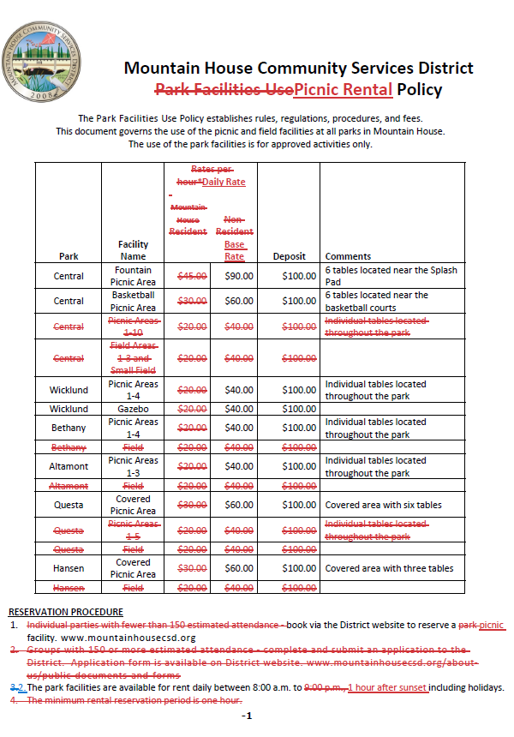
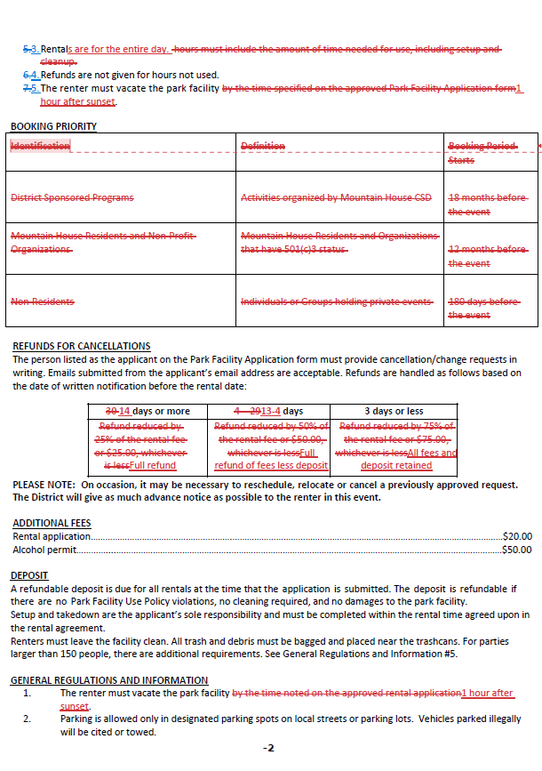
To simplify the rental process, picnic areas are available 6 months in advance but must be reserved at least 14 days prior to allow renter and staff time to collect all requirements
Hourly rate changed to a Daily Rate. Base rate is a Resident Fee. All discounts and add-ons added to base rate
Hourly rate changed to a Daily Rate. Base rate is a Resident Fee. All discounts and add-ons added to base rate
Single picnic tables were removed and are available on a first-come, first-served basis
Refunds for cancellations are easier for customers to understand and staff to process
Fields were removed an included in the new Athletic Field Policy
Rentals with over 150 will require a new Special Event permit
Rental hours will align with current muni code park hours

Slide 8
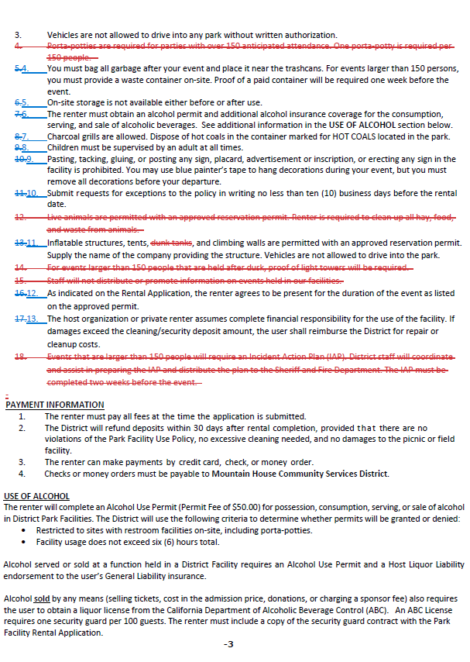
Reserved picnic areas have bathrooms, some exceptions
Deleted to reflect current muni code
All picnic areas have capacities. Special event permits are required for park spaces only

Slide 9

Draft Policies
Staff has provided the Commission with a comprehensive draft that allows the renter to understand the rental process.
New and Updated topics include;
  NEW Definitions
  NEW Nonprofit Verification Process for discounts
  Changed from hourly booking to all day booking
  Restrictions on amplified sound
  Change in rental calendar due dates
  Change in cancellation days
  Allows inflatables at select picnic areas
  Removed the “Special Event” permit requirement
  Outlines discounts for non-profits and additional fees for commercial users and non-residents
  Change of fees and deposit amounts
  Exclude animals from rental based on current muni code MH-4-12 (i)

Slide 10
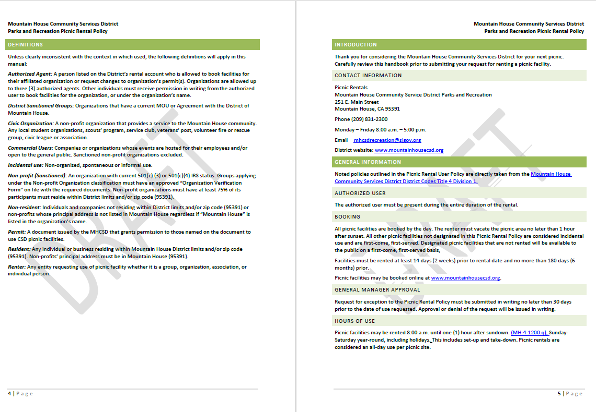

Slide 11
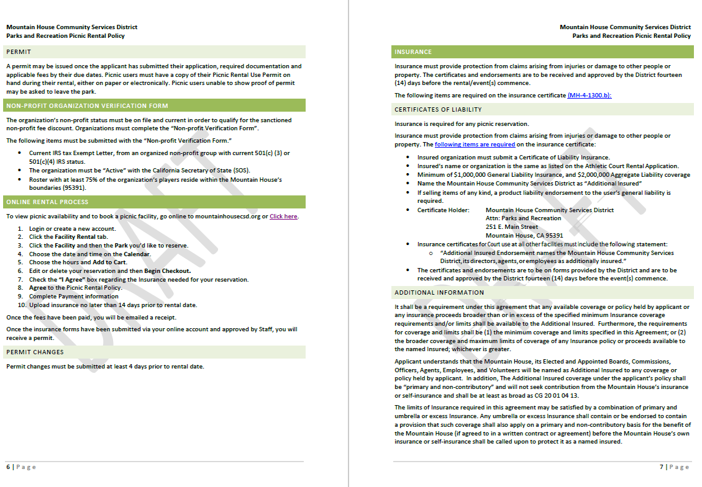
All picnic areas will be available for online reservations

Slide 12
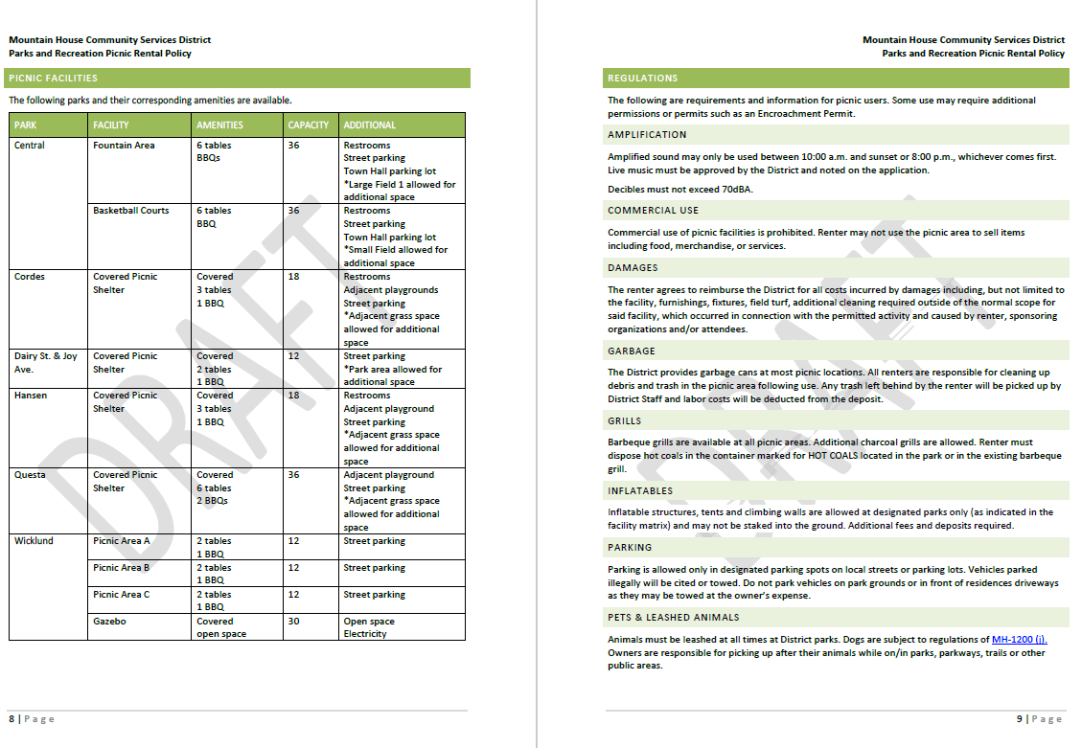
Standard regulations, most pulled from existing regulations with the addition of amplification and inflatables
New matrix will make it easier for customers to see each available area and its amenities

Slide 13
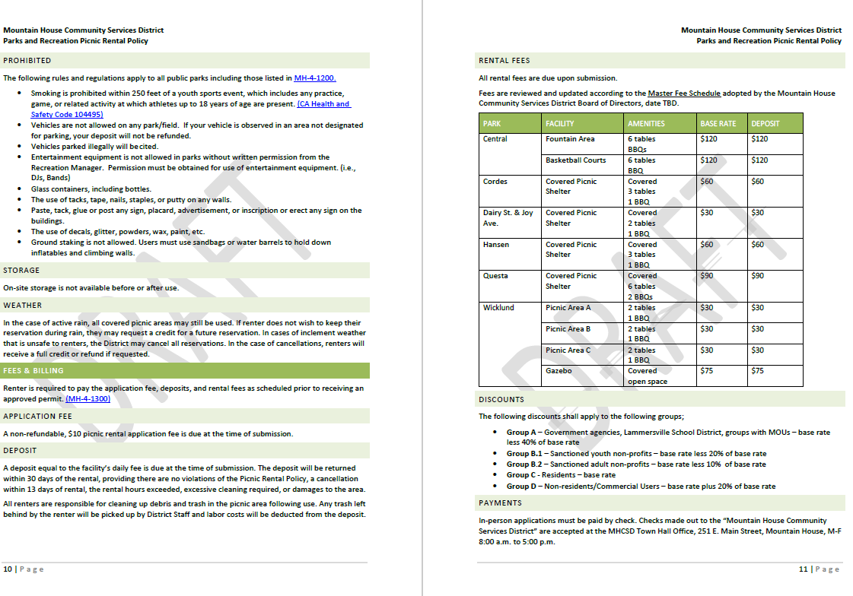
Standard regulations, most pulled from existing regulations
New fees to reflect all-day usage (average rental less than 3 hours)
Deposit will equal cost of rentals
Base rate is the resident rate
Fees will be assessed with department’s Fee Assessment at future meeting
Discount policy reflects discounts applied to athletic fields and tennis courts

Slide 14
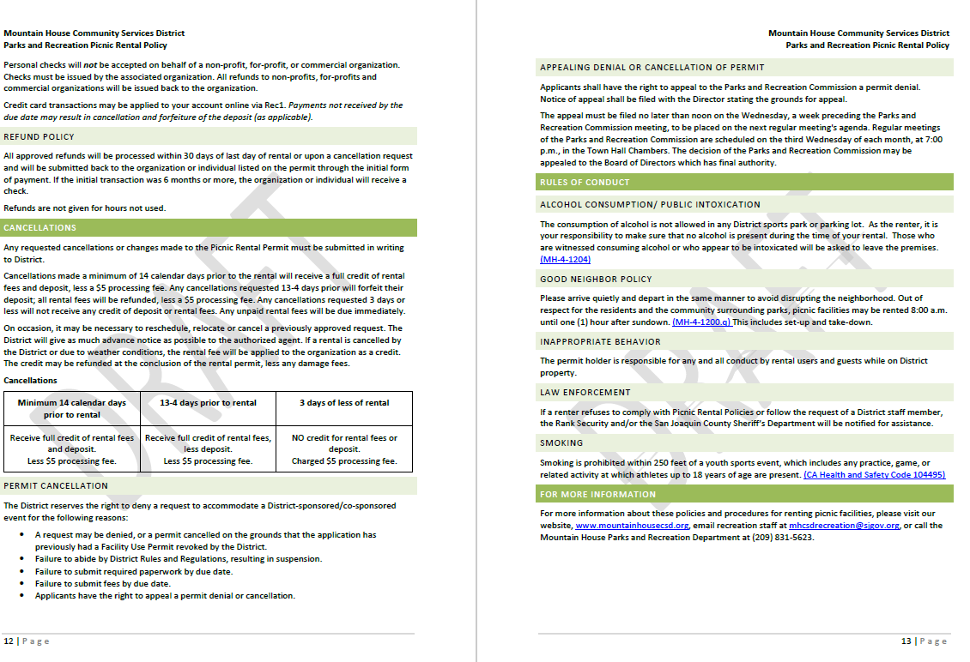
Updated and simplified cancellation process
Standard rules of conduct in all rental policies

Slide 15
Questions to Ask
Do the policies make sense?
Are they easy to understand?
Do they meet the values of the Commission and Board?

Slide 16
Questions to Ask
Do they serve the diverse user groups in Mountain House and Provide Exceptional Parks?

Slide 17
Recommendation
Staff recommends that the Commission review and discuss the Picnic Policy and make suggestions for implementation.
The Chair will ask if anyone has clarifying questions.
The Chair will open it to public comment for public and alternate Commissioners’ comments. The Commission may incorporate community feedback.
  Comments and suggestions will be incorporated in the DRAFT for the next meeting.

Slide 18
Questions?

