Slide 1

Mountain House Community Services District
5.A. Approve Final Draft of the Tennis Court Rental Policy and Recommend to Board for Adoption
February 21, 2024

Slide 2
Recommendation
Staff recommends that the Mountain House Parks and Recreation Commission (Commission) approve the draft version of the Tennis Court Rental Policy and recommend to Board for adoption.

Slide 3
Discussion
The tennis program has grown substantially since June 2020
  50% increase in court utilization 5-8pm
  Increase of 74% between 8-9pm
  Increase of 9.5% in morning and mid-day utilizations
Reservations have increased 84% from 2021-2022
Reservations have increased 10% from 2022-2023
Several issues have either been observed by staff or have been shared with staff by members of the Board and tennis community.
  Lessons, leagues and tournaments are taking up court time from public use
  Courts 1 and 2 are being used by Commercial Users
  Commercial users have been granted more than 10 hours per week
  Private rentals use their time for commercial use
  Private rentals are using alias to book courts multiple times

Slide 4
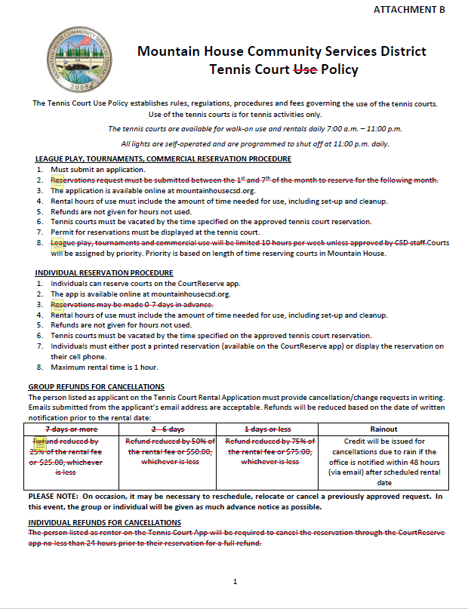
Current Policies
The Board adopted the current Tennis Court Use Policy on June 10, 2020.
Staff provided the Commission redlined copies of the current Tennis Court Use Policy.
The redlines indicate outdated or improved policies.
Fees will not be changed and will be brought back after a Pricing Guideline Policy has been established and new fees are proposed.

Slide 5
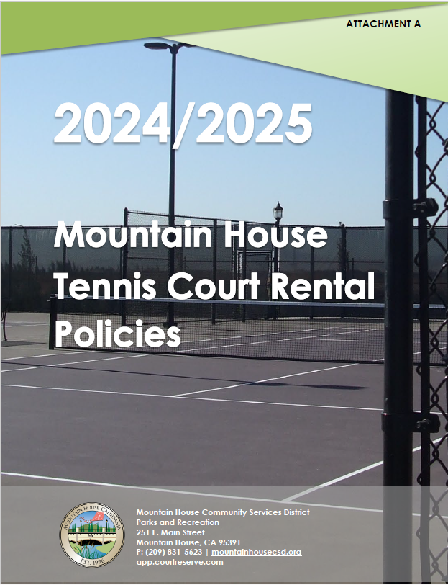
Draft Policies
Staff provided the Commission with a new comprehensive draft at their January 17, 2024 meeting.
Commissioners commented and provided staff with changes and additions.
The following draft contains Commissioners comments and suggestions.

Slide 6
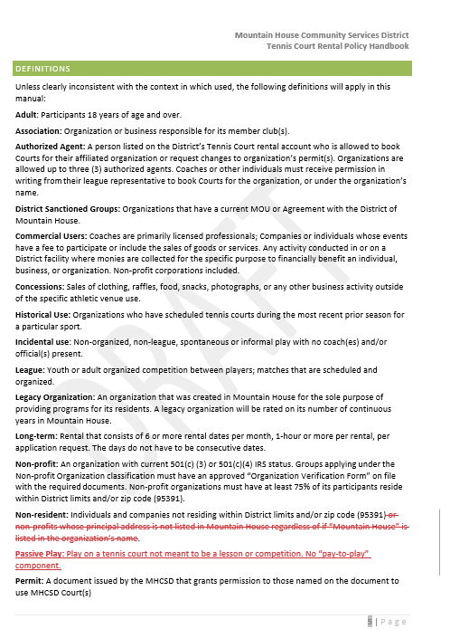
Removed non profit principal address requirement per Commission discussion
Added definition of Passive Play to identify common, public use with no lesson or competition component

Slide 7

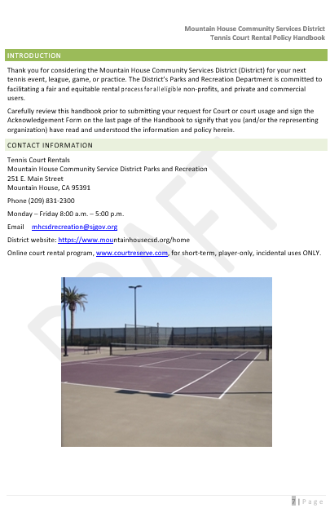
Updated primetime hours based on commission discussion
Removed non profit principal address requirement per Commission discussion

Slide 8
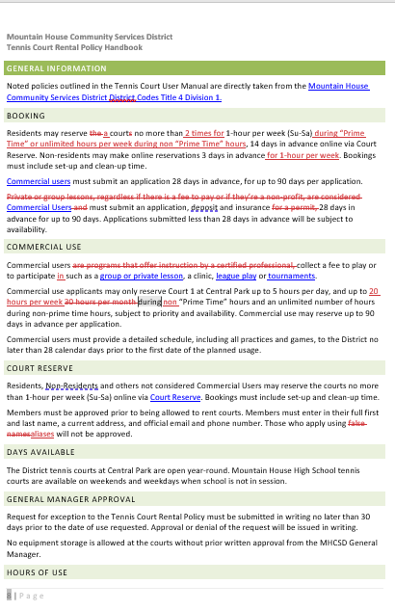
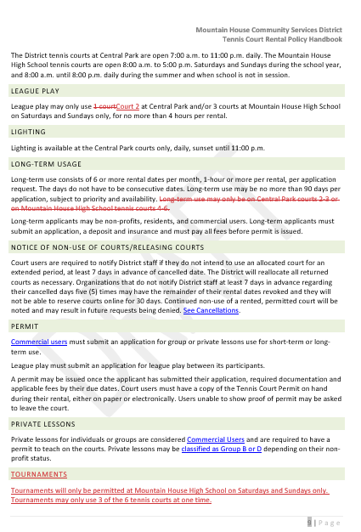
Updated number of times to allow people to rent more often, Non residents have more restrictions
Long term use for Commercial users
MHHS does not allow lesson based commercial uers. League and tournaments are approved
Court 1 assigned for commercial use
20 hours per week compared to 36 now
Up to 5 hours per day limit
Unlimited use during non primetime hours to encourage commercial users to use courts other times
Tournaments are allowed at high school courts only as they use several courts for longer periods of time, leaving Central open primarily for lessons and public use

Slide 9
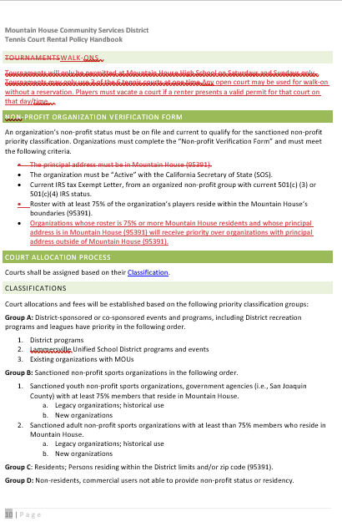
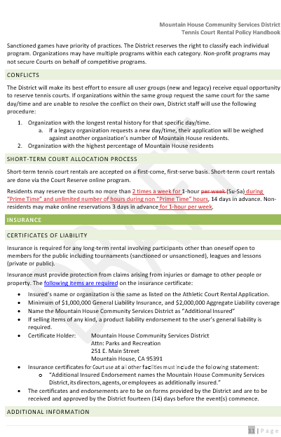
per commission discussion, walk-on use is allowed without a reservation however, they risk having to leave court if it has been reserved
Updated number of times to allow people to rent more often, Non residents have more restrictions
Requirements for non profit verification changed per commission recommendation

Slide 10
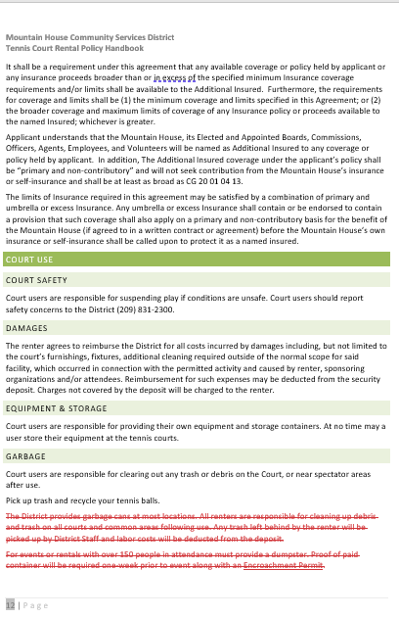
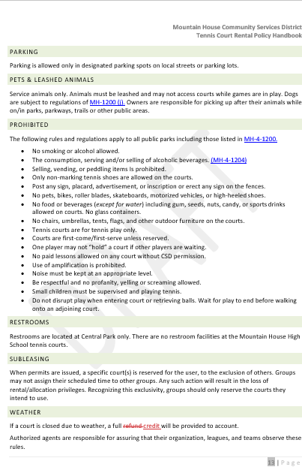
Removed unneeded language. Large events at the courts already have bathrooms

Slide 11
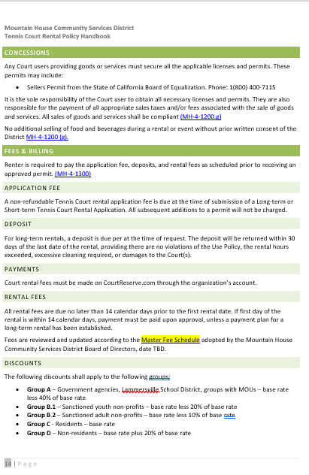
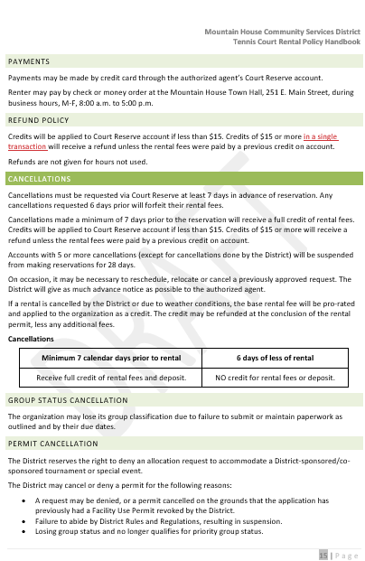
Updated refund policy to reduce transaction fees for district
5 cancellations will suspend accounts for 28 days

Slide 12
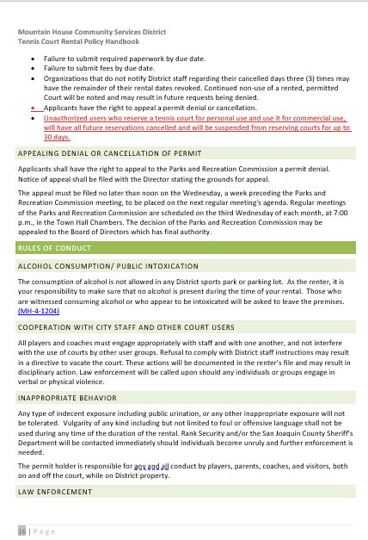
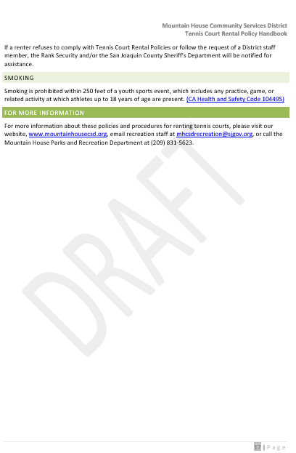
Added per commission discussion

Slide 13
Questions to Ask
Do the policies make sense? Are they easy to understand?
Do they address the concerns of staff and public?
Do they meet the values of the Commission and Board?

Slide 14
Recommendation
The Chair will open it to public comment for public and alternate Commissioners’ comments.
Confirm that the DRAFT copy includes policies that address;
  Opening up more court time
  Commercial users are limited to a single court and monthly hours to allow for more public use
  Long-term renters are able to book farther out
  The Commission may incorporate community feedback.
  Additional changes may be incorporated in the DRAFT with a motion to amend or modify or bring back to a future meeting for approval.

Slide 15
Questions?

