Slide 1

Mountain House Community Services District
6.B. Review and Discuss New Program Ideas
January 17, 2024

Slide 2
Recommendation
Staff recommends that the Mountain House Parks and Recreation Commission (Commission) review the current recreation programs offered by the District and discuss ideas for new programming.

Slide 3
Discussion
At the regular meeting on December 20, 2023, several Commissioners requested to discuss new program ideas.
Programs may be considered educational, recreational, celebratory.
Education and recreation classes are typically taught by highly skilled instructors in their respective fields.
Staff are developing a “Contract Instructor Handbook” with polices and processes to become an instructor for the District.
Other popular programs in MH include musical, religious and cultural events, and library programs.

Slide 4
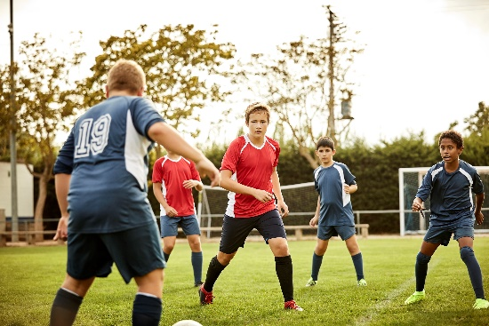

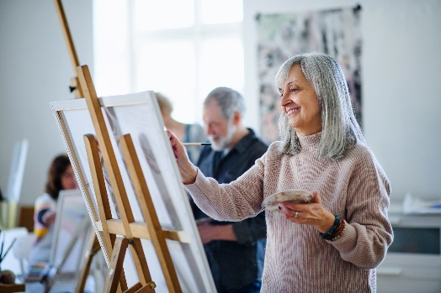
Current Trends in Recreation
Pickleball (seniors, all)
Sports Lessons (youth)
Art (adult and youth)
LEGOs (building)
Engineering and Coding (youth)
Themed Camps (youth, summer)
STEM/STEAM Programs (youth)
Fitness (adult, dance, yoga, cross-training)
Movies in the Park (summer 2024)
Active Senior Programs (younger Baby Boomers, older Gen X)

Slide 5
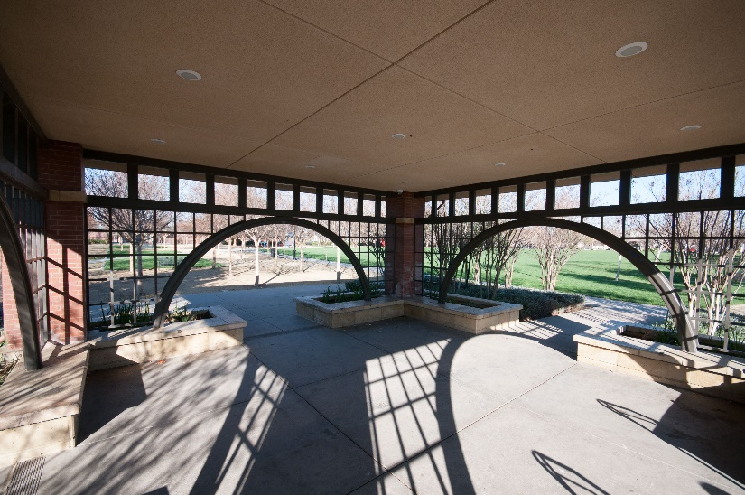
Available Facilities
7 parks
  Fields, picnic areas, sports courts
Unity Center
  Large hall with outdoor areas, tables, chairs
Firehouse Community Room
  Small classroom for up to 48; tables, chairs
Town Hall’s TH-1 Room
  Large classroom with tables, chairs, projector

Slide 6
Considerations
Commissioners should consider the following;
  Community needs
  Public input
  Available budget
  Available facilities
  Staff management

Slide 7
Recommendation
Staff recommends that the Commission;
  Share ideas on how to interact with the public
  Invite the public to a future meeting; regular or special meeting
  Participate in upcoming District-sponsored Special Events
  Survey your respective communities, share at future meeting

Slide 8
Questions?

