Slide 1

Mountain House Community Services District
5.A. Approve Final Draft of the Athletic Field Rental Policies and Recommend to Board for Adoption
January 17, 2024

Slide 2
Recommendation
Staff recommends that the Mountain House Parks and Recreation Commission (Commission) review and discuss the draft version of the Tennis Court Rental Policy and make recommendations for changes.

Slide 3
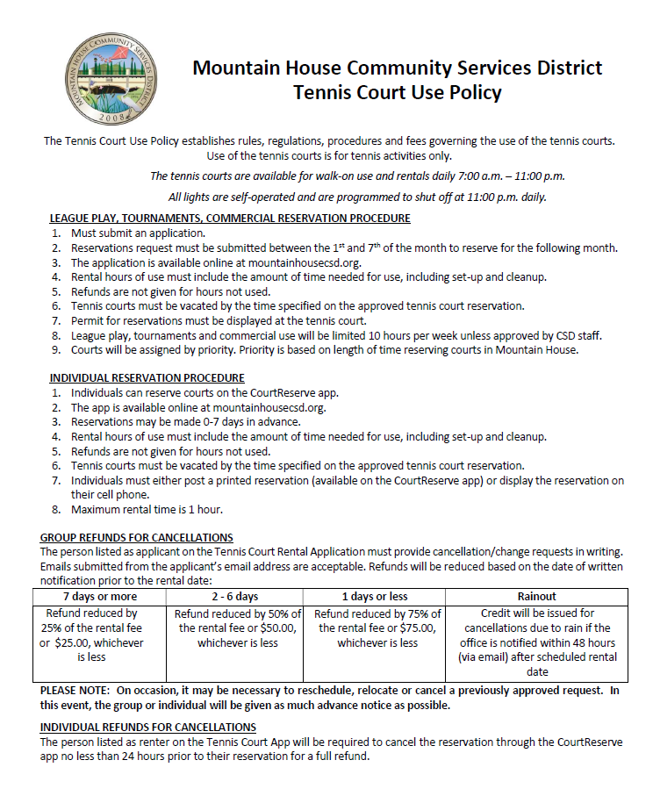
Discussion
The Board adopted the current Tennis Court Use Policy on June 10, 2020.
In order to address the growing tennis program in Mountain House and to prepare for the addition of a Tennis facility at Central Park as part of Phase 2, it’s necessary to update the Tennis Court Rental Policies.

Slide 4
Discussion
The tennis program has grown substantially since June 2020
  50% increase in court utilization 5-8pm
  Increase of 74% between 8-9pm
  Increase of 9.5% in morning and mid-day utilizations
Reservations have increased 84% from 2021-2022
Reservations have increased 10% from 2022-2023

Slide 5
Discussion
The increase in reservations and court utilization demonstrate the popularity of tennis in Mountain House.
Several issues have either been observed by staff or have been shared with staff by members of the Board and tennis community.
  Not enough courts
  Commercial users (lessons, leagues, tournaments) were taking up court time during peak hours, prohibiting public use
  Private renters are using their reservations for commercial use (no oversight)
  Renters are cancelling their rentals too close to their rental date, not giving the public enough time to rent
  Renters are creating aliases and booking courts multiple times per day
  Long-term renters are not going through formal rental process
  Courts 1 and 2 are often being used by commercial users at the same times
  All of the courts at the high school are booked for tournaments

Slide 6
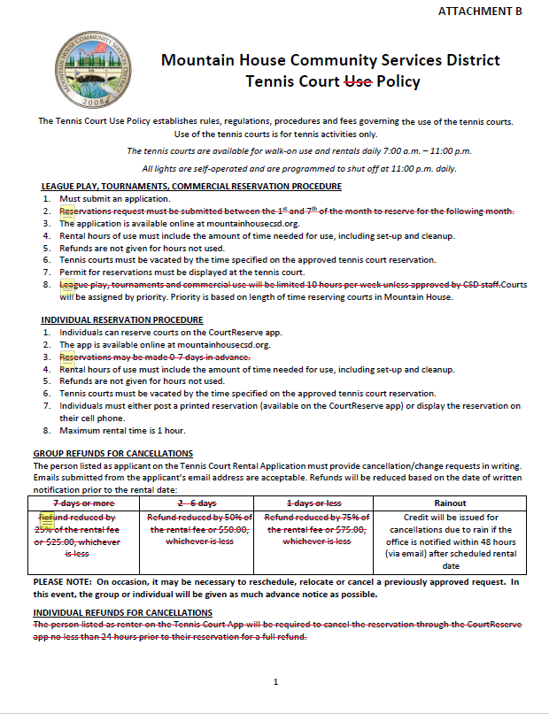
Current Policies
Staff have provided the Commission redlined copies of the current Tennis Court Use Policy.
The redlines indicate outdated or improved policies.
Fees will not be changed and will be brought back after a Pricing Guideline Policy has been established and new fees are proposed.
#2: Long-term reservations should be made 28 days in advance of first day of reservation period, but reservations can be made 3 months in advance to reduce staff time managing
#8: based on historical use, the time should be set to per day and per month; recommend no more than 5 hours per day during “peak hours” and no more than 30 hours per month; commercial users are renting courts 30-36 hours per week
Cancellations will only be allowed up to 7 days before otherwise they’d lose their fees. The court may stay “reserved” but if it’s empty, the public can use on a first-come basis. But because rental fees are only $3, the amount will stay as a credit for a future use
#3: for individuals, they can book up to 14 days in advance to allow the public more flexibility but they can only rent 1 hour per week

Slide 7
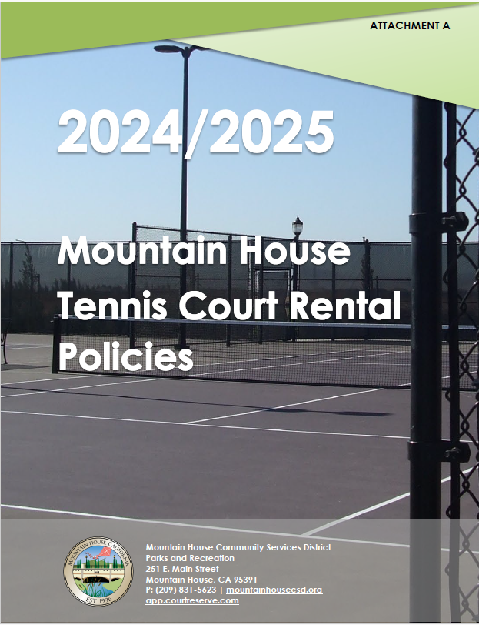
Draft Policies
Staff has provided the Commission with a comprehensive draft that allows the renter to understand the rental process.
New and Updated topics include;
NEW Definitions
NEW Nonprofit Verification Process
UPDATED booking deadlines
NEW #1 Court allocation for commercial users
NEW Classifications of users
NEW discounts based on Classifications
UPDATED cancellation policy
NEW appeal process

Slide 8
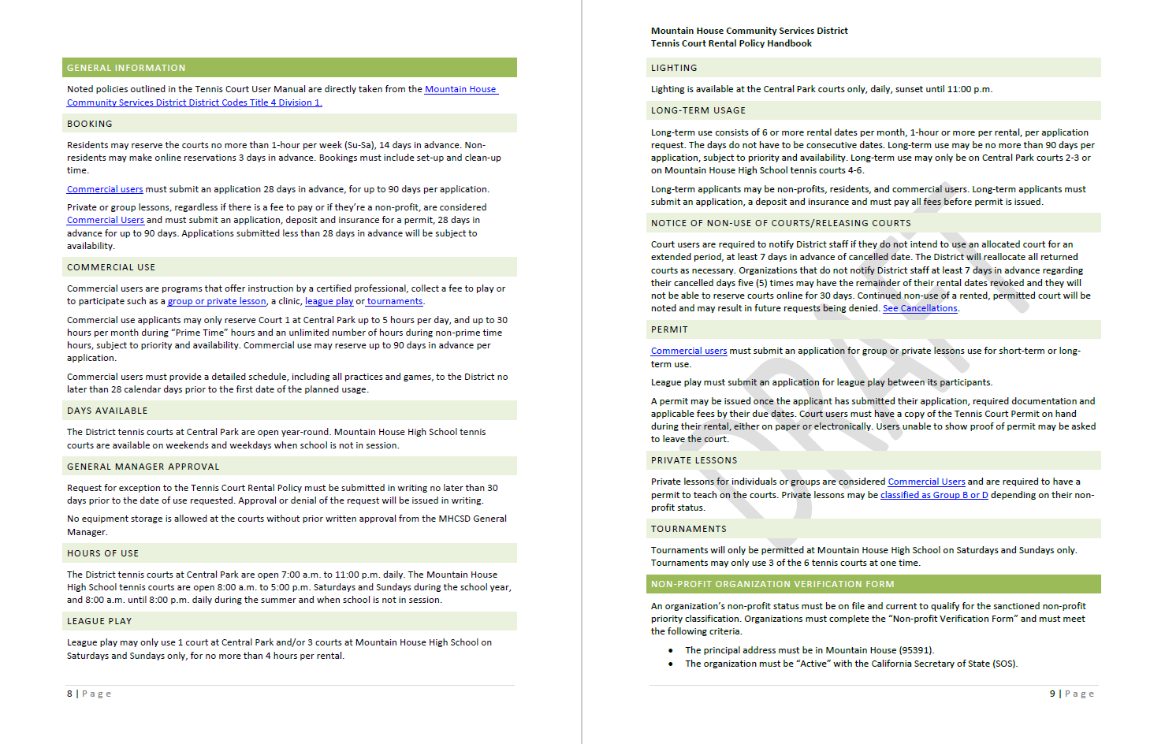
This new policy would allow a private user the option to pre-book their courts, but then they’d have to apply like the other groups and submit deposit, application fee and insurance
Policy updated to allow renters the option to book 2 weeks out, 1 hour per week
Commercial users are allowed to rent 28 days in advance for up to 90 days to allow to ensure their long-term programs and reduce staff time to manage
Commercial User is better defined as ANY program that collects a fee, regardless if they are a nonprofit or youth program.
NEW: to address public concern the courts are always booked by commercial users, this policy would limit all commercial use to court 1. MHHS does not allow commercial use.
This may help prohibit cancellations as they will be marked on their accounts
Anytime a lesson is on the court wherein the instructor is being paid is considered a “Private Lessons” and must apply. This may be harder to monitor
This allows for half of the open courts at MHHS be open for public

Slide 9
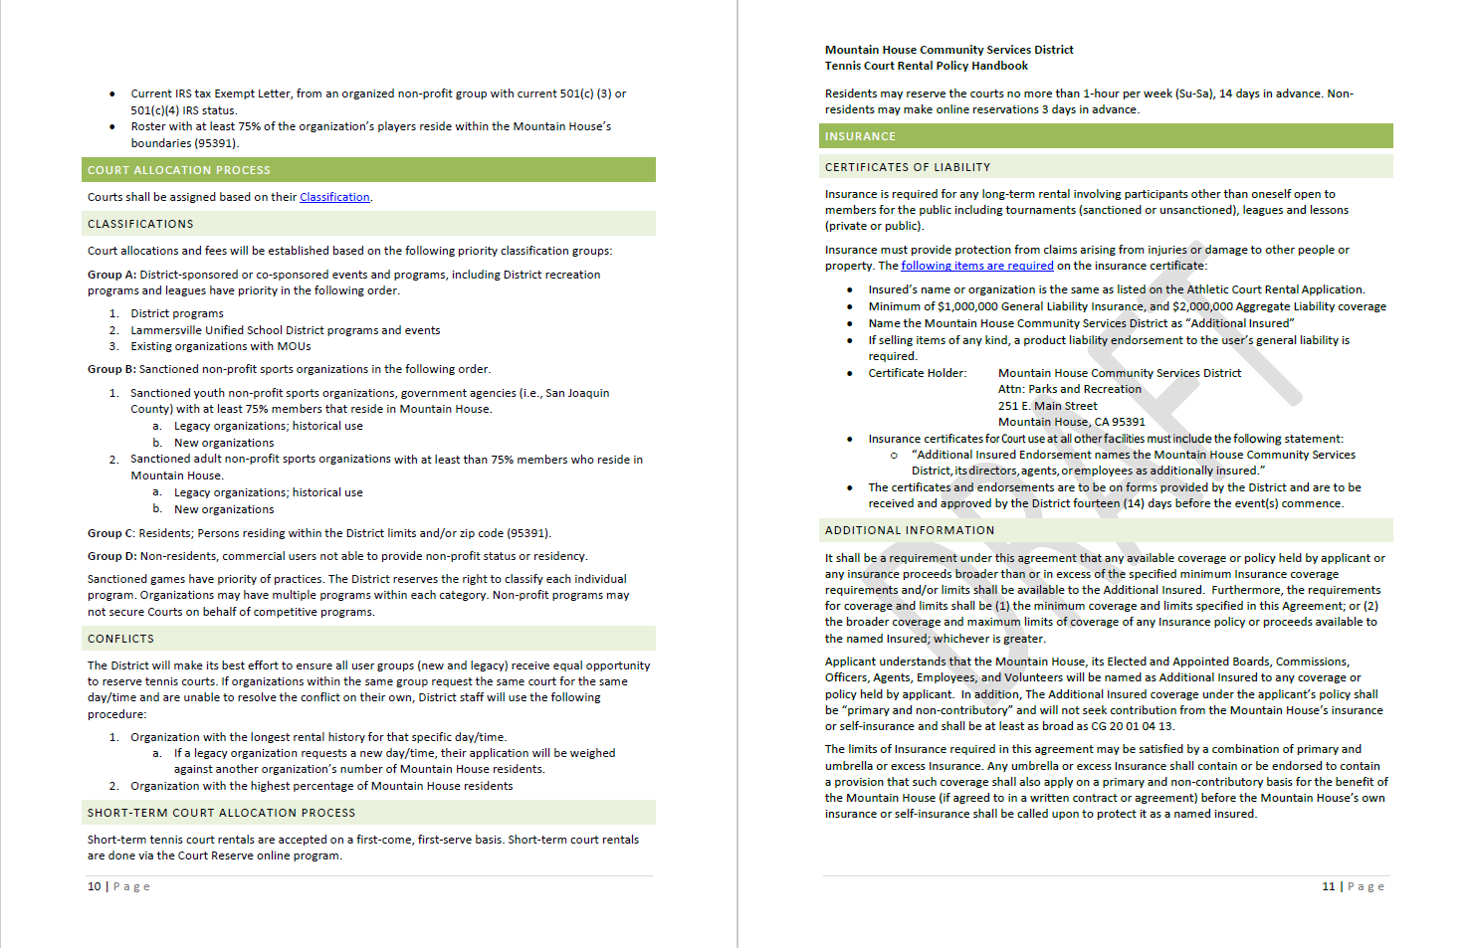
Similar classifications for the field users; prioritizes nonprofits, youth and organizations with 75% or more MH residents
Insurance is only required for groups submitting application for commercial use and long-term use

Slide 10
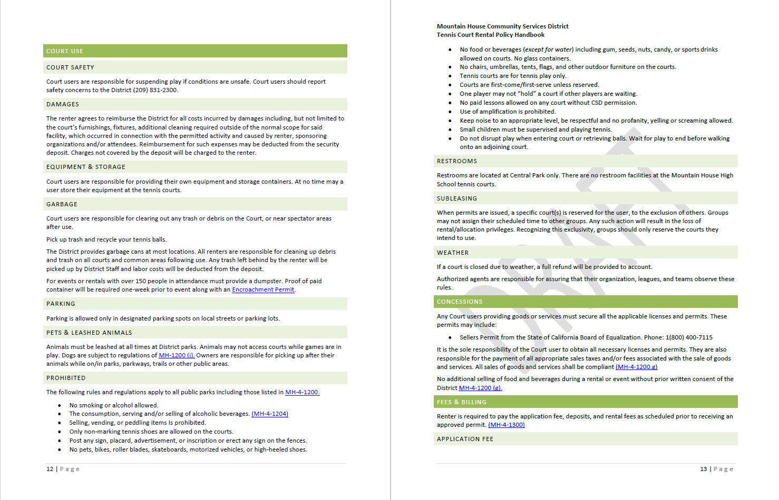
Same as previous policy, listed in current MUNI code or standard

Slide 11
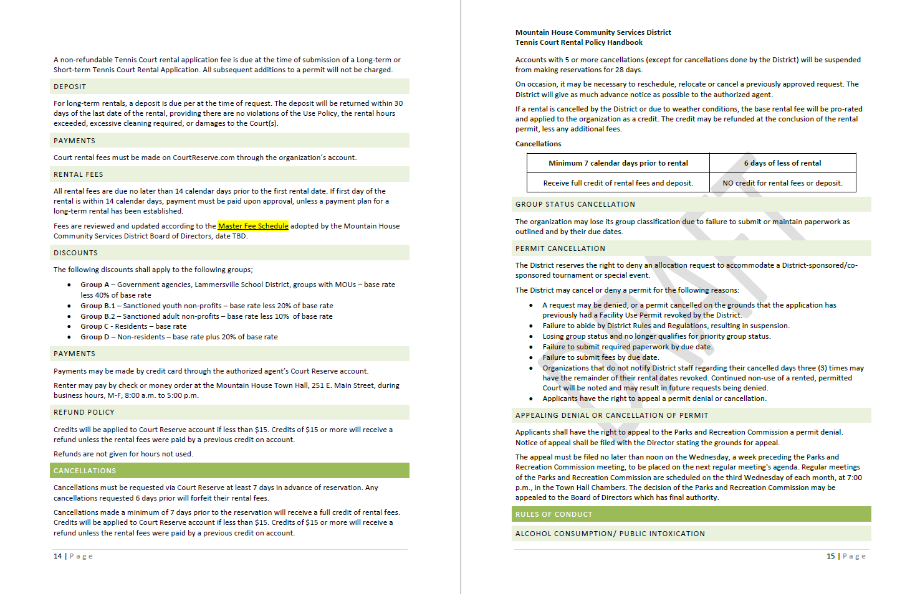
Cancellations made within 6 days are not allowed
Fees are not changing
Same discounts as represented in field rental policies
Denied or cancelled permits have right to appeal
Refunds under $15 per transaction will be applied as a credit to their court reserve accounting to reduce transaction fees charged to District by CourtReserve

Slide 12
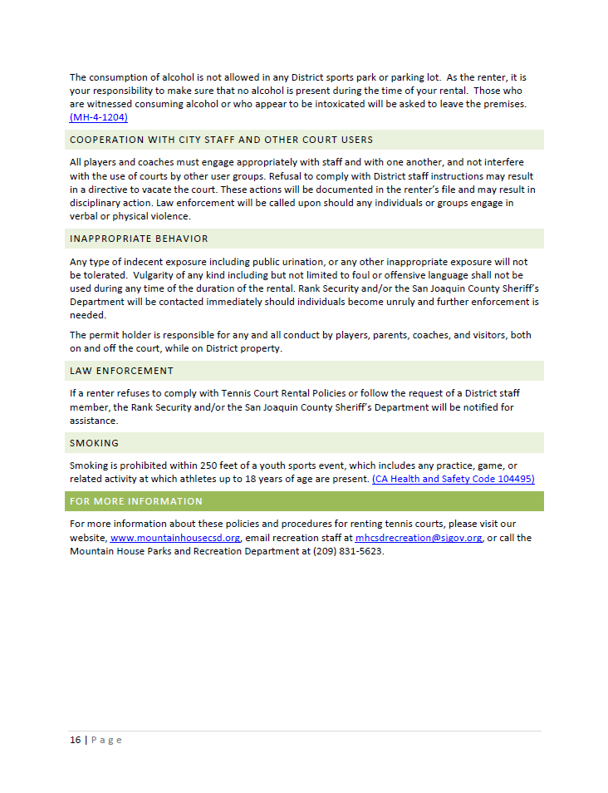

General Rules of Conduct

Slide 13
Questions to Ask
Do the policies make sense? Are they easy to understand?
Do they address the concerns of staff and public?
Do they meet the values of the Commission and Board?

Slide 14
Questions to Ask
Do they serve the diverse user groups in Mountain House and Provide Exceptional Parks?

Slide 15
Recommendation
Staff recommends that the Commission review and discuss the current Tennis Court Use Policy and make suggestions for implementation.
The Chair will ask if anyone has clarifying questions.
The Chair will open it to public comment for public and alternate Commissioners’ comments.
Confirm that the DRAFT copy includes policies that address;
  Opening up more court time
  Commercial users are limited to a single court and monthly hours to allow for more public use
  Private renters are booking courts, paying fees, submitting insurance
  Renters are not cancelling their rentals
  Long-term renters are able to book farther out
  Court 1 is designated for commercial use opening up other courts for public use
  Only 3 courts at MHHS are used for commercial use (less lessons), opening other courts for public use
  The Commission may incorporate community feedback.
  Comments and suggestions will be incorporated in the DRAFT for the next meeting.

Slide 16
Questions?

