Slide 1

Mountain House Community Services District
5.A. Approve Final Draft of the Athletic Field Rental Policies and Recommend to Board for Adoption
January 17, 2024

Slide 2
Recommendation
Staff recommends that the Mountain House Parks and Recreation Commission (Commission) approve the final draft of the Athletic Field Rental policies.

Slide 3
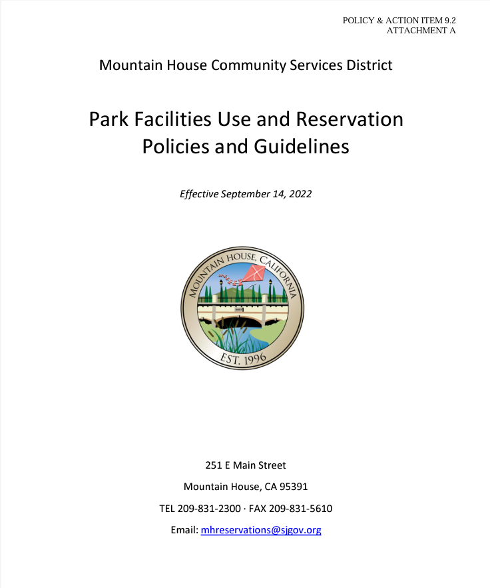
Previous Board Discussion
Staff presented the Commission with the current rental policies at their regular meeting on October 18, 2023.
Staff presented the Commission with a draft version of the “Athletic Field Rental Policy” at their regular meeting on November 15, 2023, that combines policies from the current policies and includes recommendation for updated policies.

Slide 4
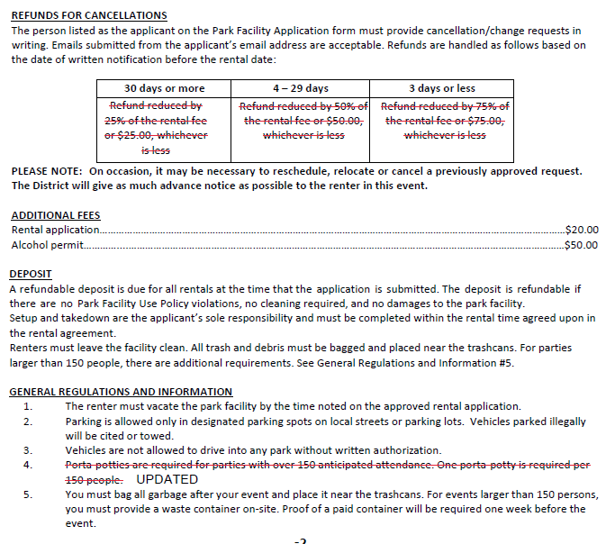
Current Policies
Staff have provided the Commission redlined copies of the current park and field policies.
The redlines indicate outdated or conflicting policies.
Some of the policies pertain to special events, tennis or picnic rentals, all of which will have their own respective rental policies.
Fees will not be changed and will be brought back after a Pricing Guideline Policy has been established and new fees are proposed.

Slide 5

Draft Policies
Staff has provided the Commission with a comprehensive draft that allows the renter to understand the rental process.
New and Updated topics include;
NEW Nonprofit Verification Process
Updated group classifications
NEW Field Allocation Process
Updated field use
NEW Concessions information
Updated fees and discounts
Updated rules of conduct

Slide 6
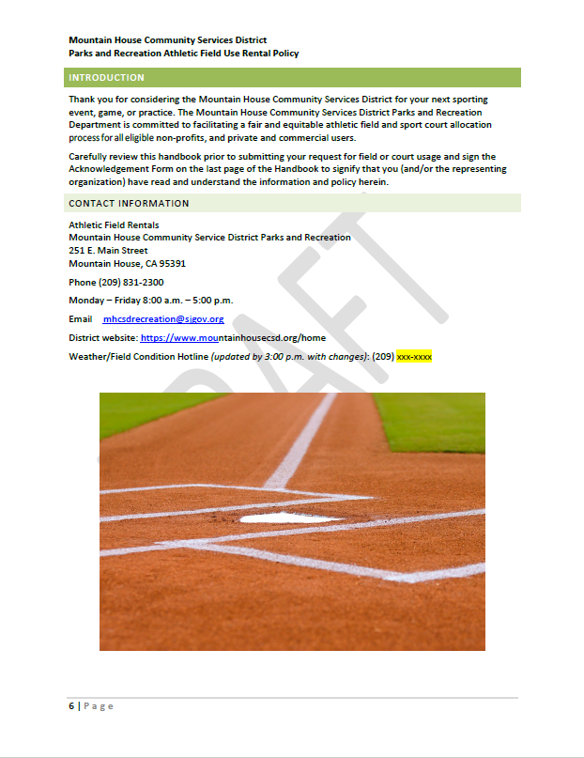
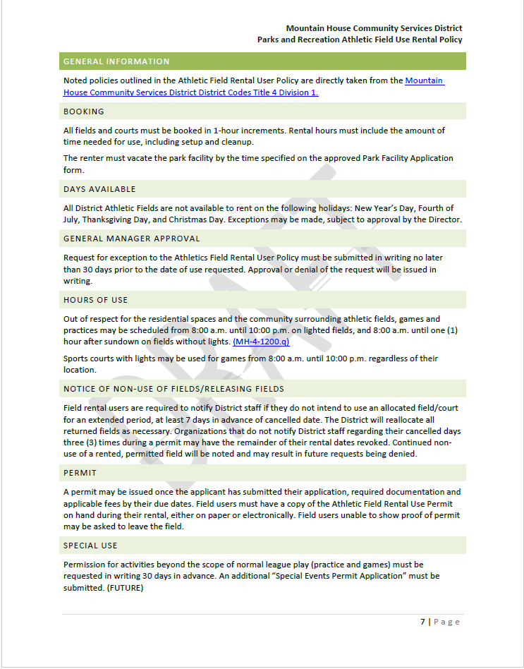
Adding a hotline or webpage will help ensure that renters aren’t on fields during bad weather
Staff will monitor

Slide 7
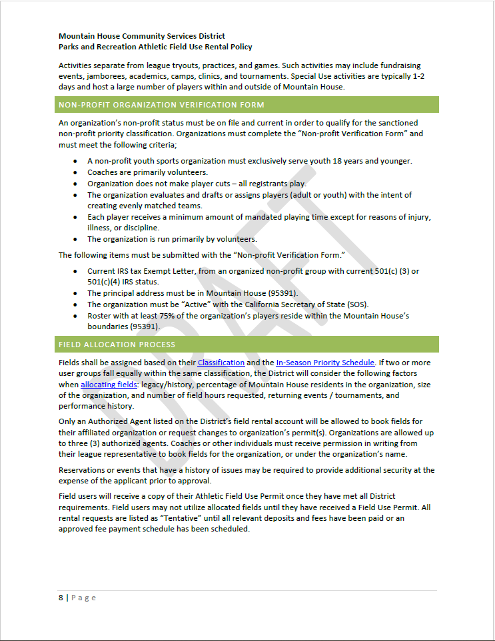
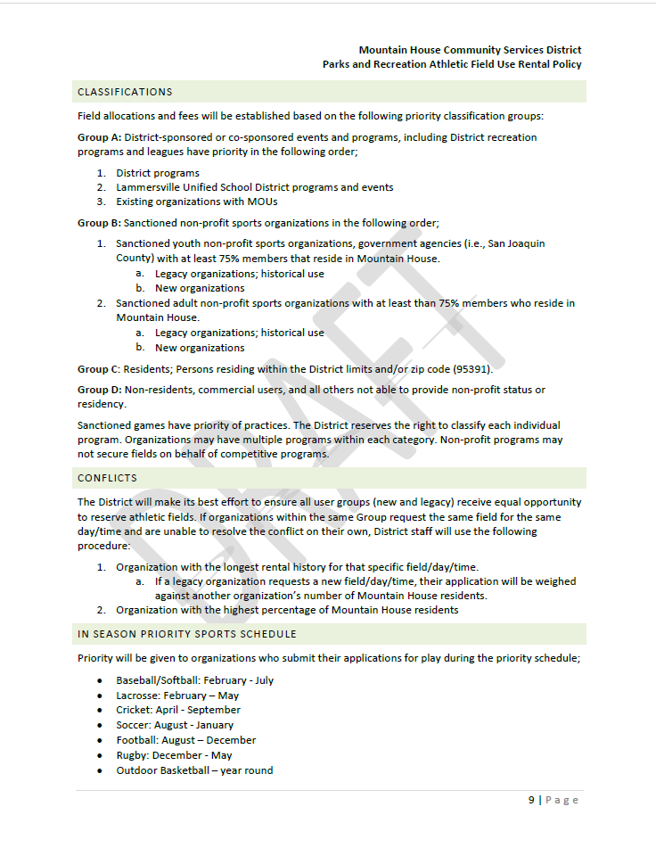
These classifications ensures that sanctioned groups are prioritized based on what the commission/board value
New process used to ensure that nonprofits are 1) nonprofits, 2) located in MH so they can receive discounted fees, 3) ensure that a percentage of its players are MH residents
The verifications will remain on file for a year
it also takes into account legacy organizations who have traditionally used the park/day/time but it also favors groups with the highest amount of MH residents

Slide 8
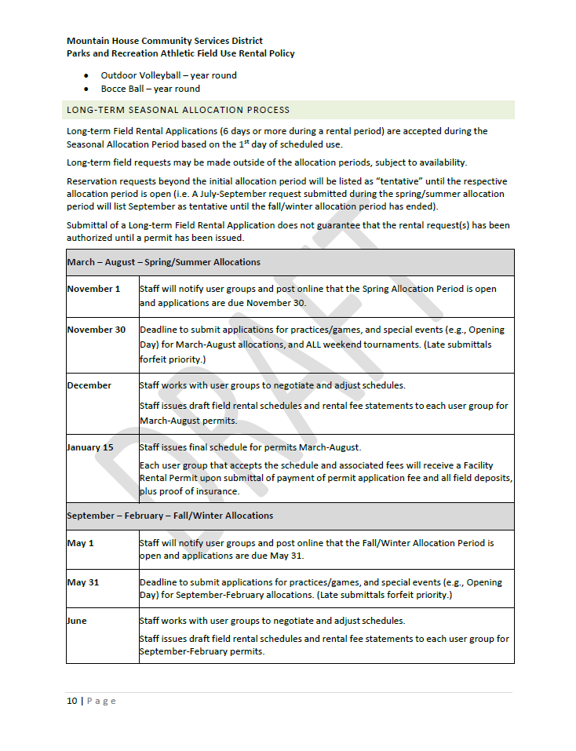
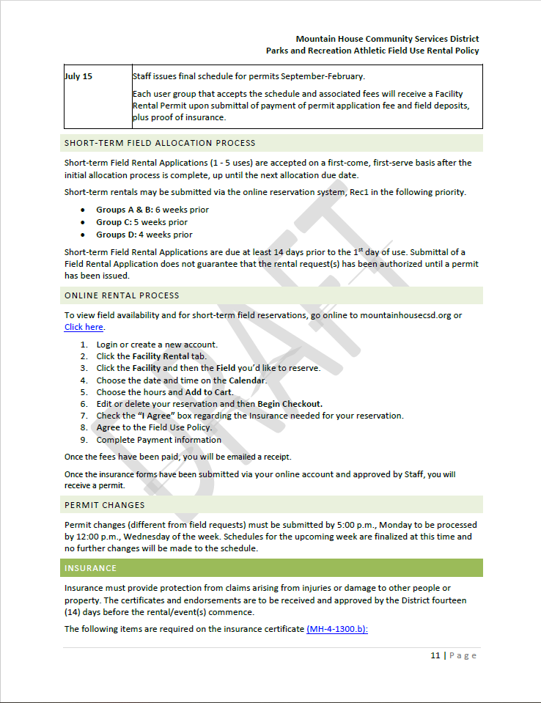
The seasonal allocation process allows the organizations the opportunity to apply at the same time. The applications will then be sorted by their classifications.
Short-term users are typically members of the public or individual coaches within sports organization who want extra field time. This system is open after the allocation calendar has been set.
Staff are working on creating online rental process
The 2 seasons align with sport user groups athletic seasons as close as possible. There may be some overlap

Slide 9
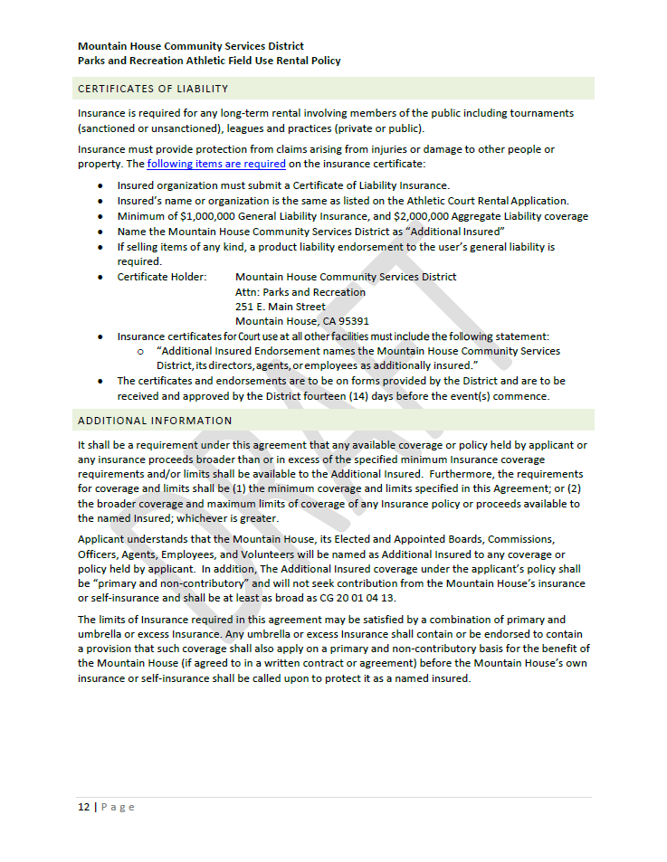
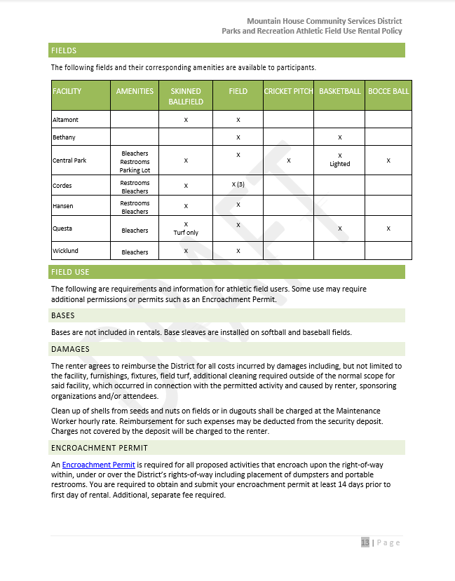
Added a “FIELD” category
Hyperlink to MUNI Code

Slide 10
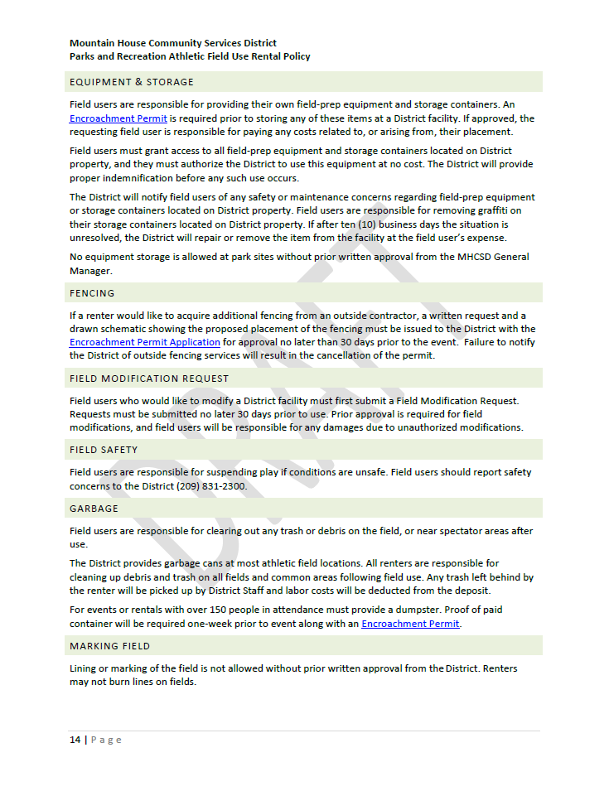
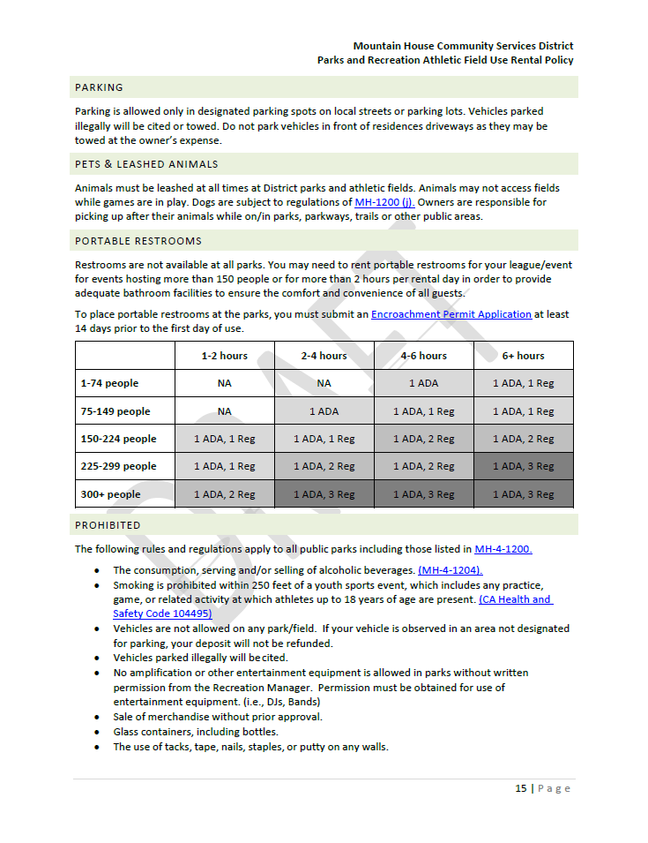
Groups need to have permission and have an encroachment permit. Encroachment permits are needed to ensure that public access isn’t blocked and that district infrastructure isn’t compromised
A dumpster may be required for sporting events that have 150 people or more. Staff will work with groups who are hosting tournaments, special events, jamborees
General standards for the benefit of the general public.

Slide 11
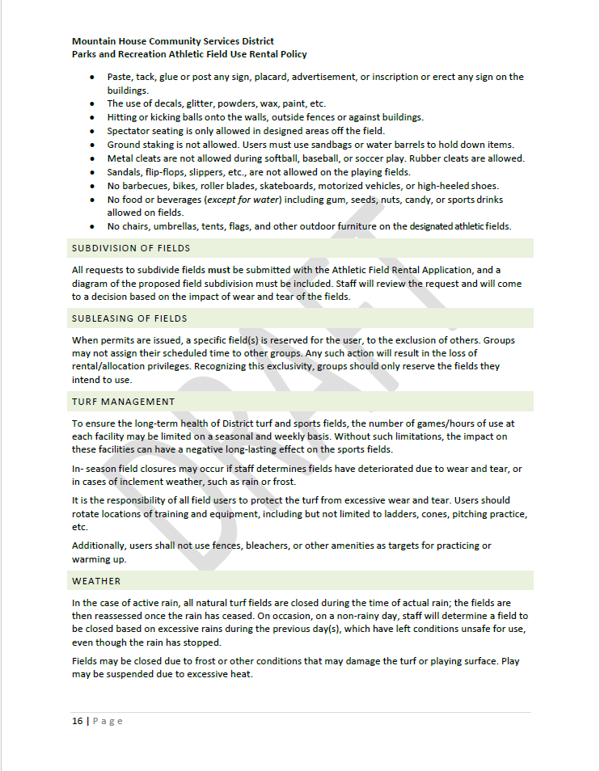
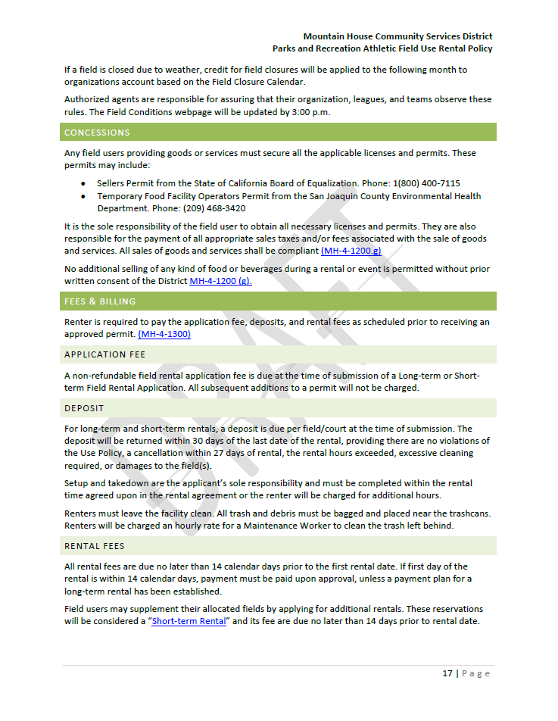
A sellers permit and food permit from the county ensures users aren’t selling items they shouldn't be and it ensures the sale of food is safe
It is recommended that field use be monitored to reduce the impact
Once an application has been received during the allocation process, the respective user will receive a bill for the application fee and field deposits before the allocation process is complete.

Slide 12
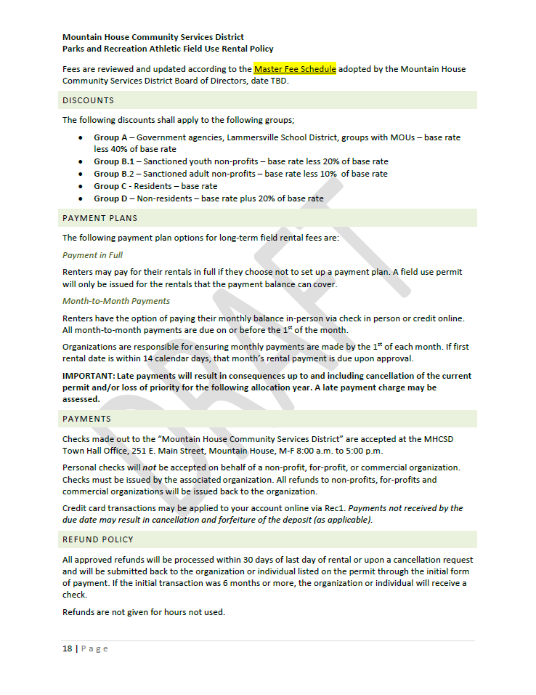
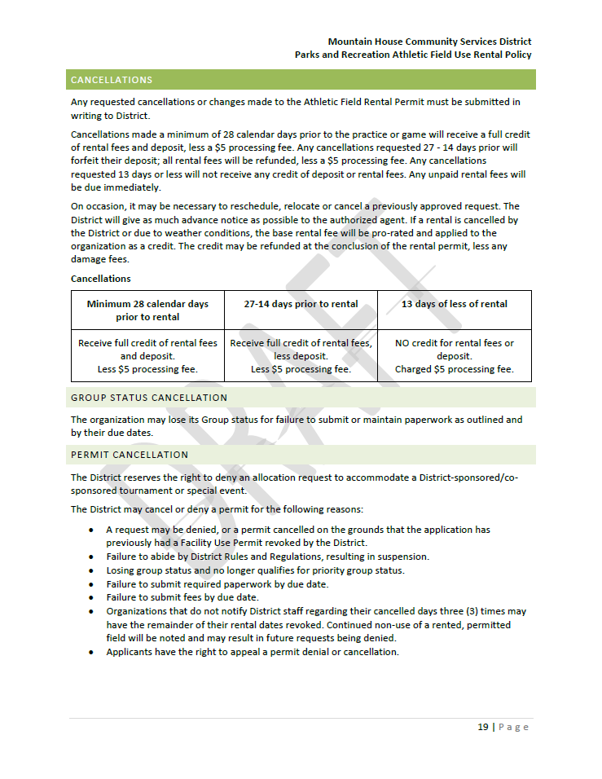
2-4 weeks prior require additional staff time and may be harder to reallocate a field
Once the application fee and deposit are paid, the users will be assigned a discount, and all user fees will be discounted based on their category.
There are several discounts with several additional factors. The proposed discounts break it down by group and ensures that residents pay the base fee, nonresidents pay more and sanctioned groups receive fair discounts.
The current discounts are
Current Park Facilities (fields)
residents 50%
Current Fields and Facilities Use Fields Commercial 25%
Private use 65%
Public use 75%
School district 80%
Nonprofits 40-80% based on # of residents
2 weeks prior, staff retain fees
28 days allows adequate time to reassign field
These payment plan options allow the long-term renter the option to pay all at once at the beginning of the rental period or be set up to pay monthly relieving the financial burden for groups who may only collect fees from participants monthly

Slide 13
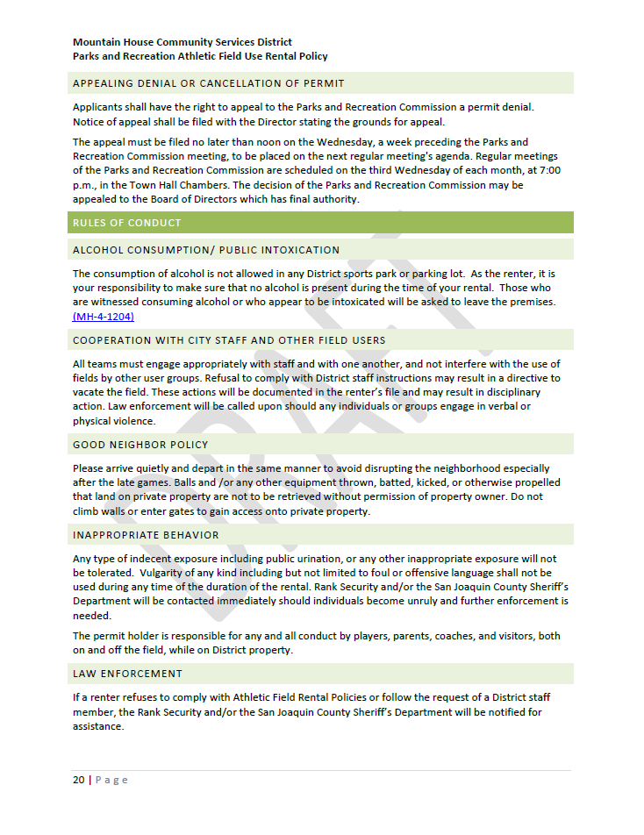
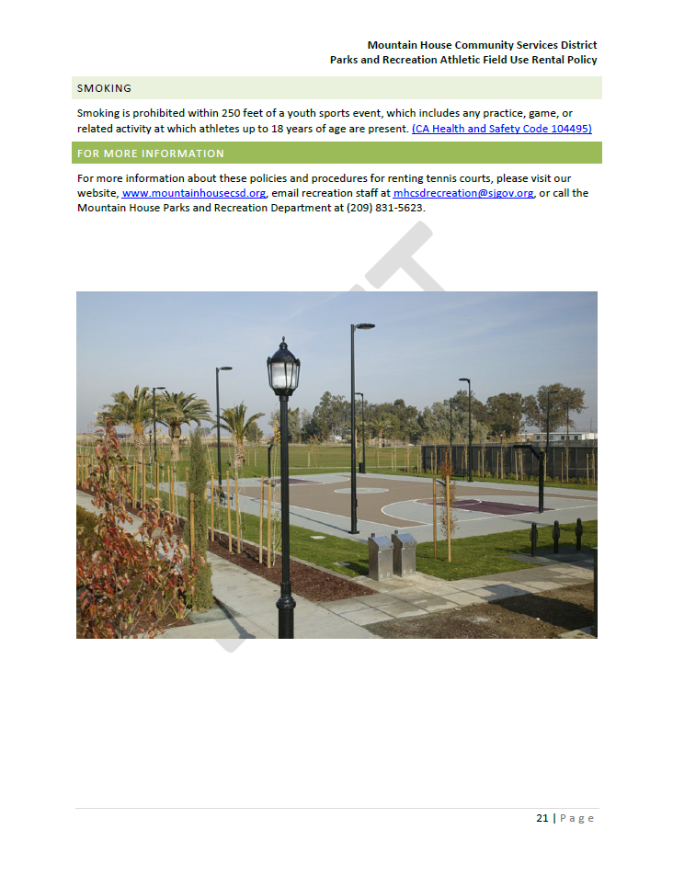
Process would be to bring forth to the commission to review why a permit was denied or cancelled. Commission may not override a policy, so it would be taken to Board for approval

Slide 14
Questions to Ask
Do the policies make sense? Are they easy to understand?
Are they fair and equitable for all types of user groups?
Do they meet the values of the Commission and Board?

Slide 15
Questions to Ask
Do they serve the diverse user groups in Mountain House and Provide Exceptional Parks?

Slide 16
Recommendation
Staff recommends that the Commission approve the final draft and recommend to Board for adoption.
The Chair will ask if anyone has clarifying questions.
The Chair will open it to public comment for public and alternate Commissioners’ comments.
  If the final draft is not approved at tonight’s meeting, staff will take tonight’s comments and suggestions and provide an updated draft at February’s regular meeting.
  Or Commission may create a subcommittee to work with staff to create a final draft to be presented at February’s regular meeting.

Slide 17
Questions?

Slide 18
Mountain House Community Services District
5.A. Approve Final Draft of the Athletic Field Rental Policies and Recommend to Board for Adoption
January 17, 2024

Slide 19
Recommendation
Staff recommends that the Mountain House Parks and Recreation Commission (Commission) review and discuss the draft version of the Tennis Court Rental Policy and make recommendations for changes.

Slide 20
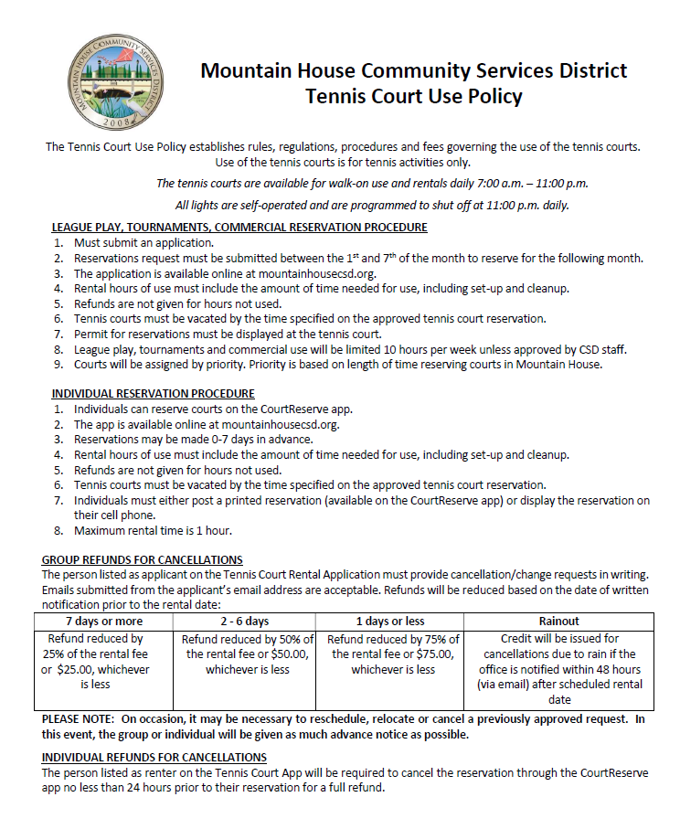
Discussion
The Board adopted the current Tennis Court Use Policy on June 10, 2020.
In order to address the growing tennis program in Mountain House and to prepare for the addition of a Tennis facility at Central Park as part of Phase 2, it’s necessary to update the Tennis Court Rental Policies.

Slide 21
Discussion
The tennis program has grown substantially since June 2020
  50% increase in court utilization 5-8pm
  Increase of 74% between 8-9pm
  Increase of 9.5% in morning and mid-day utilizations
Reservations have increased 84% from 2021-2022
Reservations have increased 10% from 2022-2023

Slide 22
Discussion
The increase in reservations and court utilization demonstrate the popularity of tennis in Mountain House.
Several issues have either been observed by staff or have been shared with staff by members of the Board and tennis community.
  Not enough courts
  Commercial users (lessons, leagues, tournaments) were taking up court time during peak hours, prohibiting public use
  Private renters are using their reservations for commercial use (no oversight)
  Renters are cancelling their rentals too close to their rental date, not giving the public enough time to rent
  Renters are creating aliases and booking courts multiple times per day
  Long-term renters are not going through formal rental process
  Courts 1 and 2 are often being used by commercial users at the same times
  All of the courts at the high school are booked for tournaments

Slide 23
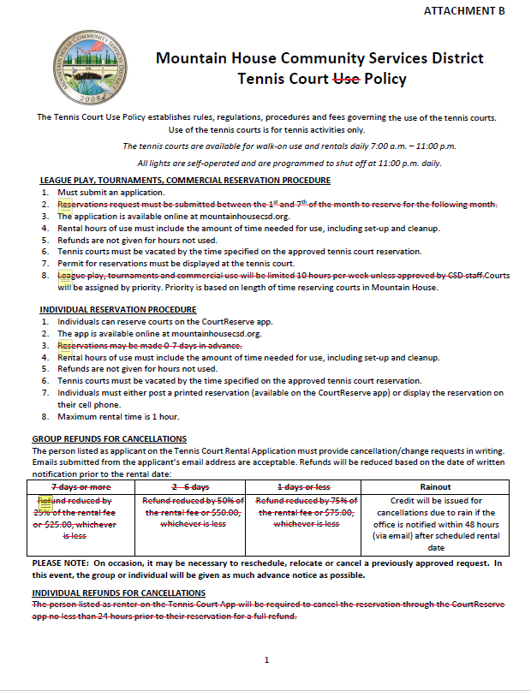
Current Policies
Staff have provided the Commission redlined copies of the current Tennis Court Use Policy.
The redlines indicate outdated or improved policies.
Fees will not be changed and will be brought back after a Pricing Guideline Policy has been established and new fees are proposed.
#2: Long-term reservations should be made 28 days in advance of first day of reservation period, but reservations can be made 3 months in advance to reduce staff time managing
#8: based on historical use, the time should be set to per day and per month; recommend no more than 5 hours per day during “peak hours” and no more than 30 hours per month; commercial users are renting courts 30-36 hours per week
Cancellations will only be allowed up to 7 days before otherwise they’d lose their fees. The court may stay “reserved” but if it’s empty, the public can use on a first-come basis. But because rental fees are only $3, the amount will stay as a credit for a future use
#3: for individuals, they can book up to 14 days in advance to allow the public more flexibility but they can only rent 1 hour per week

Slide 24
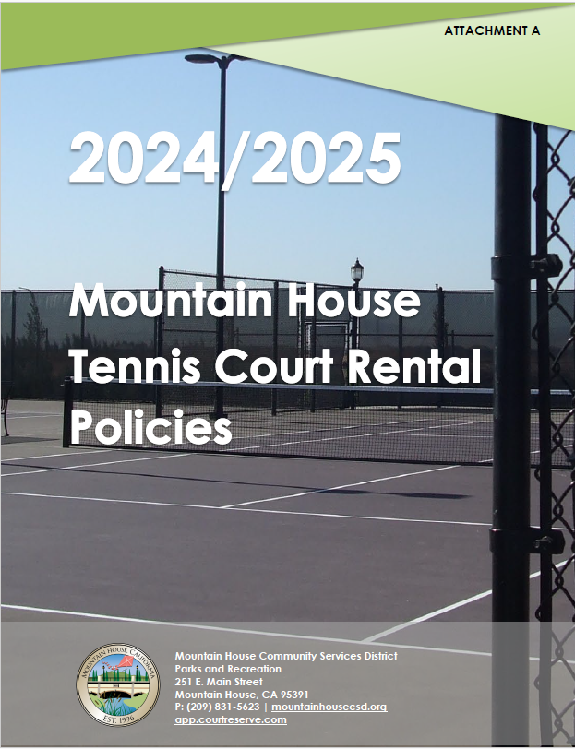
Draft Policies
Staff has provided the Commission with a comprehensive draft that allows the renter to understand the rental process.
New and Updated topics include;
NEW Definitions
NEW Nonprofit Verification Process
UPDATED booking deadlines
NEW #1 Court allocation for commercial users
NEW Classifications of users
NEW discounts based on Classifications
UPDATED cancellation policy
NEW appeal process

Slide 25
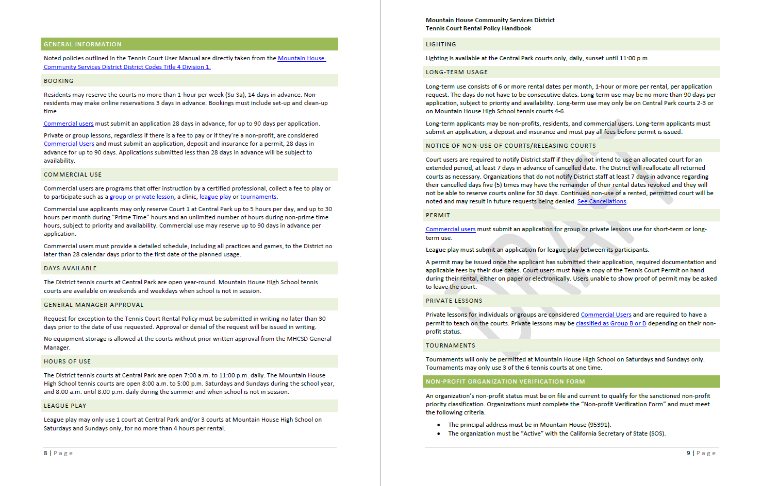
This new policy would allow a private user the option to pre-book their courts, but then they’d have to apply like the other groups and submit deposit, application fee and insurance
Policy updated to allow renters the option to book 2 weeks out, 1 hour per week
Commercial users are allowed to rent 28 days in advance for up to 90 days to allow to ensure their long-term programs and reduce staff time to manage
Commercial User is better defined as ANY program that collects a fee, regardless if they are a nonprofit or youth program.
NEW: to address public concern the courts are always booked by commercial users, this policy would limit all commercial use to court 1. MHHS does not allow commercial use.
This may help prohibit cancellations as they will be marked on their accounts
Anytime a lesson is on the court wherein the instructor is being paid is considered a “Private Lessons” and must apply. This may be harder to monitor
This allows for half of the open courts at MHHS be open for public

Slide 26
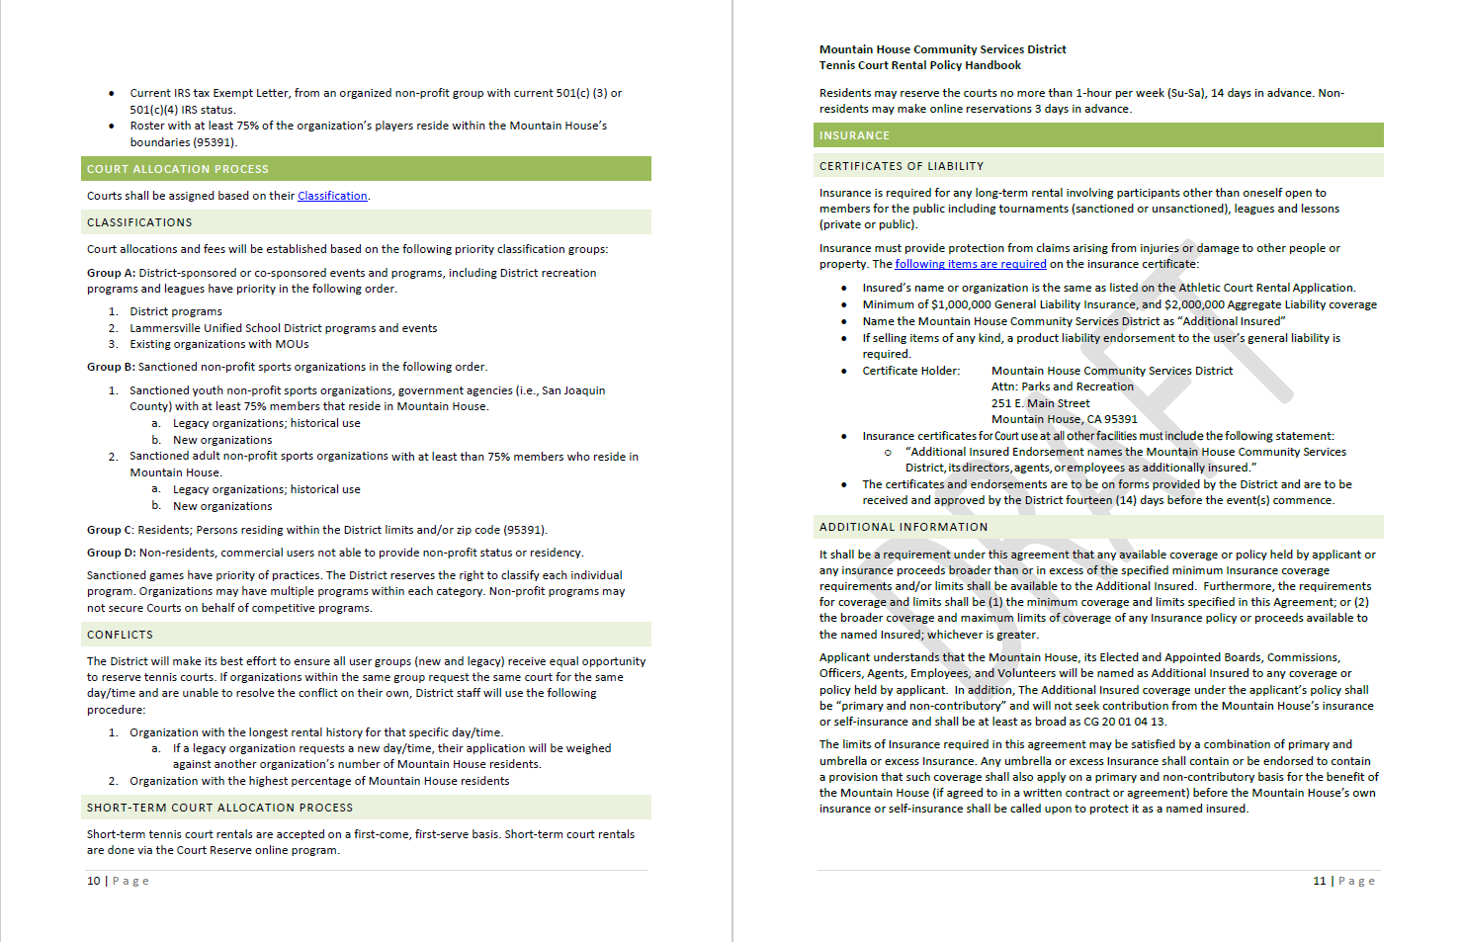
Similar classifications for the field users; prioritizes nonprofits, youth and organizations with 75% or more MH residents
Insurance is only required for groups submitting application for commercial use and long-term use

Slide 27
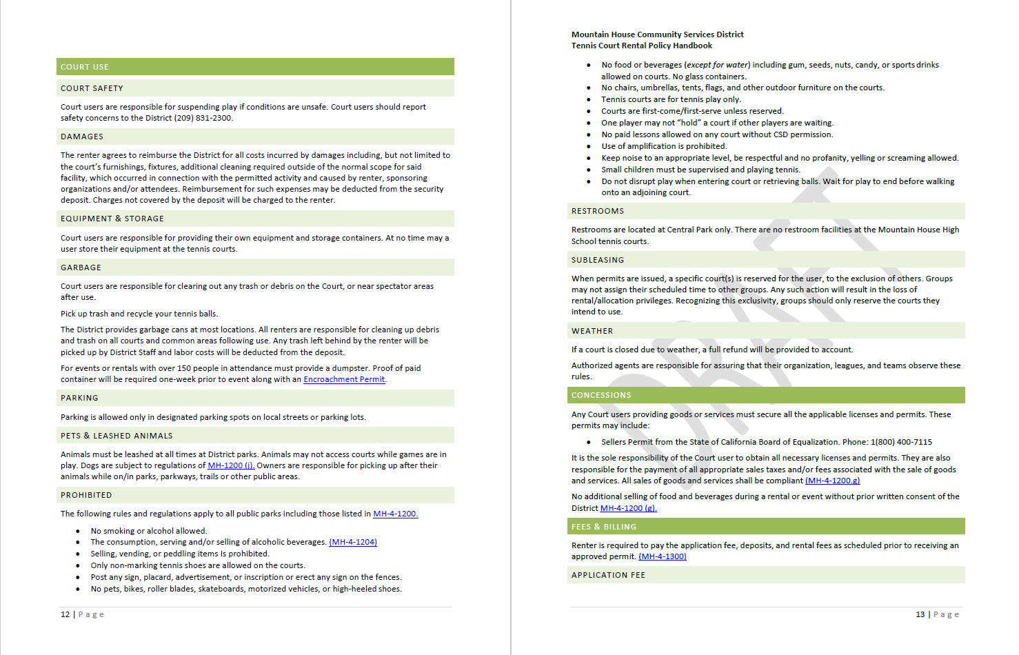
Same as previous policy, listed in current MUNI code or standard

Slide 28
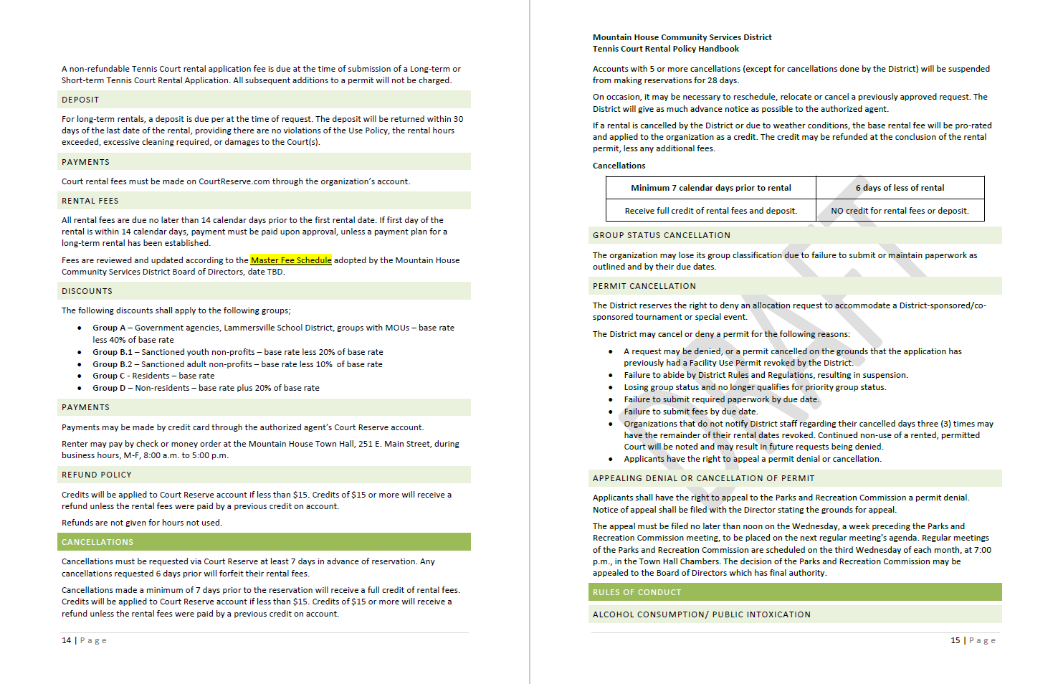
Cancellations made within 6 days are not allowed
Fees are not changing
Same discounts as represented in field rental policies
Denied or cancelled permits have right to appeal
Refunds under $15 per transaction will be applied as a credit to their court reserve accounting to reduce transaction fees charged to District by CourtReserve

Slide 29
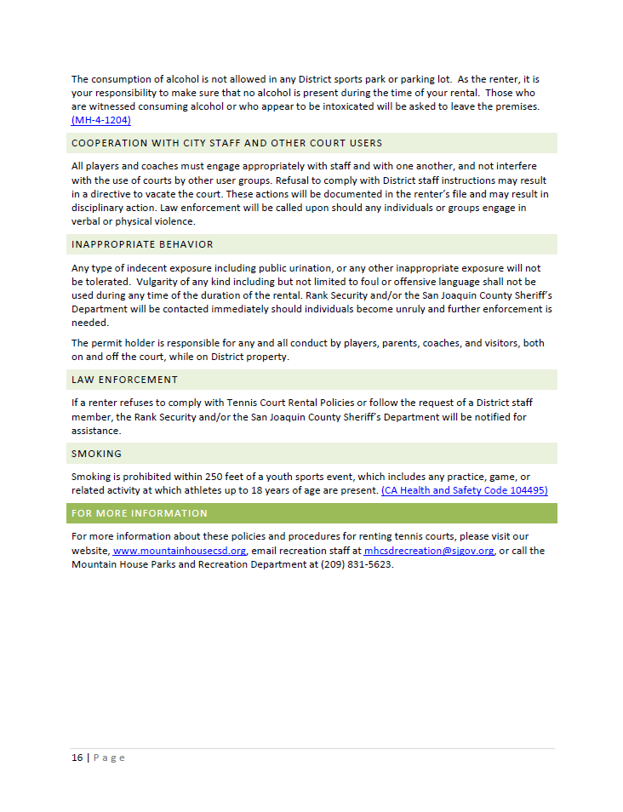

General Rules of Conduct

Slide 30
Questions to Ask
Do the policies make sense? Are they easy to understand?
Do they address the concerns of staff and public?
Do they meet the values of the Commission and Board?

Slide 31
Questions to Ask
Do they serve the diverse user groups in Mountain House and Provide Exceptional Parks?

Slide 32
Recommendation
Staff recommends that the Commission review and discuss the current Tennis Court Use Policy and make suggestions for implementation.
The Chair will ask if anyone has clarifying questions.
The Chair will open it to public comment for public and alternate Commissioners’ comments.
Confirm that the DRAFT copy includes policies that address;
  Opening up more court time
  Commercial users are limited to a single court and monthly hours to allow for more public use
  Private renters are booking courts, paying fees, submitting insurance
  Renters are not cancelling their rentals
  Long-term renters are able to book farther out
  Court 1 is designated for commercial use opening up other courts for public use
  Only 3 courts at MHHS are used for commercial use (less lessons), opening other courts for public use
  The Commission may incorporate community feedback.
  Comments and suggestions will be incorporated in the DRAFT for the next meeting.

Slide 33
Questions?

Slide 34
Mountain House Community Services District
6.B. Review and Discuss New Program Ideas
January 17, 2024

Slide 35
Recommendation
Staff recommends that the Mountain House Parks and Recreation Commission (Commission) review the current recreation programs offered by the District and discuss ideas for new programming.

Slide 36
Discussion
At the regular meeting on December 20, 2023, several Commissioners requested to discuss new program ideas.
Programs may be considered educational, recreational, celebratory.
Education and recreation classes are typically taught by highly skilled instructors in their respective fields.
Staff are developing a “Contract Instructor Handbook” with polices and processes to become an instructor for the District.
Other popular programs in MH include musical, religious and cultural events, and library programs.

Slide 37



Current Trends in Recreation
Pickleball (seniors, all)
Sports Lessons (youth)
Art (adult and youth)
LEGOs (building)
Engineering and Coding (youth)
Themed Camps (youth, summer)
STEM/STEAM Programs (youth)
Fitness (adult, dance, yoga, cross-training)
Movies in the Park (summer 2024)
Active Senior Programs (younger Baby Boomers, older Gen X)

Slide 38
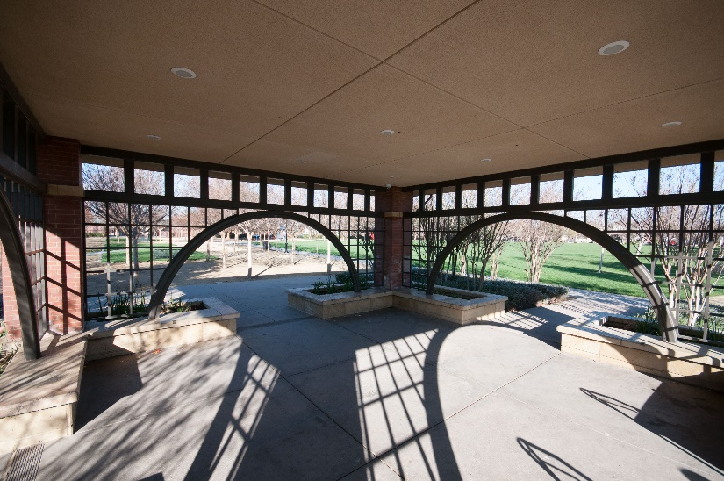
Available Facilities
7 parks
  Fields, picnic areas, sports courts
Unity Center
  Large hall with outdoor areas, tables, chairs
Firehouse Community Room
  Small classroom for up to 48; tables, chairs
Town Hall’s TH-1 Room
  Large classroom with tables, chairs, projector

Slide 39
Considerations
Commissioners should consider the following;
  Community needs
  Public input
  Available budget
  Available facilities
  Staff management

Slide 40
Recommendation
Staff recommends that the Commission;
  Share ideas on how to interact with the public
  Invite the public to a future meeting; regular or special meeting
  Participate in upcoming District-sponsored Special Events
  Survey your respective communities, share at future meeting

Slide 41
Questions?

Slide 42

Future Agenda Items?
Goals and Objectives
Reveiw Park Amenities
Park Naming Policy
Rental Policies
  Park and Picnic Rental Policies
  Indoor Facility Rental Policies
  Special Event Policies - NEW
Pricing Policy and Guidelines - NEW
  Parks and Rec Fees
  Sponsorship Policy
Recreation Classes
  Instructor handbook/contract - NEW
  Spring Classes, Summer Camps
  Senior Programming at the Firehouse

