Slide 1

Mountain House Community Services District
Transportation Committee
September 21, 2022

Slide 2
Discussion Topics
Project Management Program (PMP)
Project updates
Future projects
Future updates

Slide 3
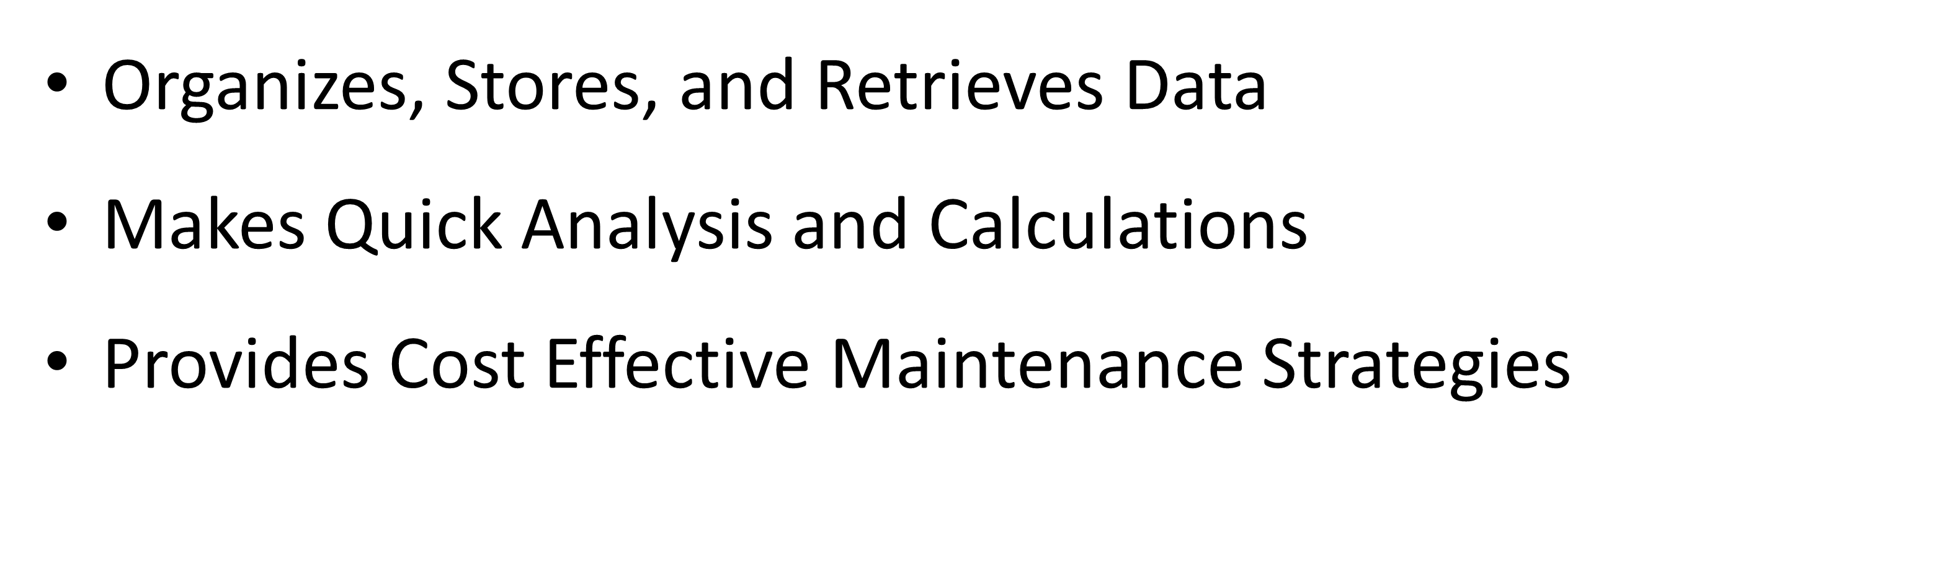
What is Pavement Management Program (PMP) ?
Pavement Management Program (PMP) is:
“Computer Assisted Method of Organizing and Analyzing Information about Pavement Conditions”

Slide 4
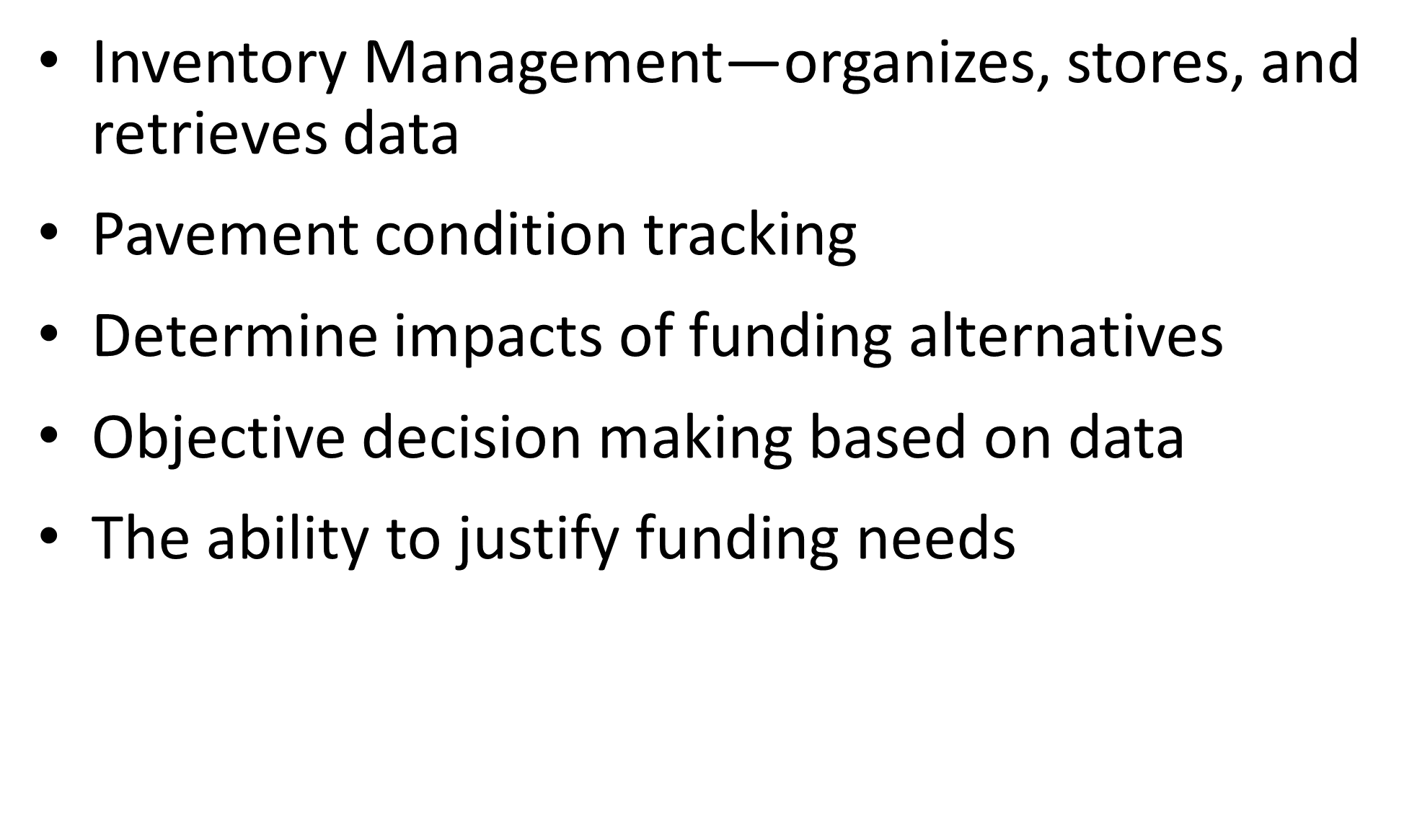
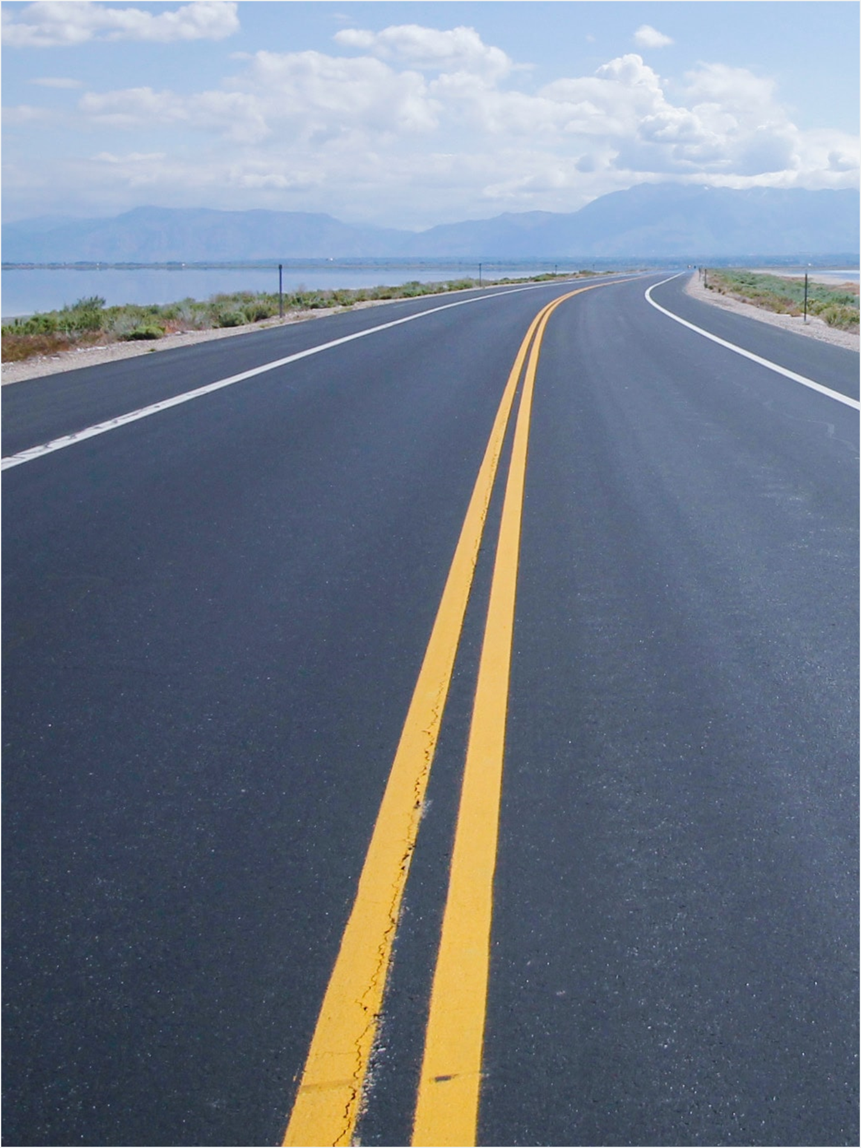
Why PMP (StreetSaver) Needed?

Slide 5
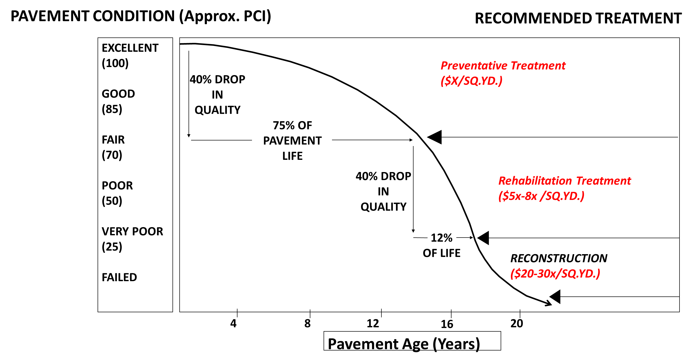

Why PMP?
More Cost-Effective to Treat Before Steep Decline

Slide 6
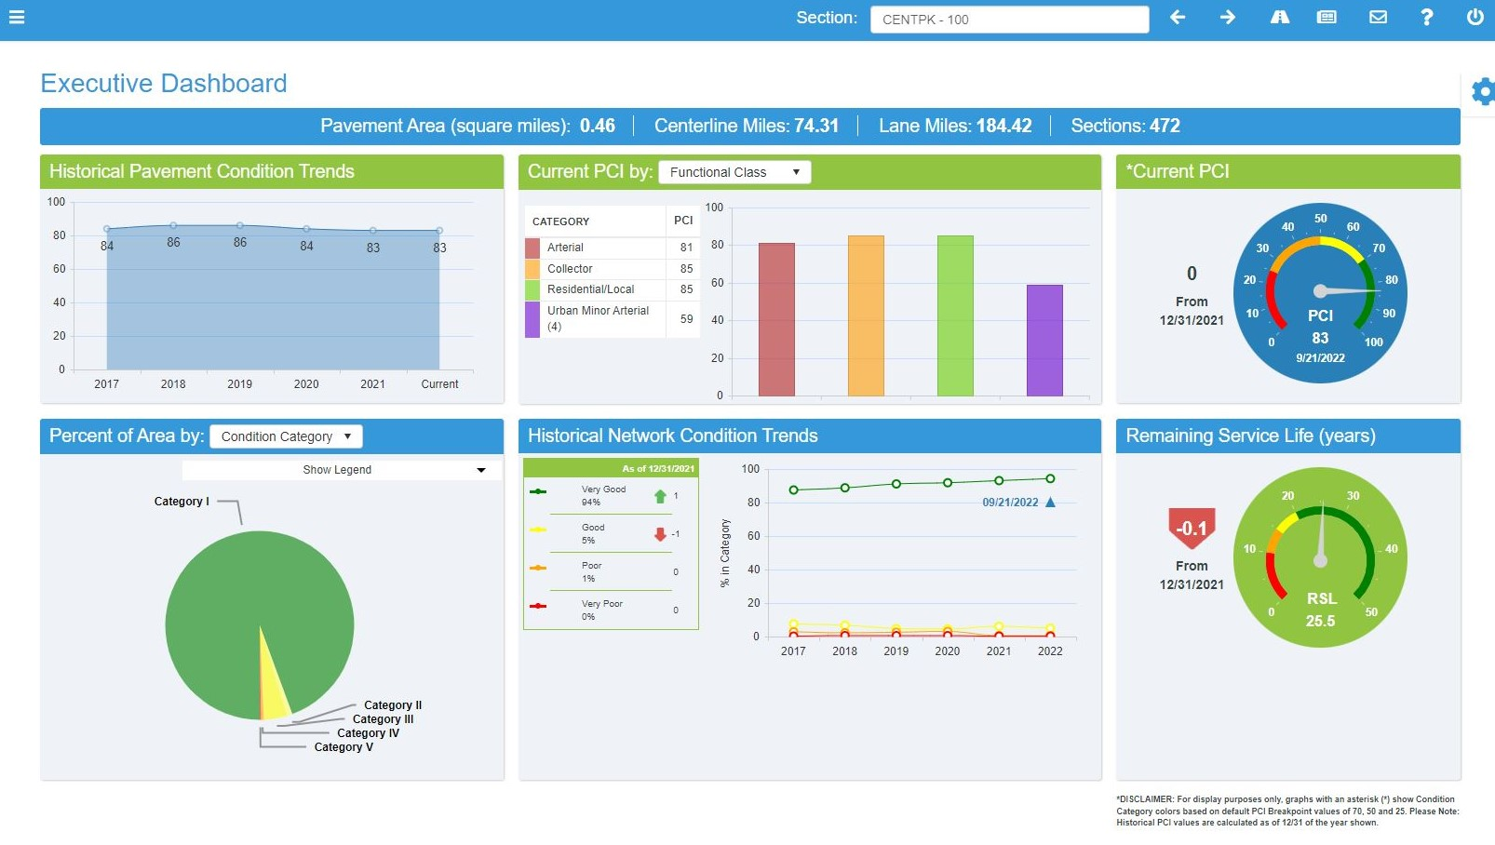
StreetSaver – Monthly Report (Current)

Slide 7
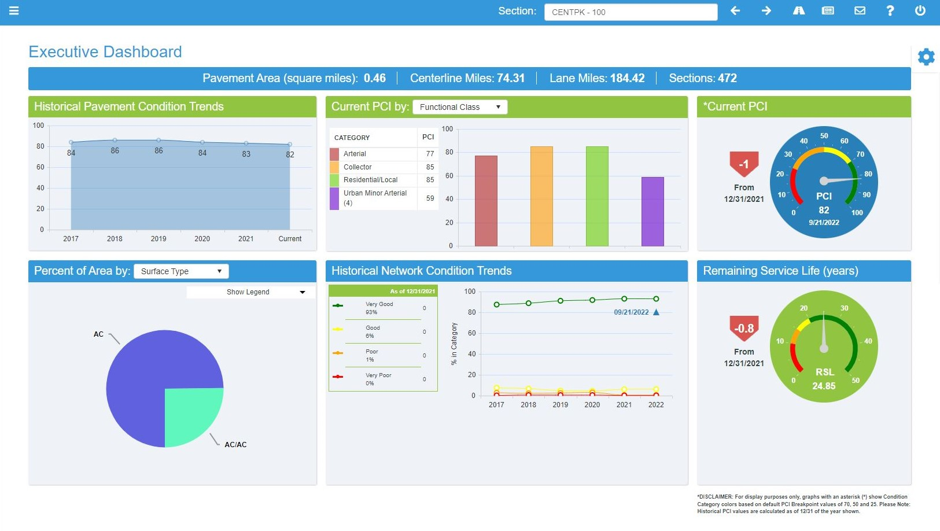
StreetSaver – Monthly Report (Previous)

Slide 8
Pavement Condition in Mountain House

Slide 9
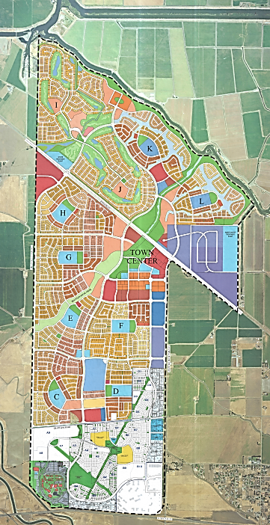
Project Updates
Public Works Project Updates
  Mountain House Arterials and Questa Village Repairs (Completed)
  Railroad Crossing and Streets Signing and Striping (Completed)
Public Works Future Projects
  Traffic Signal Synchronization
  Installing Fiber optic Lines
  Byron Road & Wicklund Village Road Repairs
Request For Future Project
  Sign and striping on Central Parkway at Legacy and Heritage
  Sign and Striping update at Comunidad and Recreo, Shields and Fremont
Mountain House Map

Slide 10
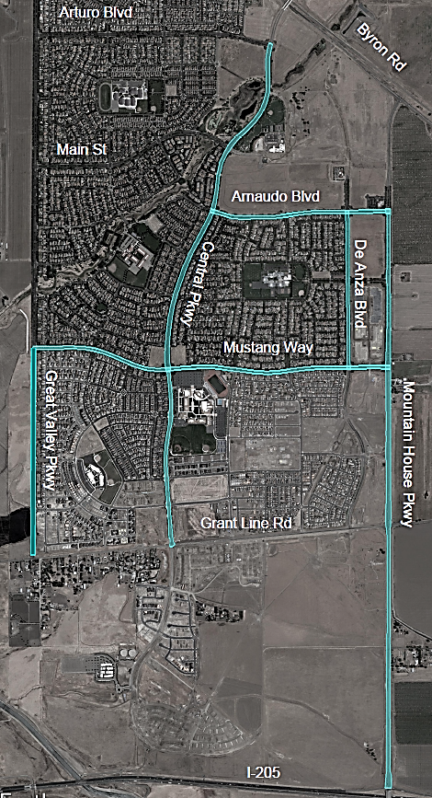
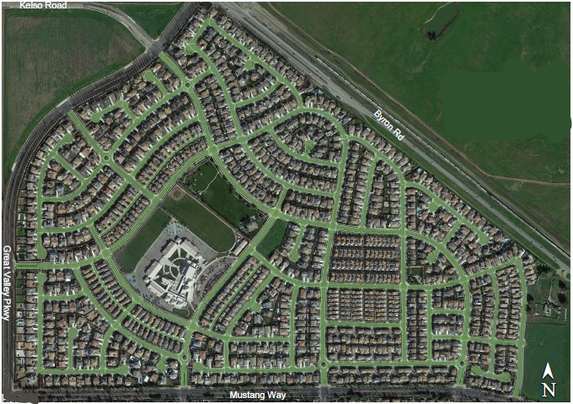
Arterials and Questa Village Repairs
Project Locations:
  Slurry Seal: Great Valley Pkwy, Central Pkwy., De Anza Blvd., Mountain House Pkwy., and Mustang Way
  Crack Seal: Arnaudo Blvd, Great Valley Pkwy, Central Pkwy., De Anza Blvd., Mountain House Pkwy., Mustang Way, and Questa Village
  AC Patching: Arnaudo Blvd, Central Pkwy., De Anza Blvd., Escuela Dr., and Mustang Way
Completion Date:
  Construction is In Progress
Bid Amount:
  $678,660
  Finished Cost: $678,231

Slide 11
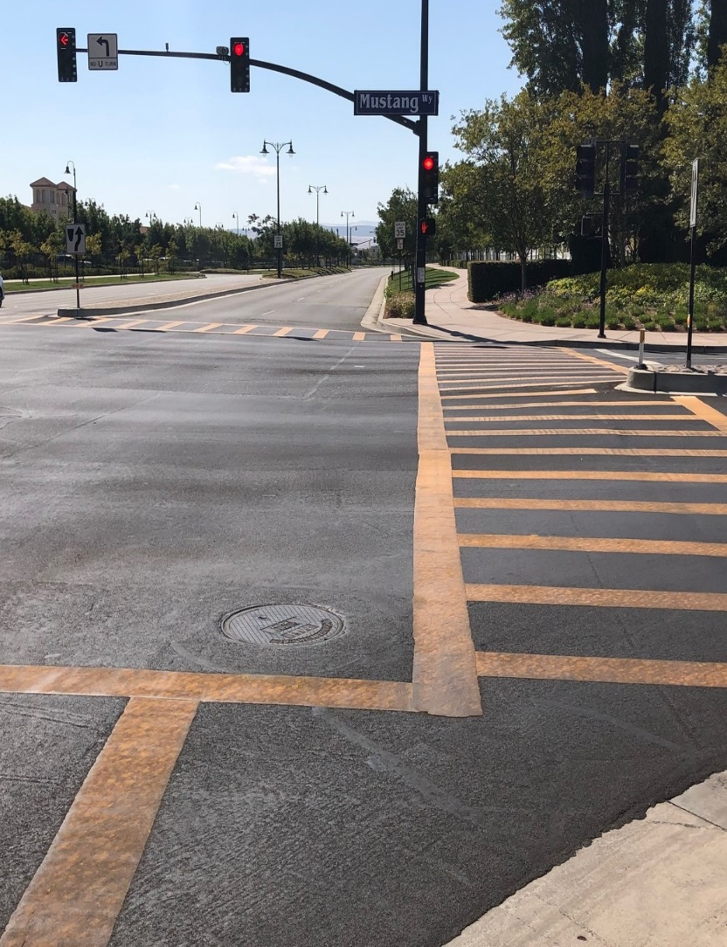
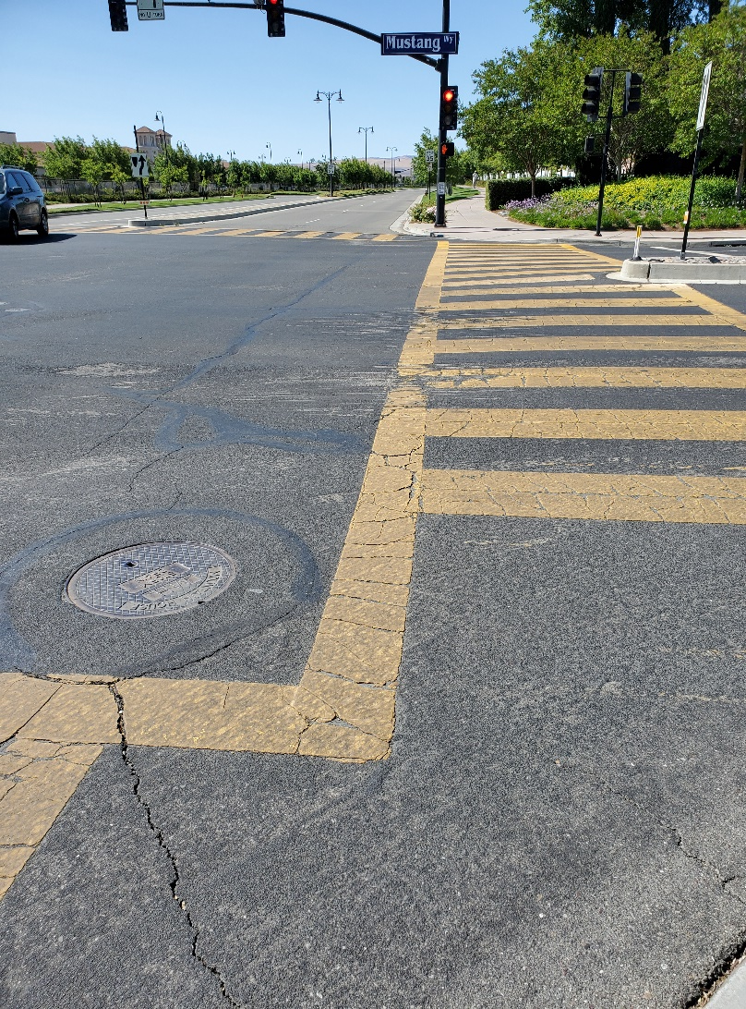
Questa Village and Arterials Repairs
Central PKWY and at Mustang Way (before)
Central PKWY and at Mustang Way (after)

Slide 12
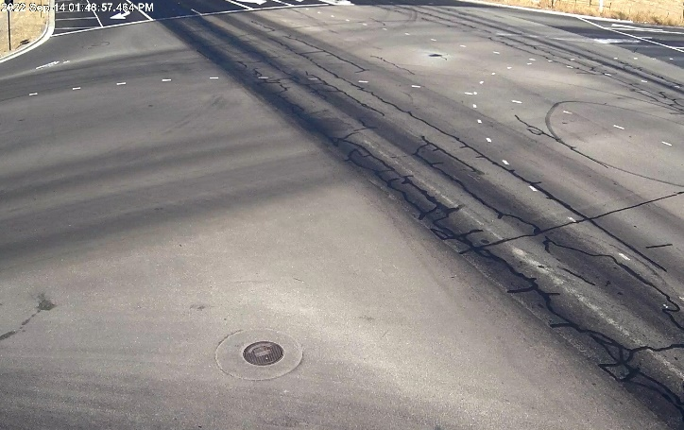
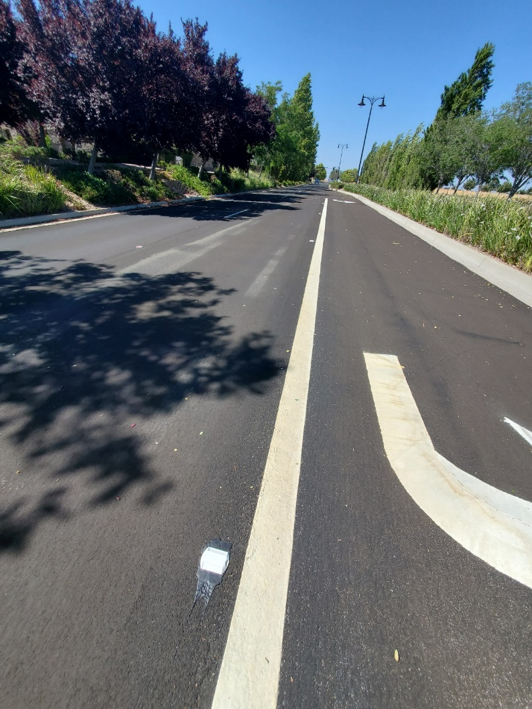
Questa Village and Arterials Repairs
Crack Seal – Mountain House Parkway
Slurry Seal and Striping – De Anza Blvd.

Slide 13
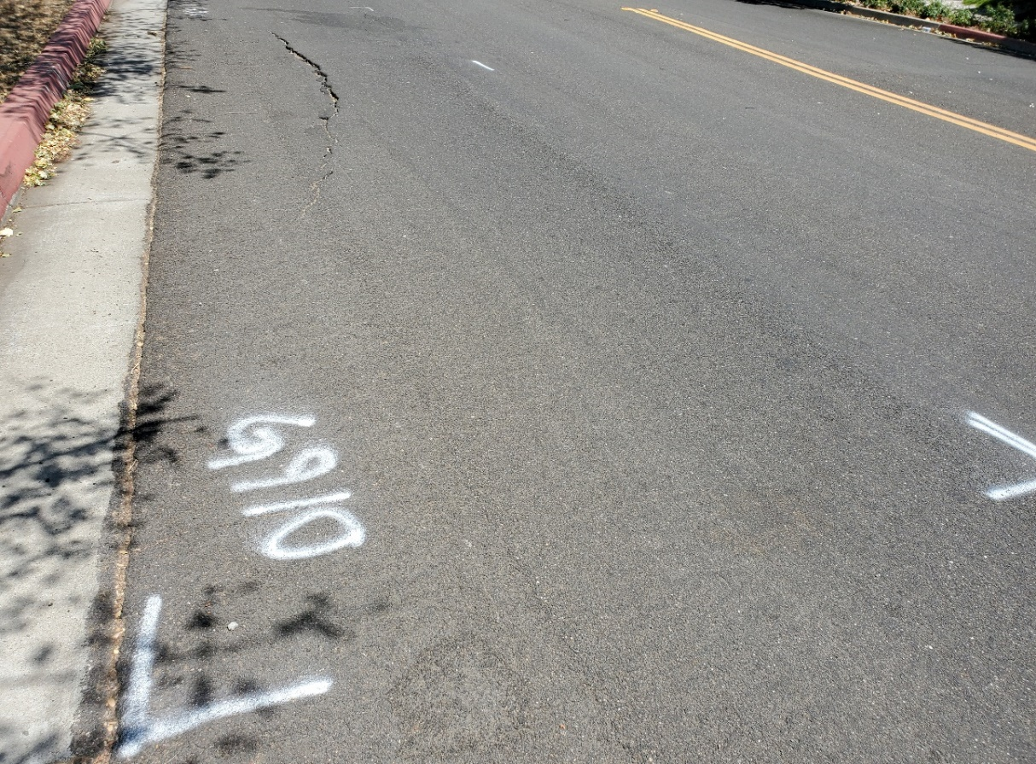
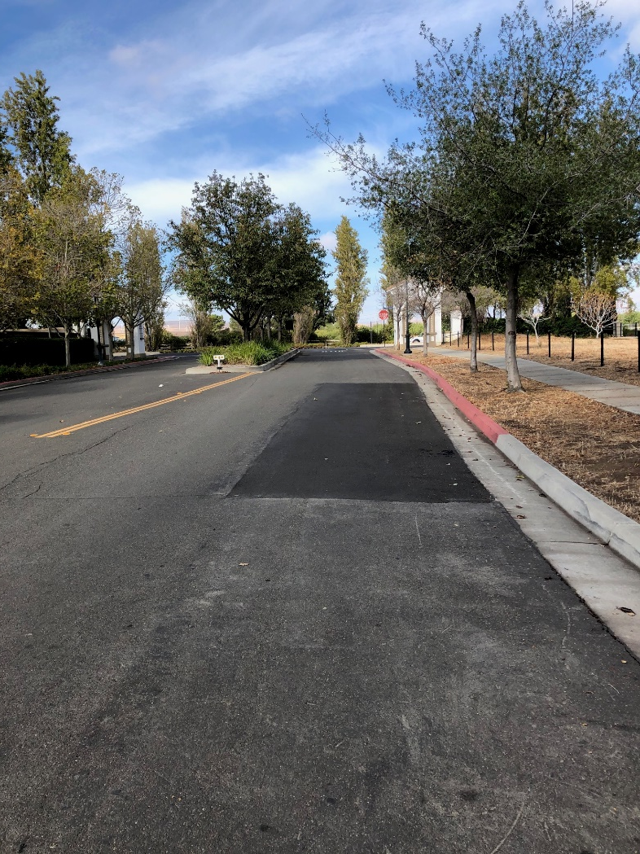
Questa Village and Arterials Repairs
Escuela Dr. Crack - Before
Escuela Dr. – After

Slide 14
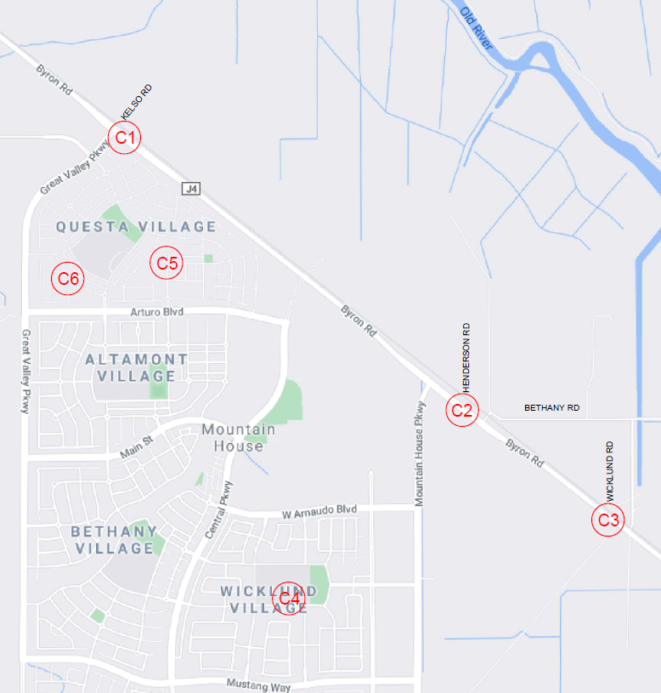
Railroad Crossing and Streets Signing and Striping
Project Locations (Railroad Crossings):
  (C1) Railroad Crossing At Kelso Rd.
  (C2) Railroad Crossing At Henderson Rd.
  (C3)Railroad Crossing At Wicklund Rd.
Project Locations (Streets):
  (C4) Heritage Drive (School Loop)-Traffic Calming
  (C5) Intersection Of
  Marquis Way At Aventino Ave. - Crosswalk
  (C6) Tramonto Dr Between
  Montobello St and Esplanade Dr. – Traffic Calming
Completion Date:
  Construction is complete 8/30/2033
Bid Amount:
  $79,000
Project Locations

Slide 15
Sign and Striping
Project Locations:
  Heritage Drive
  Tramonto.
Completion Date:
  August 30, 2022
Project Locations

Slide 16
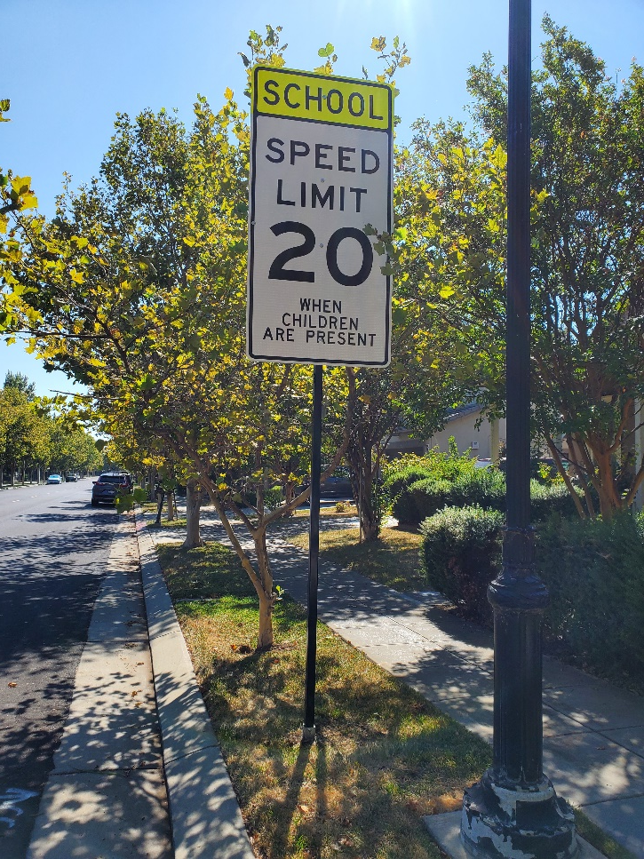
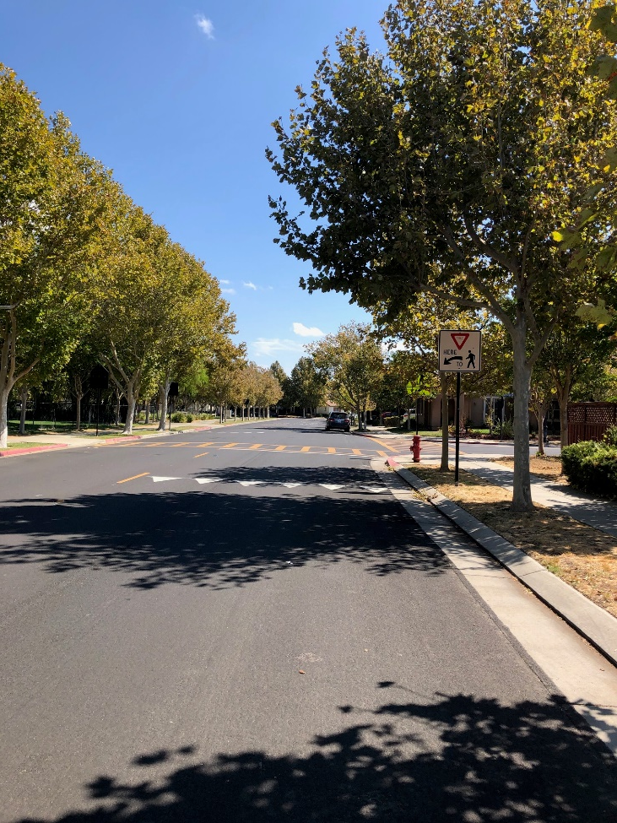
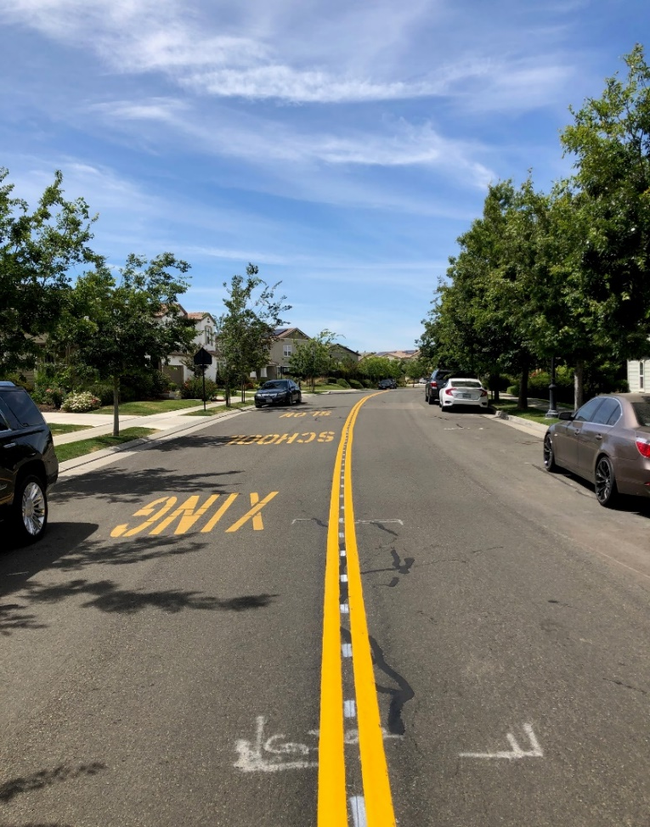
Updates to Signs and Striping
Wicklund Village – Heritage Drive
Wicklund Village – Heritage Drive
Questa Village – Tramonto Drive

Slide 17
Proposed Traffic Calming Projects
Project Locations:
  Central Parkway at
    Heritage Dr., and
    Legacy Dr.
  Proposed Upgrades:
  Add RRFB to the median.
  Add striped lane narrowing
  Add 25 mph when children are present sign
  Add yield triangles across each lane before crosswalk
  Enforcement

Slide 18
Proposed Traffic Calming Projects
Project Locations:
  Comunidad between Heritage and Recreo
  Proposed Upgrades:
  install the In-Street Pedestrian Crossing at the Verano Way crosswalk
  Add Centerline

Slide 19
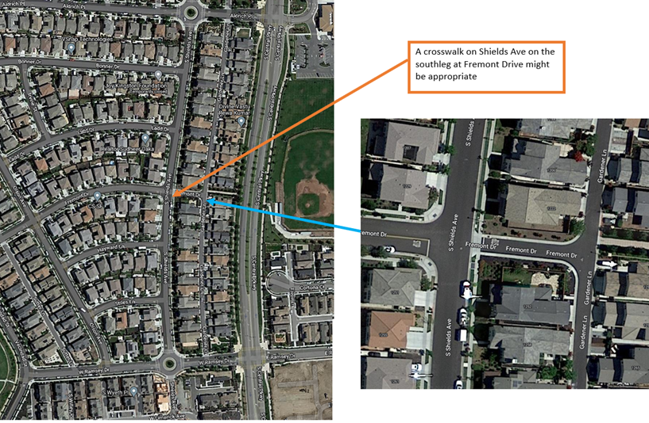
Proposed Traffic Calming Projects
Project Locations:
  Shields Ave. at Fremont Drive

Slide 20
Future CIP Projects
  1. Traffic Signal Synchronization
  2. Installing Fiber Optic Lines
  3. Byron Road and Wicklund Village Road Repair

Slide 21
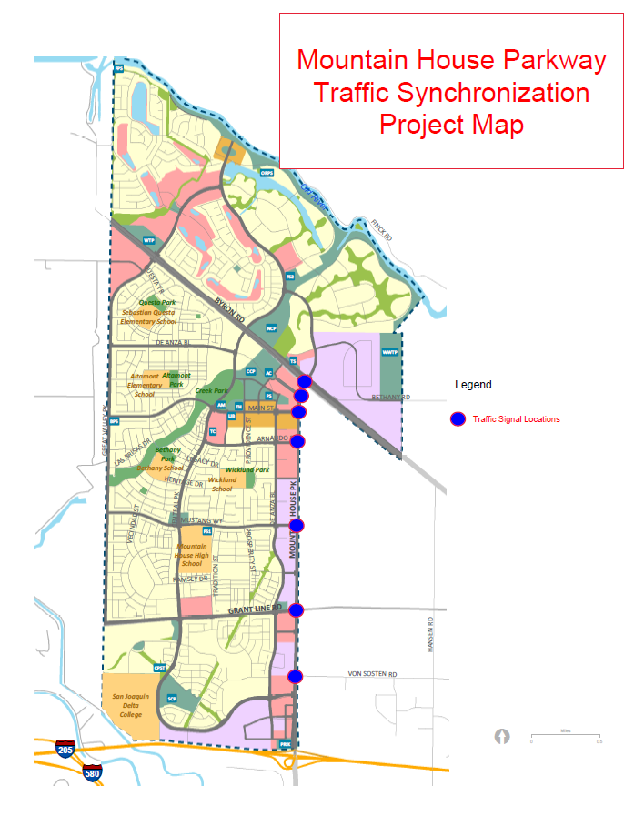
Traffic Signal Synchronization
Project Locations:
  Mountain House Pkwy from I-205 to Byron Rd.
Status:
  In Design Phase
Project Locations

Slide 22
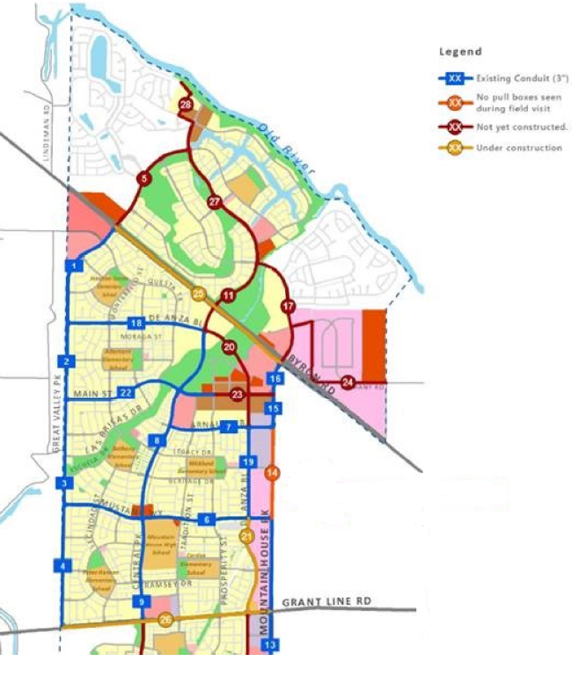
Installing Fiberoptic Lines
Project Locations:
  Mustang Way, from Mountain House Pkwy to Central Pkwy
  Central Pkwy, from Aldrich Pl. to Main St.
  Main St., from Central Pkwy to Town Hall
Completion Date:
  Pre-Design Phase
Project Locations

Slide 23
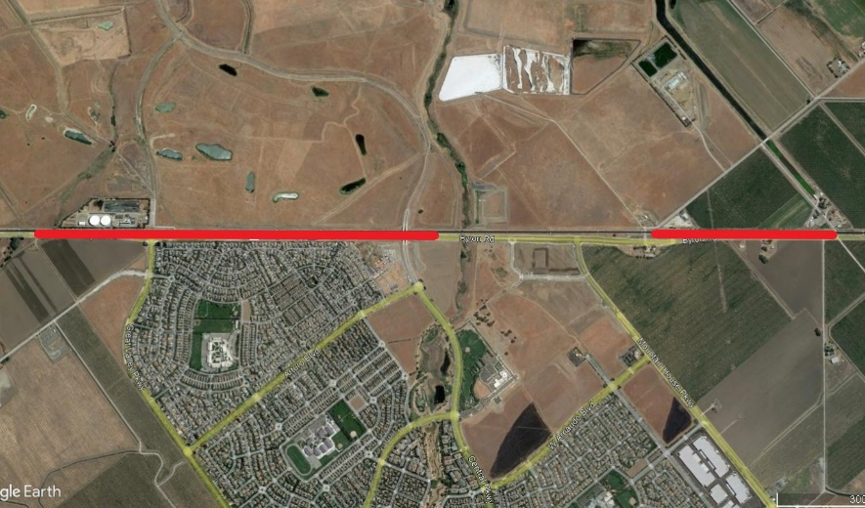
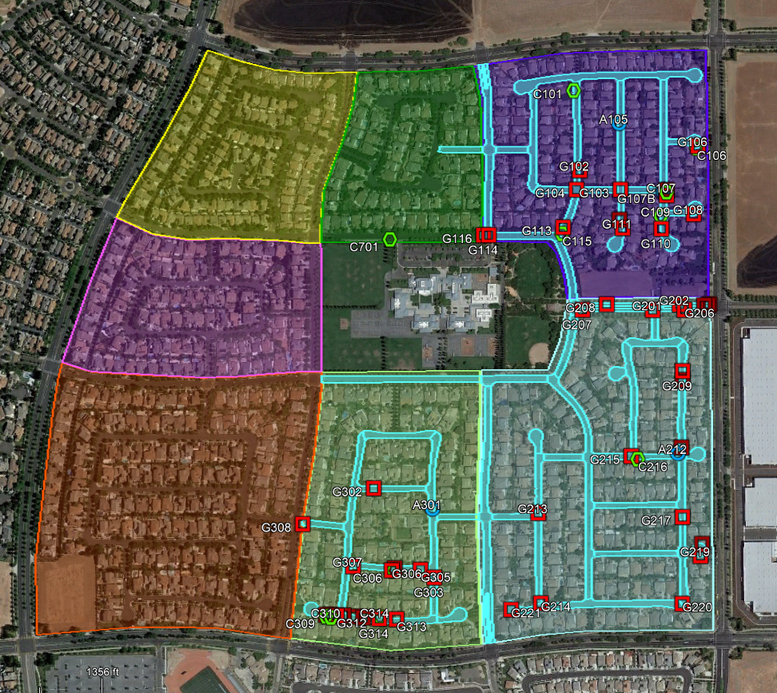
Byron Rd. & Wicklund Village Road Repairs
Project Locations:
  Asphalt Patching, Crack Seal, and/or Slurry Seal in Wicklund Village
  Asphalt Patching in Byron Road
  Byron Road is in line for full reconstruction by developers
Status:
  Under Review by Office Engineers prior to public bidding
Project Locations

Slide 24
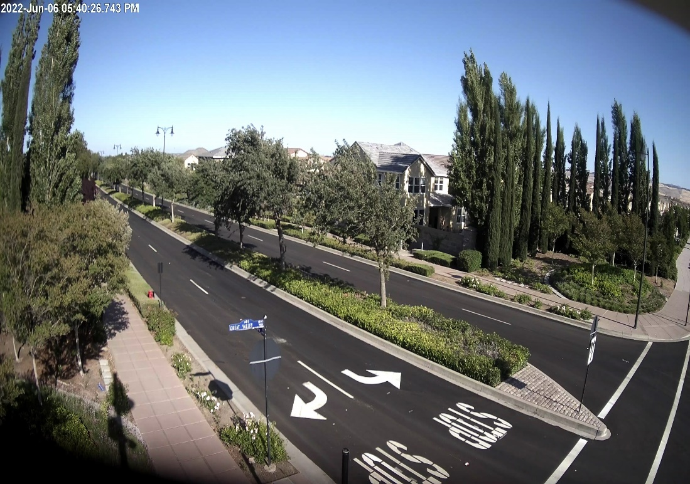
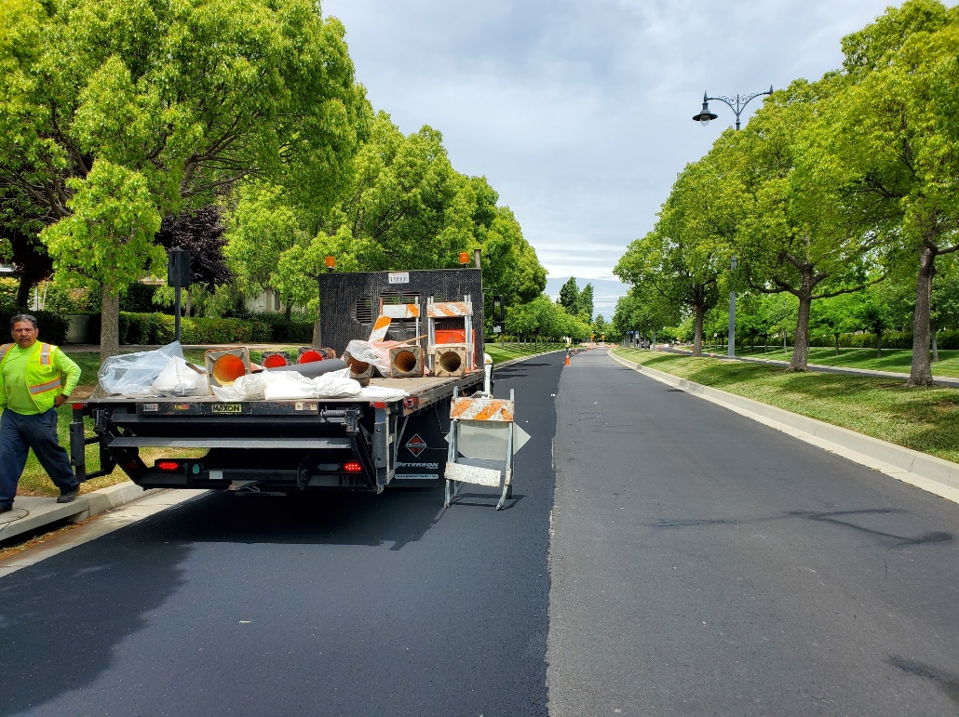
Questions?
Thank you!

Slide 25
Project Updates
Valley Link
Motorcycle Unit
CHP accident reports
Alameda County traffic circles on Grant Line Road

Slide 26
Questions?

