Slide 1
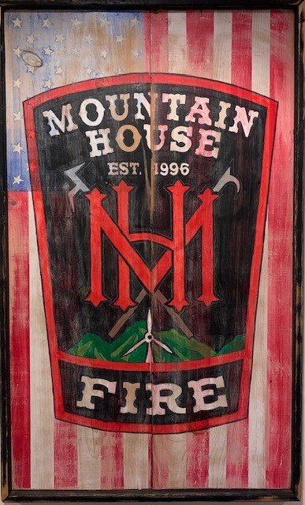
Mountain House Fire Department Community Meeting June 15, 2022

Slide 2
Mountain House Fire Department
Staffed with 5 full-time Firefighter
Staffing 1 Engine Company and 1 Truck Company
Providing both EMS/Fire Emergency Services
Total calls in 2021 EMS/Fire 780

Slide 3
Illegal Fireworks

Slide 4
San Joaquin County DA’s and Sheriff’s Department Task Force
Since June 1st SJ County Task Force has seized almost 3,000 lbs of illegal fireworks
Undercover task force members are arresting those selling and buying illegal fireworks, and the DA’s office is prosecuting all offenders
The Task Force will continue to work through July 4th.

Slide 5
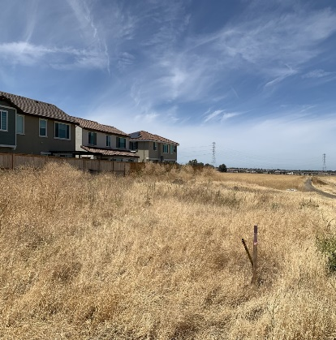
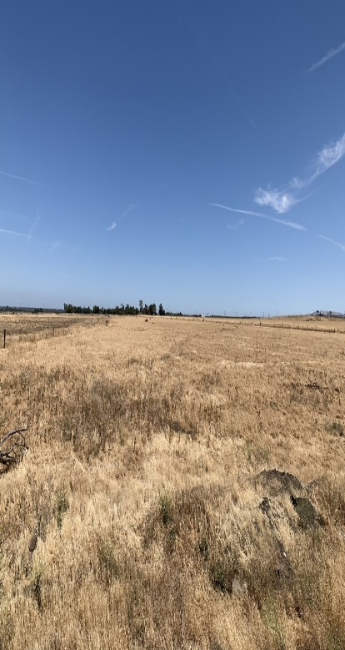
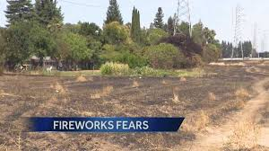
Firework Hazards in Mountain House
High winds 10-25 mph
Wind gusts up to 35-40 mph
Dry grassy areas
Large open areas
Dry vegetation close to and near houses
Fence lines close to dry grass and brush

Slide 6
Annual Damage Due to Fire Works in the US, 2021
Estimated Fires Annually: 19,500
Structure Fires: 1,900
Other Fires (grass, commercial, forest) 17,100
Vehicle Fires: 500

Slide 7
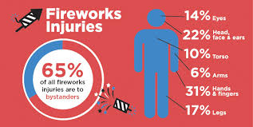
Injuries due to Fireworks in 2021
Fireworks were involved with an estimated 10,000 injuries treated in U.S. hospital emergency departments during 2021
The estimated rate of fireworks-related, emergency department-treated injuries in the United States is 3.1 per 100,000 individuals.

Slide 8
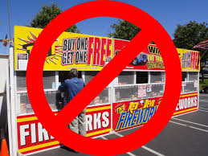
Safe and Sane Fireworks
Since Mountain House is in the unincorporated area of San Joaquin County, Safe and Sane fireworks are illegal.
If caught with any illegal or Safe and Sane fireworks within the community of Mountain House, you could be fined or sent to jail.

Slide 9
Illegal Firework Fines
Individuals could be fined up to $5,000-$50,000 if in possession of illegal fireworks
An individual could also be sent to one year in jail if in possession of illegal fireworks

Slide 10
Illegal Firework Notification
Mountain Hose Fire Department 209-407-2990
Rank Security 209-526-2025
San Joaquin Sheriff Dept/Non-Emergency 209-468-4400
San Joaquin Count Community -Development Fire Prevention Bureau 209-468-3380

