Slide 1



Mountain House Community Services District
Water and Sewer Rate Study Update
April 6, 2022
Presented by:
Steven Pinkerton – General Manager
Alice Bou – Consultant, NBS

Slide 2
Presentation Overview
  Recap of the Rate Studies
  Water Rates
  Sewer Rates
  Proposition 218

Slide 3
Recap of Studies – Financial Plan Assumptions
General Fund Subsidy:
  Repayment to the General Fund begins in FY 2027/28.
CIP Funding Levels:
  Assumes full funding of planned capital projects.
Reserve Fund Levels:
    O&M reserve fund = 45 days of O&M costs.
    Drought Contingency reserve = $2.5M.
    Capital reserve fund = 1.5% of net assets.

Slide 4
Recap of Studies – Changes in Cost-of-Service
Key Factors Affecting Water Customer Classes:
  Consumption for all customers increased by almost 87%.
  Number of single-family accounts increased by over 50%.
Sewer Customer Classes:
  Single-family average winter water use has decreased slightly and commercial decreased 50%.
  Single-family accounts have increased 35% and revenue requirements have increased about 90%.

Slide 5
Recap of Studies – Rate Design Assumptions
No Changes in Water or Sewer Rate Design
Current Rate Structures meet Industry Standards and Proposition 218 Requirements

Slide 6
WATER Rates

Slide 7
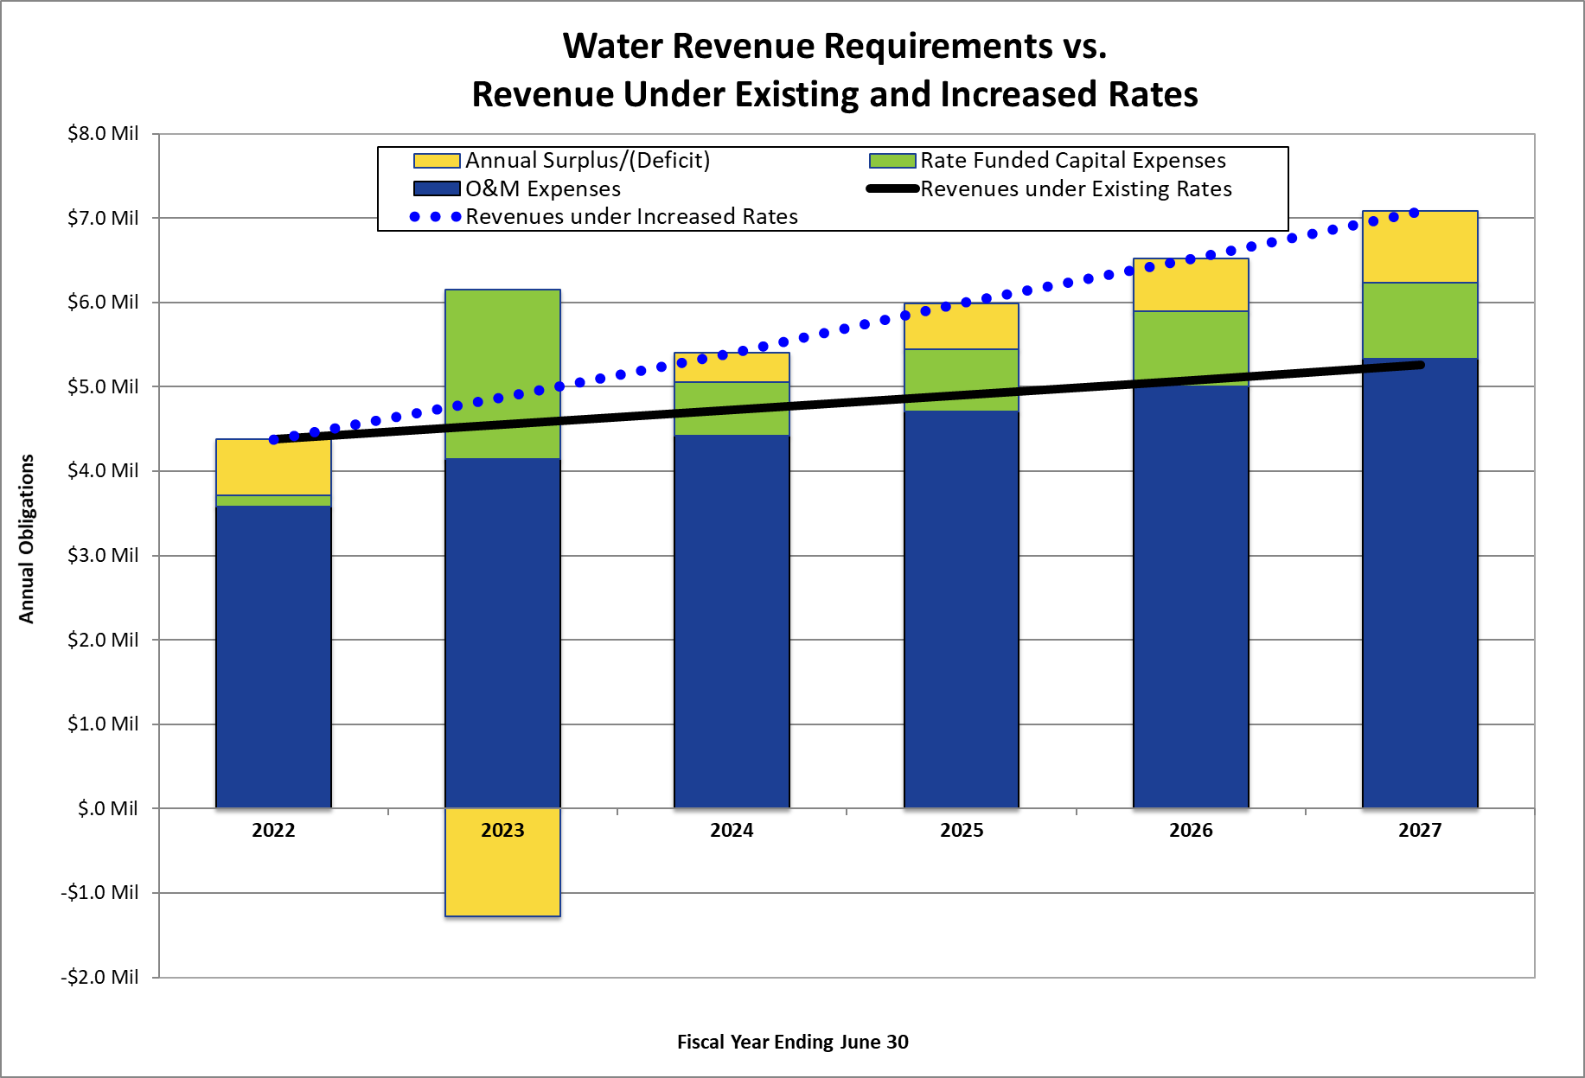
Water Financial Plan Summary

Slide 8
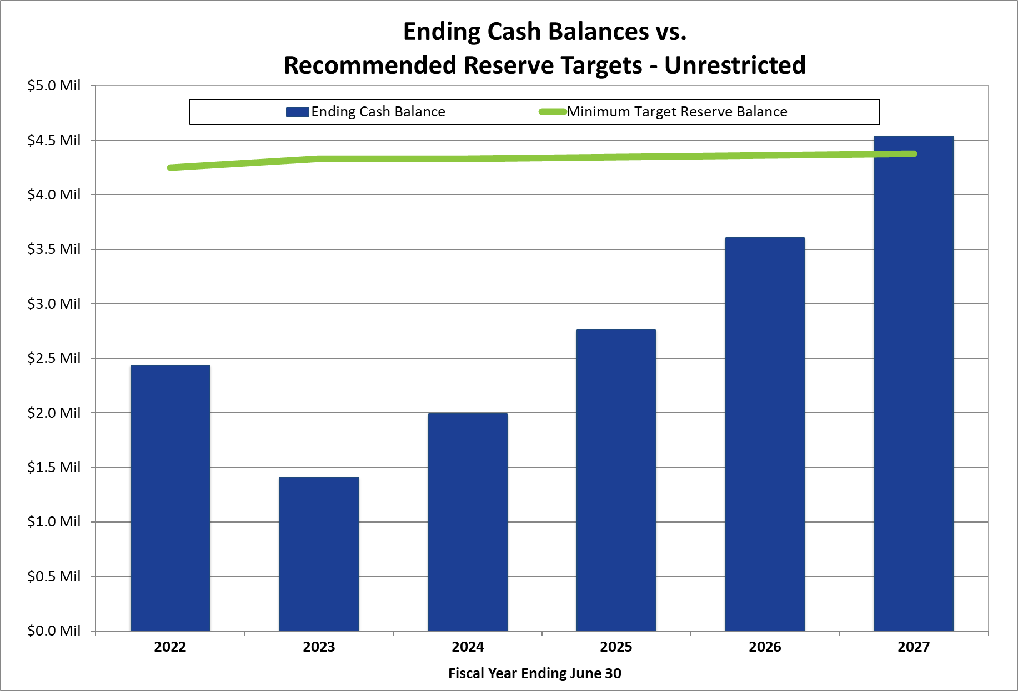
Water Reserve Fund Summary

Slide 9
Current vs. Proposed Rates

Slide 10
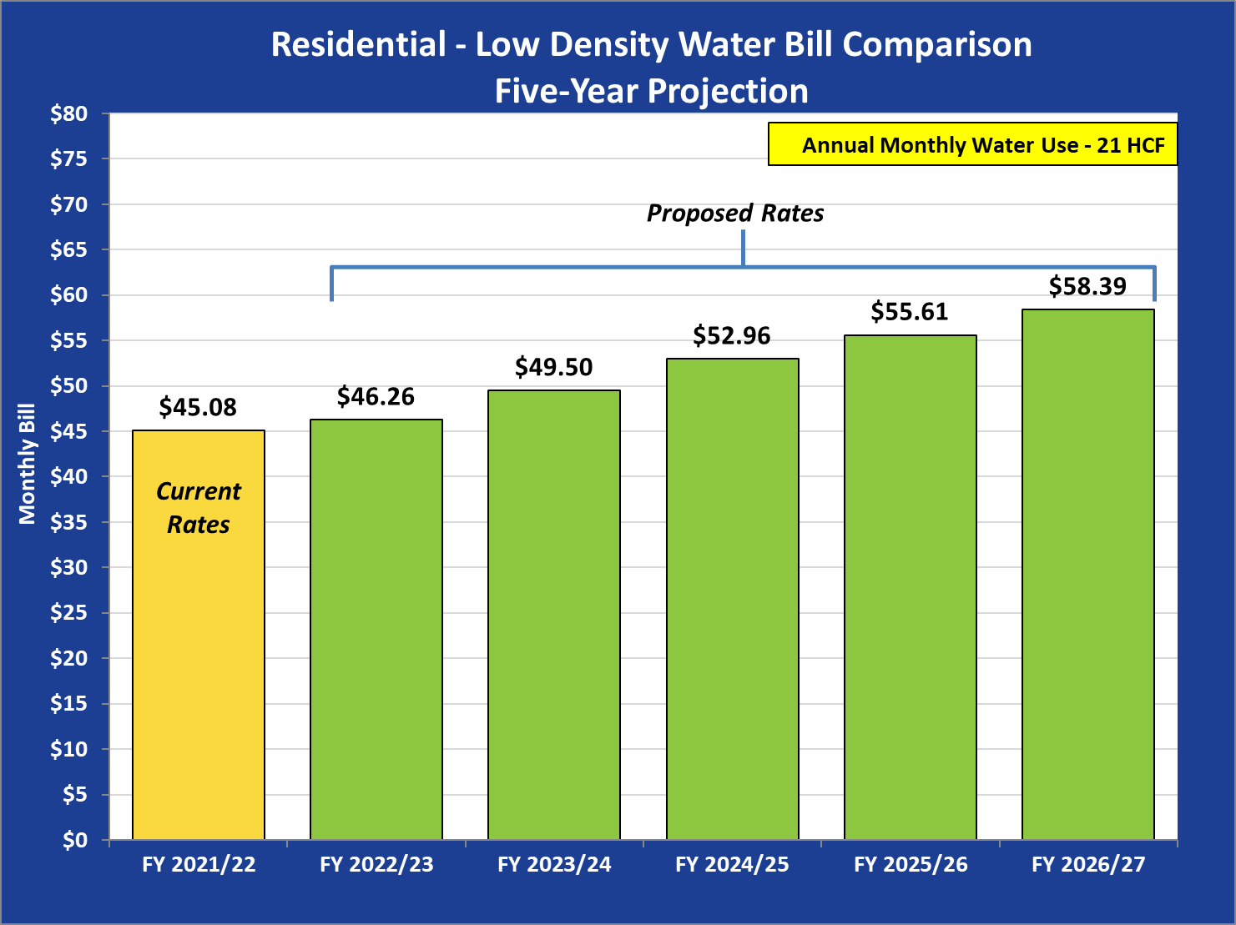
Impacts on Customer Water Bills

Slide 11
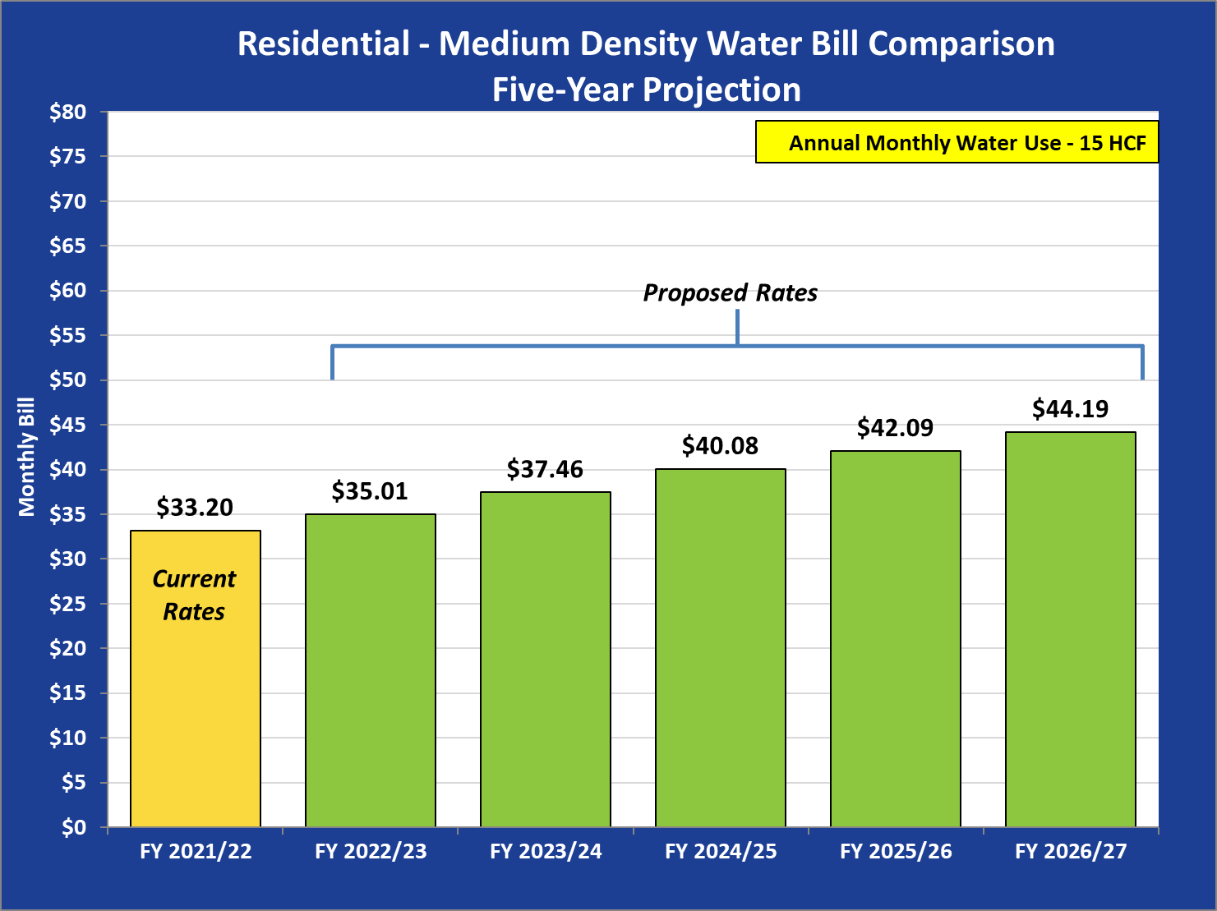
Impacts on Customer Water Bills

Slide 12
SEWER Rates

Slide 13
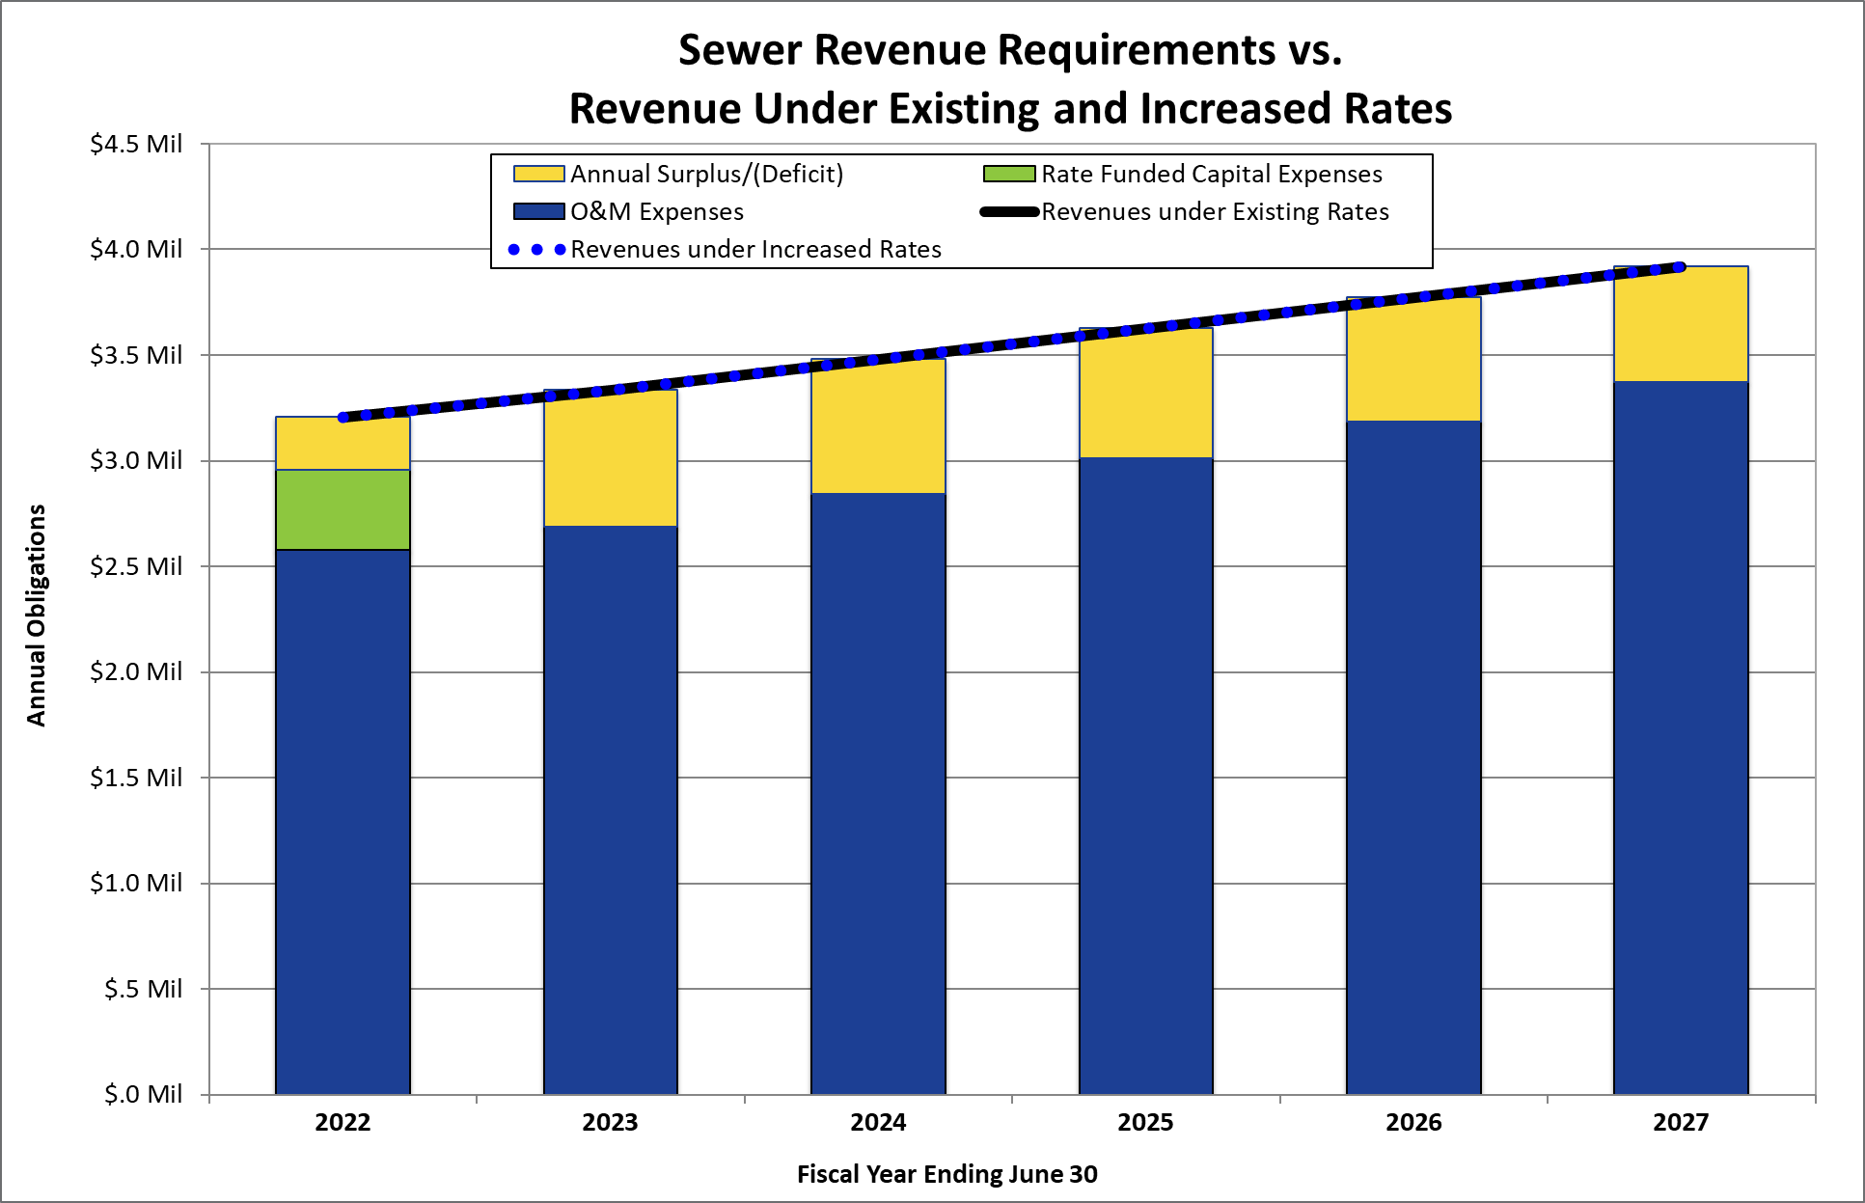
Sewer Financial Plan Summary

Slide 14
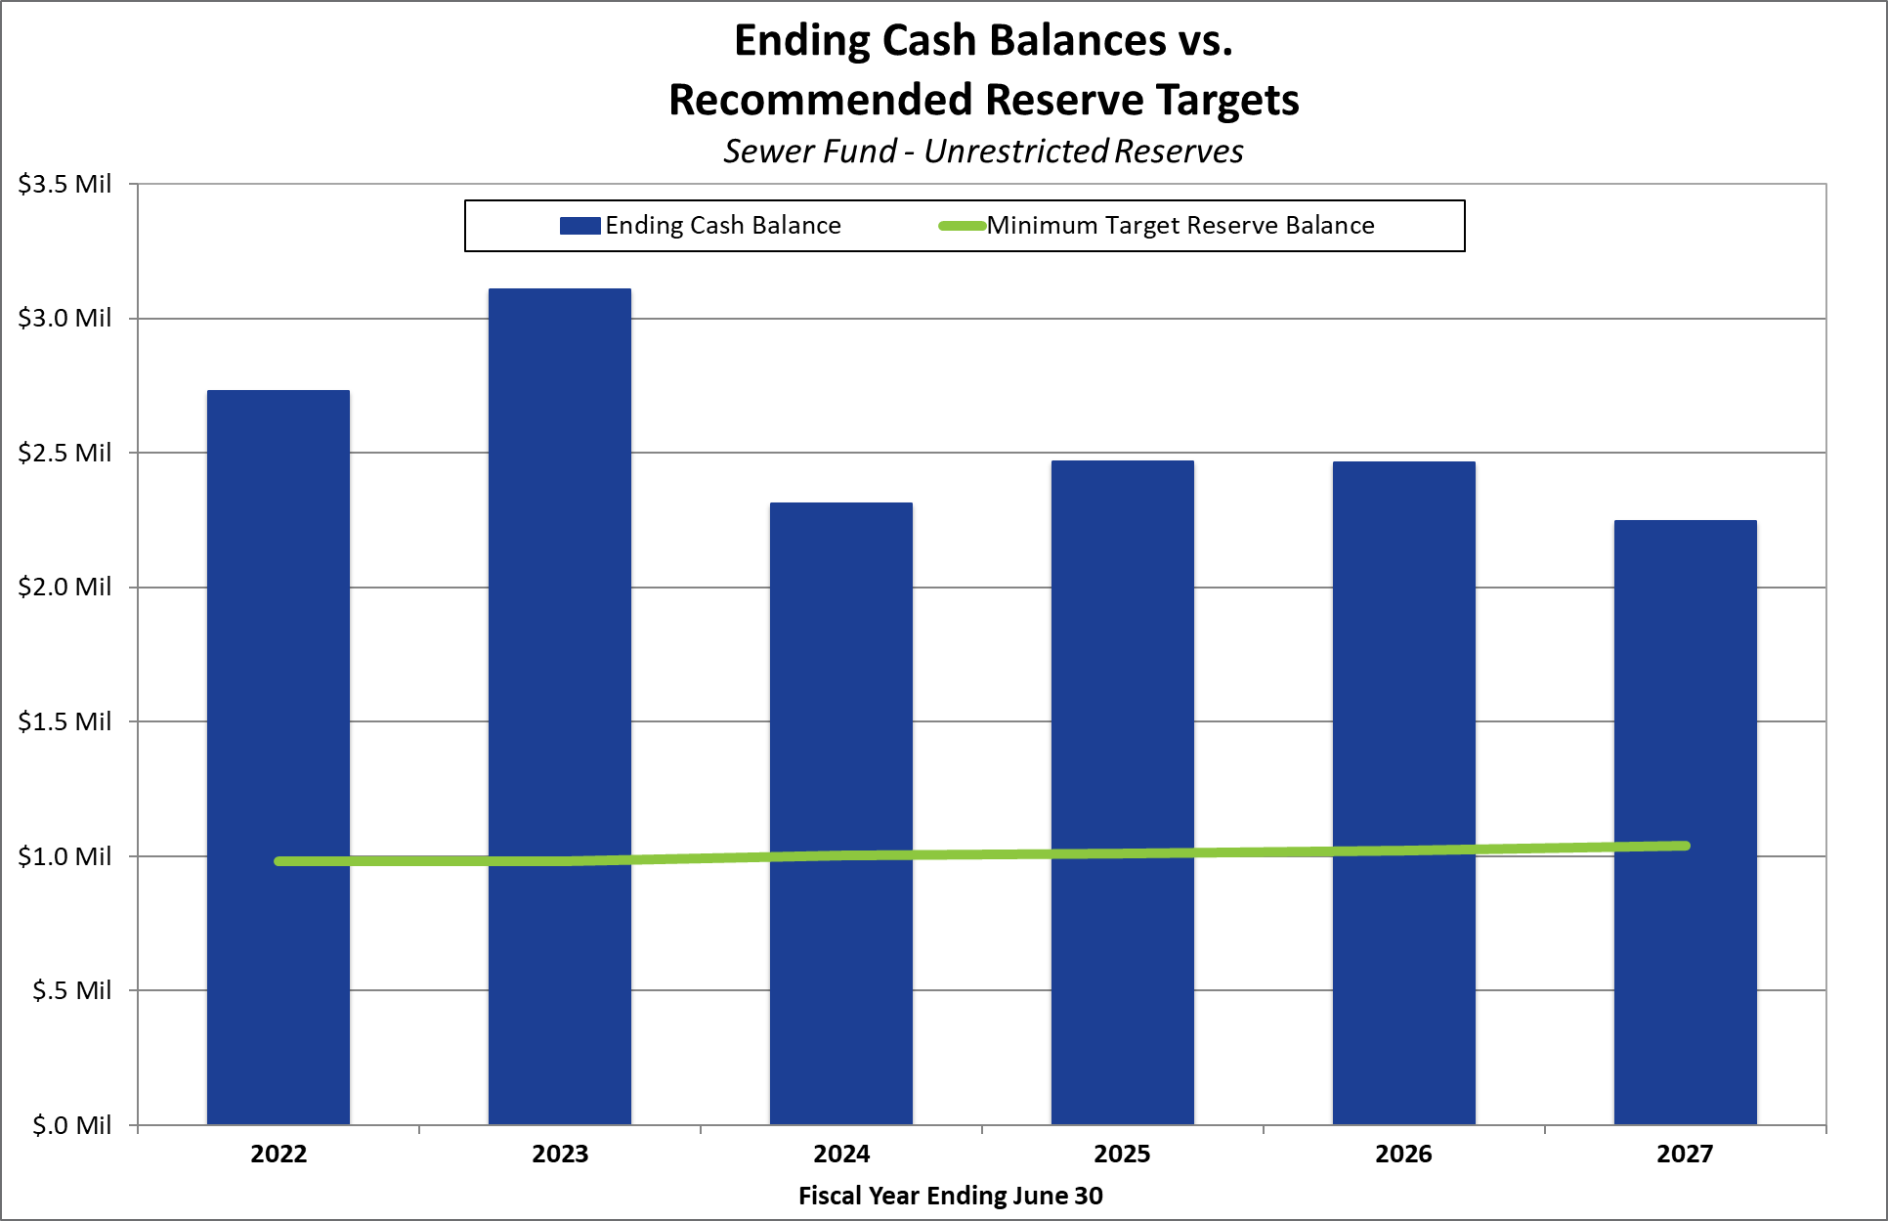
Sewer Reserve Fund Summary

Slide 15
Current vs. Proposed Rates

Slide 16
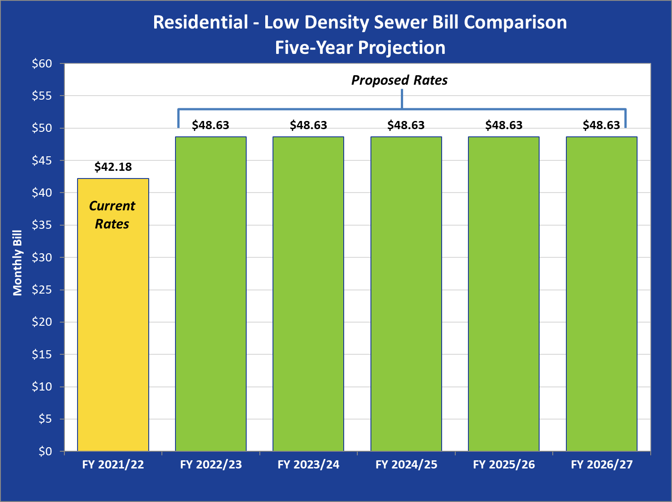
Impacts on Customer Sewer Bills

Slide 17
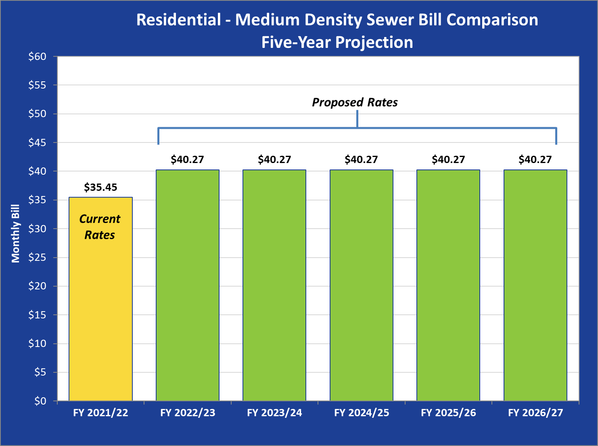
Impacts on Customer Sewer Bills

Slide 18
Combined utility bill comparisons

Slide 19
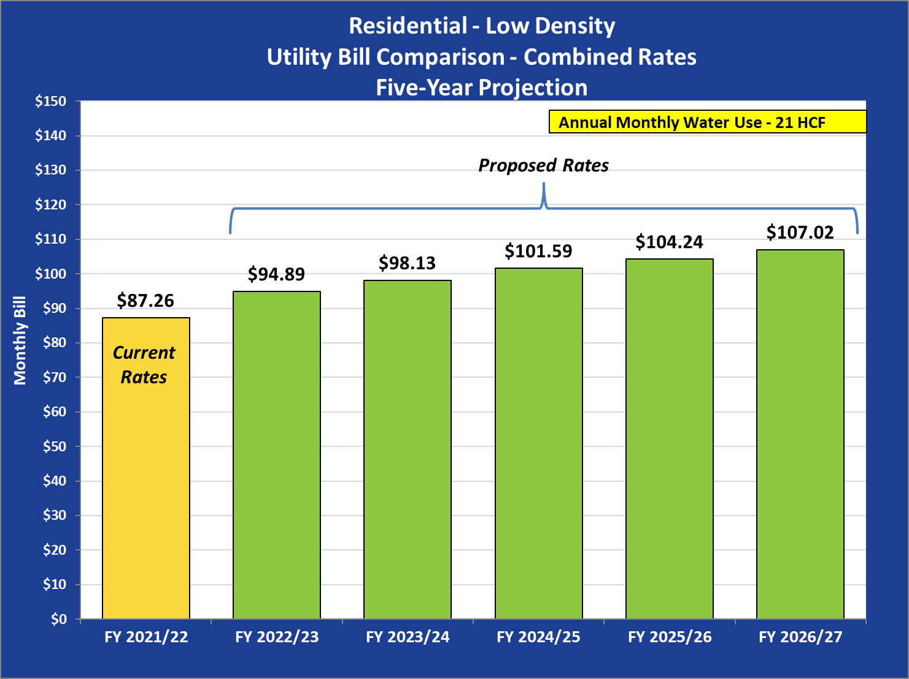
Bill Comparison – Combined Rates

Slide 20
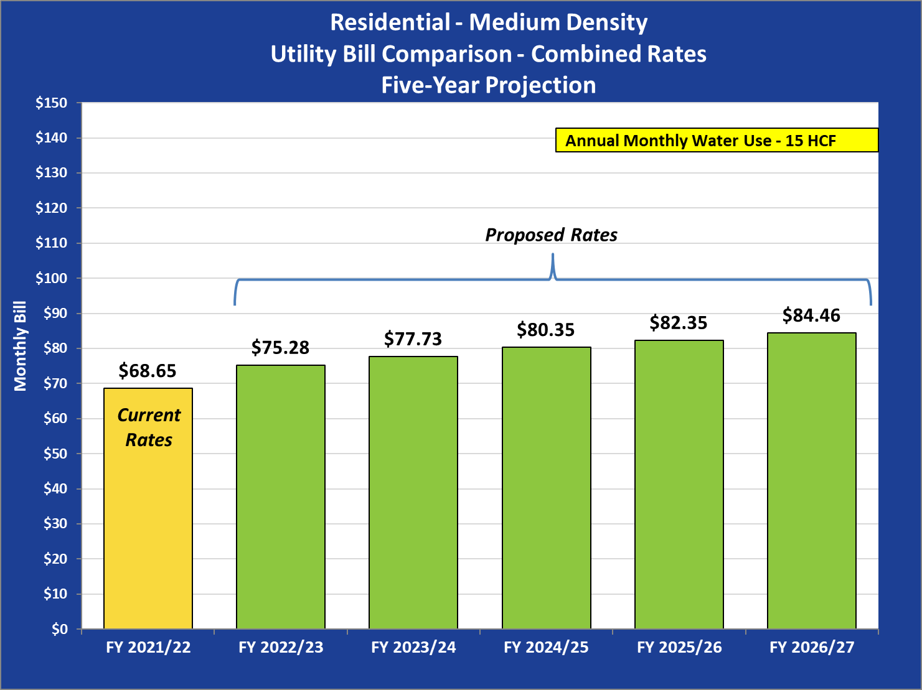
Bill Comparison – Combined Rates

Slide 21
PROPOSITION 218

Slide 22
  Overview of Proposition 218 Process
Procedural Requirements for the Prop. 218 Protest Ballot Procedure:
  Sent Notices of Public Hearing to all customers/property owners on March 23rd.
  Public Hearing will be held May 11th (45-days after mailing notices).
  If no majority protest (50% + 1), new rates can be adopted at the May 11th Public Hearing.

Slide 23

Questions and Answers
For further information, see:
https://www.mountainhousecsd.org/about-us/public-documents-and-forms/water-and-wastewater-rate-analysis

